Slide 1
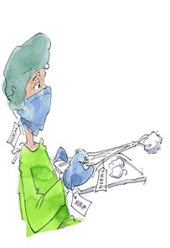
Ergonomics of medical devices
Module 7 – Learning ergonomics
© Michael Hüter

Slide 2
Content of the module at a glance
Important concepts
Medical devices used as work equipment
Statutory requirements for the ergonomics of medical devices
Usability engineering – user-centric development
Usability methods – testing ergonomics
Application example: usability test
Further literature
Notes:
Learning targets of this tuition module:
Students are able to explain the concepts of fitness for purpose, usability and functionality of medical devices
They are familiar with the statutory requirements for the ergonomic design of medical devices
They can name important standards governing the ergonomic design of medical devices
They are familiar with the impact of the ergonomic design of medical devices upon patient safety
They understand the importance of usability engineering for the development and design of medical devices and of the work systems in which these devices are used
They are able to state the suitability of different usability methods for evaluating the ergonomics of medical devices
They are able to design a usability test

Slide 3
1. Important concepts: medical devices
Medical devices:
→ Are products intended for medical purposes → Are developed for use on human beings
→ Generally have a physical effect upon a person (in contrast to medicines)
…Are generally used on the patient for:
Diagnosis
Therapy
Monitoring
Note: The legal definition of medical devices can be found in Section 3 of the German Medical Devices Act (MPG).
(With reference to Backhaus 2010)
Notes:
The concept of a medical device is defined in Section 3 of the German Medical Devices Act (MPG). The full text of the definition (unofficial translation) is:
Medical devices comprise any instrument, apparatus, appliance, software, materials or preparations of materials or other articles, used individually or in combination, including the software intended by the manufacturer specifically for use for diagnostic or therapeutic purposes and employed for proper functioning of the medical device, which by virtue of their function are intended by the manufacturer for use for human beings for the purpose of
diagnosis, prevention, monitoring, treatment or alleviation of disease
diagnosis, monitoring, treatment, alleviation or compensation of injuries or handicaps
investigation, replacement or modification of the anatomy or of a physiological process or
control of conception
and which do not achieve their principal intended action in or on the human body by pharmacological, immunological or metabolic means, but which might be assisted in their function by such means.
In-vitro diagnostic products (e.g. products in medical laboratories) are also deemed to be medical devices.
In simplified terms, it can be assumed that all products developed by a manufacturer for the purpose of therapy, diagnosis or monitoring on a human being are medical devices. A further particular feature of medical devices is that, in contrast for example to medicines, their action upon the patient is generally physical in nature.
Important: whether a product is a medical device in the sense of the MPG is decided by the manufacturer.

Slide 4
1. Ergonomics and fitness for purpose
Ergonomics: The science of the physical principles governing human or automated work (from ancient Greek ergon (work) and nomos (rule, law))
Fitness for purpose of a medical device: → Describes its suitability for the specified medical use.
The fitness for purpose is a function of the medical device's:
Functionality
Usability
Fitness for purpose
Usability
Functionality
(With reference to Backhaus 2010)
Notes:
Ergonomics is concerned with the adaptation of items or tasks to human abilities. Ergonomics also studies how human beings adapt to tasks and to the items in their environment. A more detailed explanation of the term "ergonomics" can be found in Tuition module 0, which provides a brief introduction to the subject.
Fitness for purpose describes the suitability of a product for the purpose intended by the manufacturer. It states how well the medical device satisfies its proper purpose, and is determined by objective and subjective properties.
The product can be designed to possess the objective properties and to exhibit them in its functionality. This represents the sum and quality of all technical functions provided by the medical device for the purpose of its use.
The subjective properties are termed the usability. Usability describes how well a user is able to make use of a product's functionality (i.e. how well or poorly a function of the product can be exploited by the user during its use).

Slide 5
1. Functionality and usability
High fitness for purpose of a medical device: the influencing factors of functionality and usability must be balanced.
Fitness for purpose
Functionality:
Sum and quality of all technical functions.
Usability: A measure of the:
easy
safe
satisfactory
use of a medical device in a specified system of application by a certain user.
High
Low
Low
Usability
Functionality
(With reference to Backhaus 2010)
Notes:
The functionality is what gives rise to the therapeutic benefit of a medical device, which must be demonstrated comprehensively by the manufacturer by means of a conformity assessment. The usability has a major influence upon the safety and reliability of use, and thereby upon patient safety. The greater the simplicity and ease with which a medical device can be used, the lower the risk of a use error occurring during its use.
This shows both influencing variables to be of major significance for the fitness for purpose of a medical device. They should therefore always be present in the most balanced measure possible. In other words, a medical device that is difficult to use is also lacking in its fitness for purpose.
The usability of a medical device can be understood as the simplicity and safety and the measure of user satisfaction experienced when a product is used.
The terms ergonomics, fitness for purpose and usability are used in certain standards, somewhat imprecisely, as synonyms. This is a consequence of an improvement in the usability always leading to an improvement in the fitness for purpose and thus always also to an improvement in the ergonomics. (The reverse is not necessarily the case.)

Slide 6
2. Medical devices used as work equipment
Particular aspect: Medical devices are work equipment with two human interfaces (interfaces to the patient and the user).
Functionality: Interaction between patient and medical device. This makes the treatment process possible or supports it.
Usability: Interaction between user and medical device. This makes use/application of the device possible.
Patient
Functionality
User
Medical device
(With reference to Backhaus 2010)
(With reference to Backhaus 2010)
Usability
Notes:
In contrast to other products, medical devices have certain particular features that can be presented in the patient-user-medical device system. Medical devices are seen always to have two interfaces to human beings: one interface between the user (e.g. doctor, nurse) and the medical device, and one between the patient and the medical device.
For the patient-medical device interface, the functionality is of particular importance, since it supports the treatment process or indeed makes it possible in the first instance.
For the user-medical device interface, the usability is of great importance, since it permits use of the functionality on the patient.

Slide 7
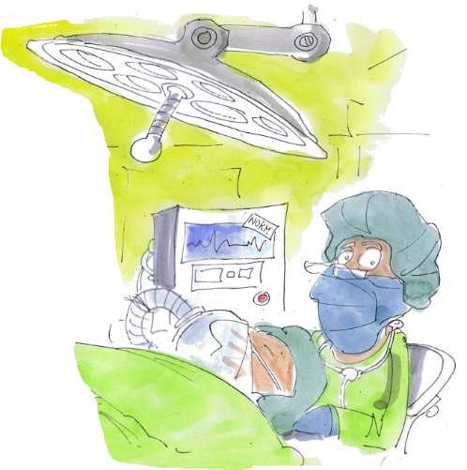
2. Medical devices used as work equipment
Particular aspects: Medical devices are frequently:
Used by different users (such as medical or care personnel, the patient him or herself, or relatives)
Used in different work systems (e.g. hospitals, nursing homes or doctor's surgeries)
Used in such a way that they act directly upon the patient's body → particular responsibility for the user
© Michael Hüter
Notes:
Medical devices are frequently used by a range of users differing in their experience (e.g. doctor, nurse, relatives, etc.).
One and the same medical device may also be used in different work systems (e.g. in emergency medicine, intensive care, home nursing, etc.).
These conditions influence the fitness for purpose of a medical device, since depending upon the user and work system, different requirements may be placed upon the medical device's functionality and/or usability.
The fitness for purpose is not therefore a property inherent to the product itself, but is dependent upon the medical device, the user, the task (treatment process) and the context of use (work system).
Further particular properties of medical devices are:
Medical devices may require reprocessing following use.
Medical devices are frequently transported together with the patient (e.g. during patient transfer).
Medical devices are frequently adapted to a patient (e.g. wheelchairs, patient lifts, etc.).
Users have not generally received technical training (in some cases, only brief instruction in use of the device).
Frequently, several different medical devices are combined flexibly to form a work system (e.g. intensive care station).
Medical devices produced by different manufacturers and used for the same purpose (e.g. infusion pumps) frequently differ in their operating concepts.
Misuse or functional failure may be harmful to the health of the patient or the user.
Developers are frequently unaware of the precise conditions under which a medical device is used.

Slide 8
2. Medical devices used as work equipment
Practical exercise:
Determine the requirements for ergonomic design of a non-invasive blood-pressure meter for use in the following areas of application:
Group 1: hospital
Group 2: ambulance service
Group 3: home nursing service
Time allotted for the exercise: 20 minutes
Followed by: presentation of the results to the whole class
(With reference to Backhaus 2010)
Notes:
Exercise illustrating the dependency of ergonomics upon the system
To illustrate the dependency of ergonomics upon the system, the students can divide up into groups and develop, in an exercise, the requirements for the ergonomic design of a typical medical device (such as a blood pressure meter) for the following work systems:
Hospital
Ambulance service
Home nursing service
The time allotted for the exercise is approximately 20 minutes. The results from the individual groups are then presented to the whole class and the common features of and differences between the ergonomic requirements of the individual work systems discussed by the students.
The requirements can be presented on the board, on a flip chart or with the aid of presentation cards.
The lecturer moderates presentation of the results.
The exercise illustrates how ergonomics depends not only upon the medical device, but also upon the user, the task, and the context of use.
It is not important in this context precisely which detailed requirements are identified by the students, but that the requirements are seen to differ between the individual work systems. Whilst explaining the exercise, the lecturer can guide it by drawing attention to certain characteristics typical of the work systems to be examined. Examples include:
Hospital: Typical users are doctors or nursing staff. The medical device is used on different patients. The environment of use in the hospital is generally well lit, clean, neat and tidy. The product is subject to a metrological inspection every two years by the medical technology department.
Ambulance service: Typical users are ambulance crews. The medical device is assigned to a vehicle (ambulance). The environment of use may be loud, dark, and very dirty (for example during an emergency callout). Acoustic and visual perception is severely impaired during use in the moving ambulance owing to the engine and road noise, and vibration. The device may come into contact with the patient's body fluids. The medical device is checked daily (visual and function inspection) at handover of the vehicle.
Home nursing service: Typical users are relatives and care personnel, and also the patients themselves. The environment of use is the patient's home environment. This may be chaotic, untidy and poorly lit. The patient's vision or that of their relative may be impaired by old-age long-sightedness and/or the onset of cataracts. Their hearing ability may be impaired as a result of old age. The medical device is supplied to the patient by a medical store on behalf of the patient's health insurer. Since it may not be clear as a result who is responsible for the medical device, the inspections that are a legal requirement – a metrological inspection every two years – are often not performed.

Slide 9

3. Statutory requirements for ergonomics
European and German legislation
German Medical Devices Act (MPG): Requires observance of the "essential requirements" for medical devices stated in the 93/42/EEC Medical Devices Directive.
A product's satisfaction of these requirements must be demonstrated by the manufacturer through the conformity assessment of the product.
New since April 2017: 2017/745/EU Medical Devices Regulation; in contrast to directives, which apply only after they have been transposed into national law, EU Regulations apply directly.
Notes:
The requirementes to be satisfied by medical devices under the German Medical Devices Act include "essential requirements". Satisfaction of these requirements must be demonstrated by the manufacturer by means of a conformity assessment procedure. The "essential requirements" are stated in European Directive 93/42/EEC, governing medical devices. With regard to ergonomics, these requirements include a reduction in use errors and risks of injury, and the design of displays and control elements in accordance with ergonomic principles.
Regulation (EU) 2017/745 of the European Parliament and of the Council on medical devices has been in force since 5 April 2017. This regulation repeals (among other legislation) EU Directive 93/42 EEC. The existing Directives 90/385/EEC on active implantable medical devices, 93/42/EEC on medical devices and 98/79/EC on in vitro diagnostic medical devices are repealed and replaced by the new Regulation on medical devices and Regulation (EU) 2017/746 on in vitro diagnostic devices. The consequences for the user are that, whereas in the past, the decisive legislation was the national legislation with which these directives were transposed (in Germany, the Medical Devices Act – MPG – and the regulations pursuant to it), the EU Regulations themselves will apply directly in the future. The Member States will be able to apply additional regulations of their own only within the scope allowed by the EU Regulations.

Slide 10
3. Statutory requirements for ergonomics
Directive 93/42/EEC | Regulation 2017/745/EU
Ergonomic features must reduce risks presented by use errors | Reduction in the risks caused by use errors owing to ergonomic features of the device and the environment (emphasis on patient safety)
Exclusion of risks of injury related to ergonomic features | Exclusion of risks of injury related to ergonomic features
Scales of measurement and facilities for operation and display satisfy ergonomic principles | Scales of measurement and facilities for operation and display satisfy ergonomic principles
Notes:
Application of the EU Regulation becomes binding three years after its entry into force in 2017. Certificates issued up to that point in time, i.e. mid-2020, are to remain valid for medical devices for a maximum of a further five years. The legal requirements for ergonomics have not fundamentally changed.
With regard to ergonomics, this includes requirements for reduction in use errors and risks of injury, and the design of displays and control elements in accordance with ergonomic principles. The formulation in Regulation (EU) 2017/745 places the emphasis upon patient safety, however. Text of the Regulation:
Directive (EEC) 93/42 (Annex I) requires, with regard to ergonomics:
"…reducing, as far as possible, risks posed by use error due to the ergonomic features of the device…" (Paragraph 1)
"…Devices must be designed ... in such a way as to remove ... the risk of injury, in connection with their ... ergonomic features" (Paragraph 9.2)
" The measurement, monitoring and display scale must be designed in line with ergonomic principles." (Paragraph 10.2)
Regulation (EU) 2017/745 sets out similar requirements:
"The manufacturer shall ... reduce as far as possible the risks related to the ergonomic features of the device and the environment in which the device is intended to be used." (Annex I Chapter I Section 5) → The focus lies here upon patient safety, i.e. the ergonomic design is explicitly constrained in the patient's interests and possibly to the detriment of the user
"Devices shall be designed ... in such a way as to remove ... the risk of injury, in connection with ... ergonomic features" (Annex I Chapter II Paragraph 14)
"Any measurement, monitoring or display scale shall be designed and manufactured in line with ergonomic principles." (Annex I Chapter II Section 14)

Slide 11

3. Statutory requirements for ergonomics
Harmonized standards permit
→ Demonstration of observance of the "essential requirements" of the 93/42/EEC Directive
Searches for standards (in the area of ergonomics): → free ErgoNoRA search tool
Harmonized standards require a development process oriented towards the fitness for purpose:
EN 62366 Medical devices – Application of usability engineering to medical devices
EN 60601-1-6 Medical electrical equipment – General requirements for basic safety and essential performance – Usability
Searching for standards
Notes:
Requirements for the ergonomics of medical devices can be found for example in EN ISO 14971 (risk management), EN 62304 (medical device software) and ISO 13485 (quality management systems).
KAN's ErgoNoRA online search tool is available at: https://nora.kan-praxis.de/ergonora
The EN 62366 and EN 60601-1-6 standards require the integration of ergonomic requirements and findings into the process of development of medical devices.
From the outset of product development, the manufacturer should define who is to use the medical device, for what purpose, how, under what ambient conditions and on whom. Based upon these application scenarios, ergonomic requirements are formulated and set out for example in the functional specification.
In the course of the development process oriented towards the fitness for purpose, the requirements are reviewed iteratively in order for possible deficits in operation to be identified and to be eliminated by improved design solutions.
The entire process is to be documented by the manufacturer in an ergonomics file. This file constitutes part of the conformity assessment, which is a statutory requirement.

Slide 12
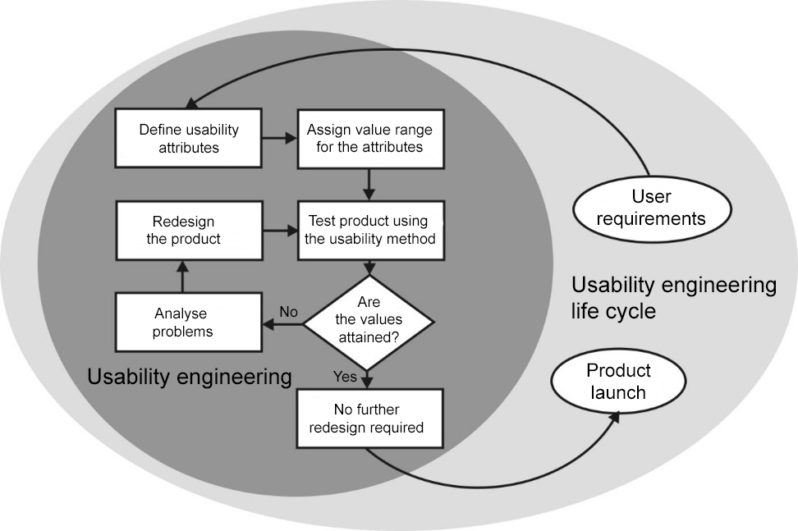
4. Usability engineering
Development process oriented towards fitness for purpose
Use of usability methods to review product designs
(Backhaus 2010)
Notes:
The slide shows the development process oriented towards the fitness for purpose in the form of a usability engineering life cycle.
The systematic and iterative checks enable usability problems to be detected at an early stage and the medical device to be improved by modified design, i.e. redesign. The improvement must also be confirmed by rechecking. The procedure must be repeated until the medical device satisfies the specified usability targets.
The usability engineering process must be performed for all phases of product development. A range of usability methods are available for the checks (testing).

Slide 13
4. Usability engineering
Usability features and value ranges
Usability features
Time allotted
Required use steps
Use errors
Level of target attainment
User acceptance
User satisfaction
Etc.
Value ranges
Nominal scale (e.g. A, B, C)
Ordinal scale (e.g. good, average, poor)
Interval or ratio scale (e.g. date, 1-20 minutes)
Important: The steps in the range must be described as clearly as possible
(Backhaus 2010)
Notes:
In order for a medical device's usability to be evaluated, suitable features must be identified that enable potential ergonomic deficits in design to be detected. Features indicative of poor ergonomic design may include:
Excessively long operating or processing times
High frequency of operator error
Excessive number of steps for execution of a function
Inhibition (the user is unable to use the medical device, i.e. to perform a certain action required for its use)
Dissatisfaction with the medical device
General rejection of the medical device
Before a study is conducted, it is important for a value range to be defined for the desired satisfaction of the targets for the above features, in order to enable weaknesses in the ergonomic design of the medical device to be identified.

Slide 14
5. Usability methods
User tests: User-based methods
→ Usability tests are highly suitable as soon as function prototypes of a product are available
Procedure: Observation of the users during the performance of allotted tasks (directly or indirectly, i.e. by video recording or one-way mirror)
Benefit | Drawback
Good procedure, largely realistic depending upon the simulation overhead. Behaviour of infrequent events (incidents) can be evaluated by simulation | Resource-intensive performance and evaluation
Notes:
User tests are particularly suited to later phases in development at which function prototypes or software simulations are already available that permit interaction with the medical device.
User-based and expert-based methods exist. In the user-based methods, the user is observed during the performance of predefined tasks. Observation is either direct or indirect, i.e. by video recording or one-way mirror.

Slide 15
5. Usability methods
User-based methods: think-aloud technique
Procedure: As in the preceding user test; in addition, the users are requested to "think aloud", i.e. to describe their thoughts during use of the medical device
Benefit | Drawback
Facilitates the detection of strategies and procedures during use of the device. Facilitates the interpretation of usage situations that are particularly problematic (e.g. on monitors) | "Thinking aloud" leads to greater self-reflection on the part of the test subjects, thereby influencing how they proceed during use of the device
Notes:
This think-aloud technique is particularly suitable for testing graphical user interfaces and user software.

Slide 16
5. Usability methods
User-based methods: Consultation of users
Procedure: Individual or group interviews → Record the users' experience during use of the device → Selective questions concerning "critical" usage situations (critical incident technique, CIT)
Benefit | Drawback
Highly standardizable, easy to conduct; records user acceptance and user satisfaction; suitable for performance following usability tests | Evaluation resource-intensive where questions are open (no choice of answers provided); low flexibility where questions are closed (selection from a choice of answers)
Notes:
User questionnaires are used for example to record typical user requirements in the early stages of product development. They can however also be used to measure user satisfaction and acceptance. They are therefore suitable for use in all product development phases, and should for example also be used as a supplement to user tests.
Individual interviews or group interviews in focus groups record users' experience during use of the products. Questions can be asked selectively concerning "critical" usage situations. These are recalled particularly strongly by users→ the critical incident technique. They are well suited to use following usability tests.

Slide 17
5. Usability methods
User-based methods: Consultation of users
Example of a standardized user questionnaire (in german) employing the system usability scale (SUS): agreement is determined in the form of a percentage based upon specified items.
(Backhaus 2010)
Notes:
The SUS measures the acceptance of a medical device in the form of a percentage. It is very well suited for example to systematic evaluation for the trialling of devices. The SUS value obtained as a result, which represents the percentage of acceptance, enables different medical devices to be compared with each other, for example when a device is being selected from a number of products.
Since the usability of a medical device is always dependent upon the user, the task and the application context, dedicated SUS questionnaires should always be conducted, rather than the results of other studies being used.
Ideally, SUS questionnaires should be extended with open questions. For example: "What did you particularly like about the use of the medical device?". This yields a more detailed impression of the medical device's strengths and weaknesses.

Slide 18
5. Usability methods
Expert-based methods: Cognitive walkthrough
Procedure: Experts in the application and/or ergonomics (ideally in both) iterate in their minds through a usage procedure/application of a device for a usage scenario, and thereby intuit possible difficulties in usage.
Benefit | Drawback
The method rapidly reveals a large number of possible usage deficits. The procedure enables developers to review the impact of a (modified) user interface very easily, for example. | The procedure primarily reveals simple deficits in usage.
Notes:
Expert-based methods are particularly suitable for use in early phases of a product development when a prototype of the medical device does not yet exist. These methods often yield a large number of usability deficits, which are however often simple deficits in use.
In the "cognitive walkthrough", it is constructive for the tester to place him or herself in the role of a potential user and to run through use of the product in his or her mind. Fictional "characters" are often used for this purpose who are intended to be typical representatives of a user demographic. For example, a typical user in the sphere of home nursing, "Helmut", cares for his wife at home, is 86 years of age, wears spectacles, has diabetes, and has little interest in technology. Helmut has something of a fear of medical devices.
The procedure can be performed simultaneously by several assessors in a group session, or by one or more experts independently. Frequently, several passes are performed for different usage scenarios (e.g. variation of the user, the task or the work context , etc.).

Slide 19
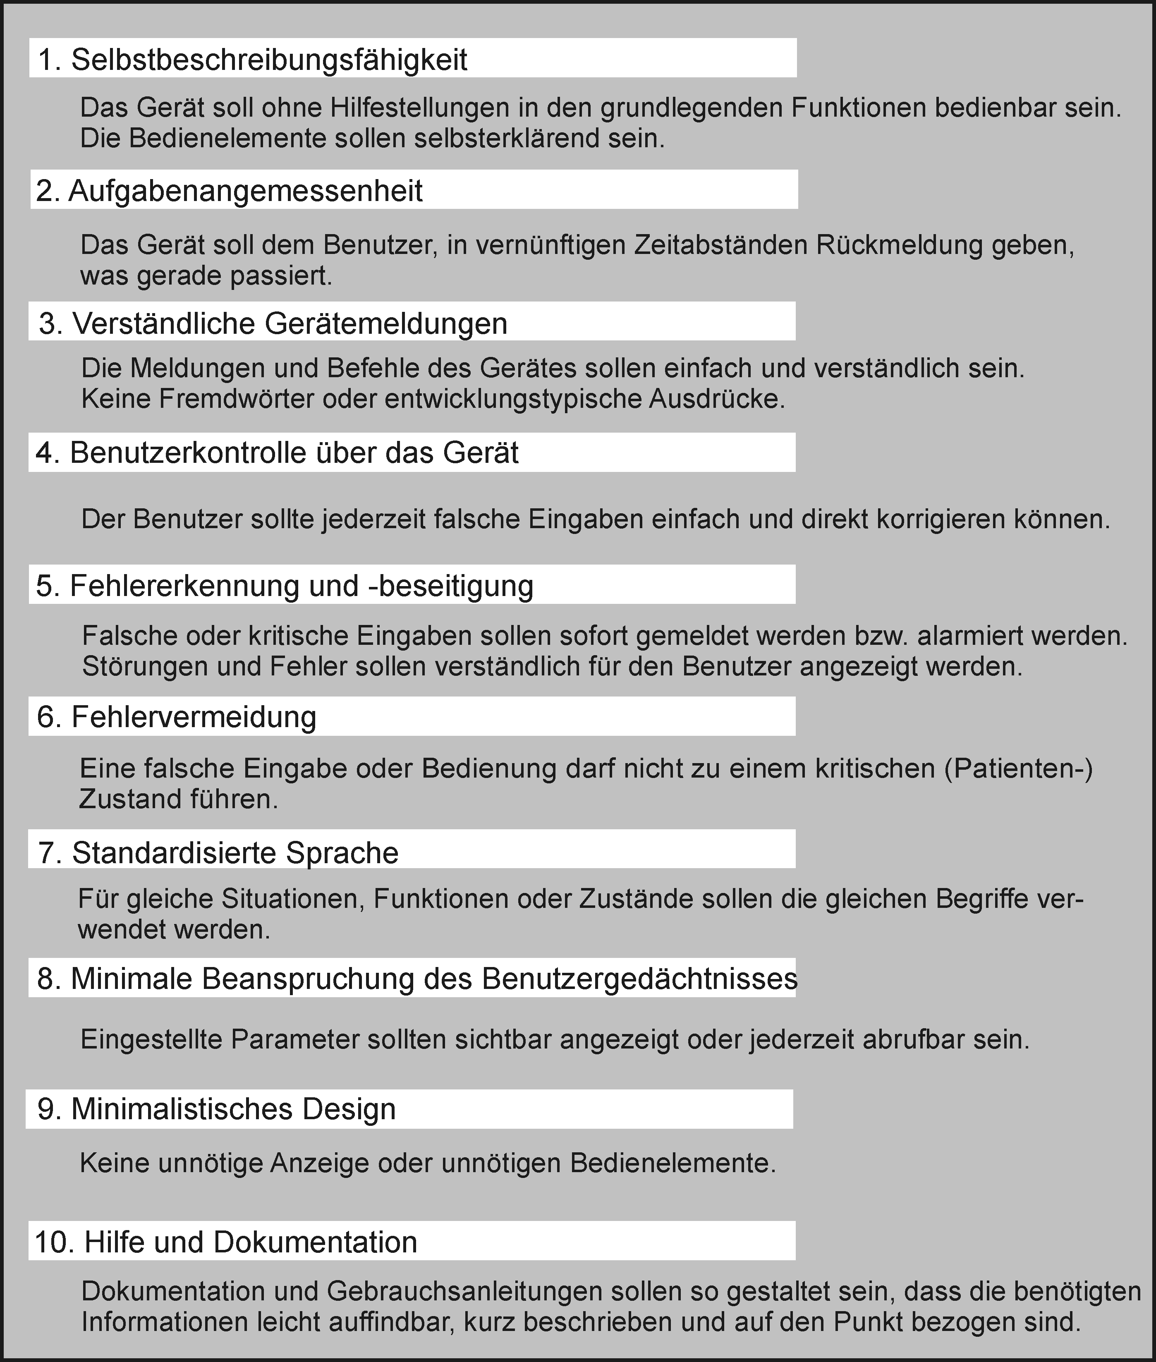
5. Usability methods
Expert-based methods: Heuristic evaluation
Procedure: Experts evaluate the usability of a product with reference to specified rules (heuristics).
Benefit
Rapid and simple procedure that can be employed without difficulty.
Drawback
Tends to reveal simple deficits in usage.
(Backhaus 2010)
Notes:
Heuristics can be used particularly effectively to test graphical user interfaces and their control by means of menus. Evaluation can be performed by individuals or in a group; one or more experts may assess the usability. A range of heuristics can be used for the procedure. Like the cognitive walkthrough, the heuristic evaluation tends to reveal simple deficits in usage.

Slide 20
6. Application example of a usability test
Evaluation of an infusion pump
Workplace in intensive-care medicine
© Backhaus
Notes:
The following example explains a usability test with reference to the example of an infusion pump. These medical devices are frequently used for example in intensive care, in order to administer precise doses of fluids and medicines to patients.
The purpose of the medical device is to deliver a fluid (infusion solution) highly precisely through a tube system (infusion set) and an entry into the vein (indwelling venous cannula) into the patient's bloodstream. Among other things, this requires the tube system to be inserted into the infusion pump, the desired delivery quantity to be set, and the infusion pump to be started.

Slide 21

6. Application example of a usability test
Evaluation of an infusion pump
1. Task analysis
Task
Standard application
= Administering of an infusion solution with a specified delivery rate
Analysis
1. Assemble the device
2. Connect to mains power
2. Open enclosure
3. Insert tube, fix
4. Close enclosure
5. Open roller clamp
Sequence of sub-steps
© Backhaus
Notes:
Before the usability test proper, a task analysis is performed in order to determine the steps required for performance of an infusion therapy.
These steps or sub-actions form the basis of the subsequent usability test.

Slide 22
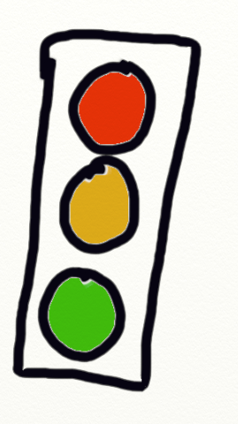
6. Application example of a usability test
Evaluation of an infusion pump
Detection of use errors in a standard application; evaluation of the user steps (during following of the sequence of specified sub-steps) by means of a three-level ordinal scale in accordance with DIN EN 614-1 (traffic-light pattern)
2. Specification of the usability characteristics and value range
Red=3 | Sub-step not completed, trial-and-error behaviour, inhibition
Amber=2 | Cautious, uncertain execution; slow
Green=1 | Confident and swift execution of the sub-step
© KAN
Notes:
In the example shown here, the usability feature to be evaluated is the ability to complete the determined sub-steps. The three-level method (traffic-light pattern) to EN 614-1, Safety of machinery – Ergonomic design principles – Part 1: Terminology and general principles, serves as the value range.

Slide 23
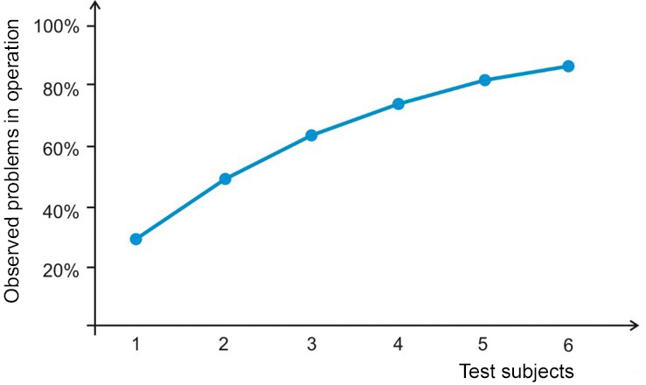
6. Application example of a usability test
Evaluation of an infusion pump
Group of test subjects = inexperienced users (novices)
Random sample size defined as 10 test subjects
3. Set random sample
Number of usage problems observed
as a function of the number of test subjects
(with reference to Virzi 1992)
Notes:
Inexperienced users with little or no previous experience with the medical device under test are selected as the test subjects. The test subjects are not instructed in use of the device, but are simply asked to administer an infusion at the delivery rate XY. The lack of instruction and the test subjects' inexperience enable the self-explanatory characteristics of the medical device to be assessed.
The random sample for this usability test was set at 10 test participants. According to the literature, 6 test subjects were sufficient to detect 85% of the major usability deficits on a product (see Virzi 1992, Backhaus 2010).

Slide 24
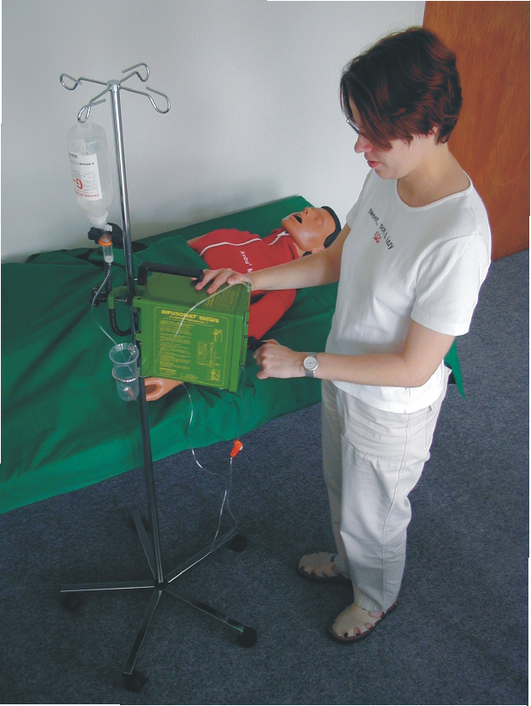
6. Application example of a usability test
Evaluation of an infusion pump
4. Testing in the laboratory
No
Sub-step
Infusion pump
1
Assemble the device
██ 1.3
2
Connect to mains power
██ 1.0
3
Open enclosure
██ 1.7
4
Insert tube, fix
██ 2.3
5
Close enclosure
██ 1.4
6
Open roller clamp
██ 1.5
7
Hook up droplet sensor
██ 1.8
8
Switch on device
██ 1.2
9
Set delivery rate
██ 1.4
10
Press start
██ 1.2
→ Result: Average (median) of the assessed sub-steps
(Backhaus 2010)
Notes:
The test is recorded by means of two video cameras. One camera records the overall situation, in order to permit evaluation of the test subjects' behaviour during the test. The second camera records only the user interface of the infusion pump, in order to record the user's interaction with it in detail.
For each sub-action, the median is formed from the assessment results across all test subjects. This enables actions assessed as poor to be identified and analysed with regard to ergonomic design deficits.

Slide 25
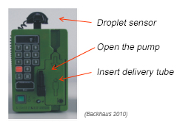
6. Application example of a usability test
Evaluation of an infusion pump
5. Evaluation of the user test data
No
Sub-step
Infusion pump
Identification of the weak points in usage (based upon the specified value range) + analysis of the usage potential
Definition of recommendations for ergonomic design
1
Assemble the device
██ 1.3
2
Connect to mains power
██ 1.0
3
Open enclosure
██ 1.7
4
Insert tube, fix
██ 2.3
5
Close enclosure
██ 1.4
6
Open roller clamp
██ 1.5
7
Hook up droplet sensor
██ 1.8
8
Switch on device
██ 1.2
9
Set delivery rate
██ 1.4
10
Press start
██ 1.2
Notes:
In the example here, three potential usage deficits have been identified and can be seen from the steps ranked as amber (value range 1.6-2.3).
The following steps exhibit usage deficits:
Attaching the droplet sensor. Deficit: the sensor must be detached from the top of the infusion pump and plugged onto the infusion set. This requires the test subjects to leave the user interface on the front of the device. The need to do this is not grasped by all test subjects. Improvement: the infusion pump indicates the need for the droplet sensor to be attached by an instruction in plain text.
Opening the pump. Deficit: in order to provide protection against inadvertent opening, the interlock mechanism must be pulled and twisted simultaneously in order to be opened. Improvement: none. Since this function provides protection against inadvertent opening, it should be retained in its current form. Recommendation: this point should be mentioned during instruction.
Inserting the delivery tube. Deficit: inserting the delivery tube is a problem for the test subjects, as they do not know where the tube must be attached. Improvement: the function elements for attaching to the infusion pump and the delivery tube (infusion set) should be marked in colour in order to show their location in or on the device more clearly.

Slide 26
7. Further literature
ANSI/AAMI HE75 (2013) Human factors engineering – Design of medical devices. American National Standard. http://my.aami.org/aamiresources/previewfiles/HE75_1311_preview.pdf Retrieved: 10 February 2017
Backhaus C. (2010) Usability-Engineering in der Medizintechnik. Berlin: Springer
EN 60601-1-6/VDE 0750-1-6 (2016). Medical electrical equipment – Part 1-6: General requirements for basic safety and essential performance – Collateral standard: Usability
EN 614-1 (2009) Safety of machinery – Ergonomic design principles – Part 1: Terminology and general principles
EN 62366/VDE 0750-241 (2016). Medical devices – Application of usability engineering to medical devices
FDA (2013) Applying Human Factors and Usability Engineering to Medical Devices. U.S. Department of Health and Human Services, Food and Drug Administration http://www.fda.gov/downloads/MedicalDevices/.../ UCM259760.pdf Retrieved: 10 February 2017
Hölscher U., Laurig W., Lindenthal M., Hoffmeier N. (2016) Sicherer Umgang mit Medizinprodukten in Kliniken. Landsberg: ecomed
© Michael Hüter

Slide 27
7. Further literature
Hölscher U., Laurig W., Müller-Arnecke H.W. (2008) Prinziplösungen zur ergonomischen Gestaltung von Medizingeräten. Forschung Projekt F 1902. Dortmund: BAuA
KAN Report 31 (2004) Ergonomics Guidelines for the Design of Medical Devices. St. Augustin: Verein zur Förderung der Arbeitssicherheit in Europa e.V.
Medizinproduktegesetz (MPG) https://www.gesetze-im-internet.de/mpg/MPG.pdf, 2 August 1994, last amended by Article 16 G, 23 December 2016 (BGBl. I pp. 3191, 3215)
Council Directive 93/42/EEC of 14 June 1993 concerning medical devices http://eur-lex.europa.eu/LexUriServ/LexUriServ.do?uri=CONSLEG:1993L0042:20071011:en:PDF EU OJ L 169 of 12 July 1993, p. 1
Regulation (EU) 2017/745 of the European Parliament and of the Council of 5 April 2017 on medical devices, amending [...] and repealing Council Directives […] 93/42/EEC http://eur-lex.europa.eu/legal-content/EN/TXT/PDF/?uri=CELEX:32017R0745&from=EN
Virzi R.A. (1992) Refining the test phase of usability evaluation: How many subjects is enough? Human Factors, 34. pp. 457-471
Wiklund M.E. (1995) Medical Device and Equipment Design. Buffalo Grove (IL): Interpharm Press
© Michael Hüter

Slide 28
Contact
Author of this module:
Professor Claus Backhaus
FH Münster University of Applied Sciences
Centre of ergonomics and medical technology Bürgerkamp 3
48565 Steinfurt Germany
claus.backhaus@fh-muenster.de
Launched and financed by:
Commission for Occupational Health and Safety and Standardization (KAN)
Alte Heerstrasse 111
53757 Sankt Augustin Germany
info@kan.de

