Slide 1
Process ergonomics
Module 6: Learning ergonomics

Slide 2
Process ergonomics
Generic term for elements of humane work organization that place the focus upon adapting it to sustained task orientation on the part of employees
→ creation of motivational work content and working conditions
flexibility in performance, supervision and decision-making, and facility for interaction.
Design measures for process ergonomics must take account of differences in ability between individuals owing to their physical and mental characteristics, their qualifications and their experience.
Process ergonomics is often related directly to productivity.
The design of technical systems has a direct influence upon process ergonomics, for example because machines or concatenated systems may determine dependencies, constraints, and thus scope for flexible action.
Notes:
The lecture modules have been developed independently of each other, and can therefore be used in isolation. Module 6 constitutes an additional resource that draws attention to ongoing effects of technical and organizational solutions with far-reaching consequences for the affected workers and users.
flexibility and facility must engender those affected with a substantial sense of meritocracy.

Slide 3
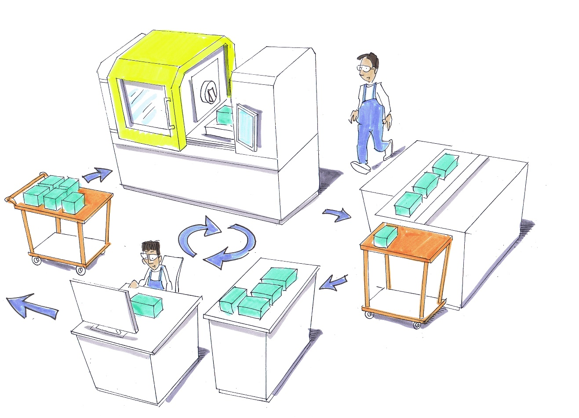
Example of process ergonomics
Operator requirements: monitoring, maintenance,
responding…
❶
Laser cutting
Supply of a casing
❷
Interface to logistics, etc.
Assembly
Machining centre Milling
Testing
❸
Supply of a drive unit
❹
Coordination between employees, dependency…
© Michael Hüter
Process ergonomics is characterized by technical, organizational and social interrelationships that are influenced by the underlying conditions of the work and company processes.
Notes:
A selection of elements in process logistics is presented with repeated reference to model situations.

Slide 4
The five levels of ergonomics
Level 1 | Safe design of work equipment and workplaces | Safety
Level 2 | Product-specific ergonomic design of work equipment and working conditions | Product ergonomics
Level 3 | Application-specific ergonomic analysis and design of work equipment and working conditions | System ergonomics
Level 4 | Process-oriented ergonomic analysis and design of the work process as a whole | Process ergonomics and productivity
Level 5 | Overall analysis and design of the task, the goal and the work process | Productivity and innovation
Notes:
The five levels of ergonomics should be applied successively.
The development of safe products takes priority (Level 1).
Level 2 concerns design of the direct interface between the user and the work equipment.
In Level 3, the emphasis lies upon the linking of multiple elements, for example of an item of work equipment. A handle that fits well in the hand for example is of little benefit if its position is not ideal for the application of force (for example on an electric drill). The overall ergonomics of a pushbutton concerns not only how easily it can be reached, but also the reaction of the process triggered by its operation.
Level 4 concerns the linking of multiple workplaces. On a production line, the quality of work is dependent upon the balance of the requirements imposed by the work in the system as a whole.
Level 5 challenges existing solutions and seeks innovative and ergonomically superior solutions by way of new approaches.

Slide 5
Model for regulation of the task
Human abilities:
Action regulation
Sensorimotor regulation
Perceptive-conceptual regulation
Intellectual regulation
Motivational regulation
Attitude
Motivation
Activity level
Job
Requirements
Task
Work result
Strain
Positive consequences of strain
Learning processes
Negative consequences of strain
Mental fatigue
Monotony
Mental saturation
Stress
Based upon Hacker, 1984
+
Improvement in the action regulation
Optimum use of force
Dysregulation
Reduction in incentives
-
Notes:
The model for regulating the task represents the relationship between strain and regulatory influence in consideration of each individual's ability. Given that it is hardly realistic for suitable processes to be planned in advance for each individual, scope for self-regulation is seen to be advantageous, since the affected individual possesses their own sensory abilities and therefore their own means of influencing the task.

Slide 6
Mental regulation of tasks
Motivational regulation
i.e. it is determined whether action is taken
Principles: personal motives, attitudes and preferences
Action regulation
i.e. it is determined how action is taken
Principles: personal sub-targets, choice of ways and means, control of execution
Based upon: Hacker, W. 1986
Notes:
Whereas motivational regulation arises through inner motivation such as the satisfaction of needs, interests, etc., design of the working conditions has a major influence upon the scope for action regulation. Process ergonomics therefore focusses upon measures for improving action regulation.

Slide 7
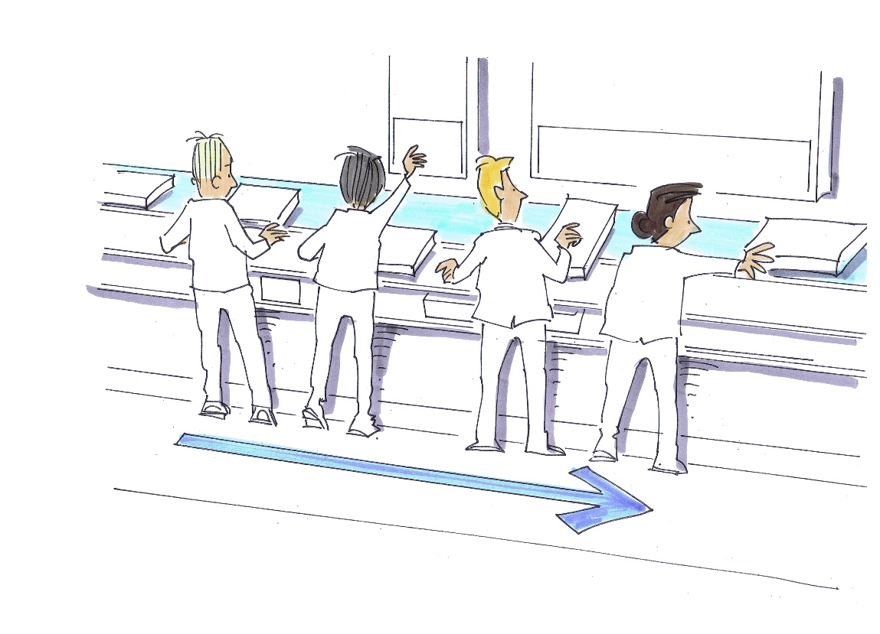
Examples
work situations with a destabilizing effect Permanently synchronized
workplaces with a rigid cycle time,
such as assembly lines, limit the
scope for action regulation
Mere operation of machinery,
particularly with work content
repeated in short cycles, is also
an obstacle to action regulation
© Michael Hüter

Slide 8
Destabilization of action regulation by:
Mental fatigue
Performance impaired by excessively high mental requirements per time unit
Recovery from fatigue during short breaks
Monotony and mental saturation
Situations of low stimulation, monotonous tasks, a state of dullness, aversion towards the task
Modification of the incentive structure, content, broadening of the scope for action, enhancement of motivation
Stress
Performance and well-being impaired by excessive demands and insufficient influence
Elimination of stress factors, reduction of arousal responses, increased experience of satisfaction
Physical and mental disease
Performance impaired by physical or mental impairments
Ergonomic workplace design, elimination of stressful environmental conditions, formation of health circles
Based upon: Bullinger, H.-J. 1994
Notes:
The four elements destabilize action regulation and are an obstacle to motivation. Major stresses can be a cause of diseases. Possible countermeasures are shown on the right.

Slide 9
Factors influencing the feedback cycle of the task
S
Stimulus
Motivation
Information
Qualification
O
Organism
R
Reaction
Task
Perception
Processing
Implementation
C
Control
Notes:
The SORC model (Stimulus, Organism, Reaction, Control) considers human beings as organisms that draw a high level of motivation from active perception, development of a model for solutions, monitoring of its efficacy, and the scope for improving the model. Where this scope of influence does not exist, motivation cannot be generated, and the employee becomes a mere performer of a task, without identifying with it.

Slide 10
Motives and motivation
A motive is a latent willingness to adopt a certain behaviour, of relatively long duration and connected to the environment, that explains what people want or desire (e.g. hunger, thirst, a desire for power).
Motivation exists when certain motives are activated by stimuli from the environment and therefore have an influence upon behaviour towards attainment of a goal.
Based upon: Heckhausen, H., 1980
Stimuli
(e.g. food)
Motivation
If for example the motive is "hunger", the goal is not "eating", but "satiety". "Eating" is the behaviour leading to this goal.
Behaviour
(eating)
Motive
(e.g. hunger)
Goal
(satiety)
Notes:
Definition of the motive (clarify with the participants what they consider a motive to be) and of the resulting motivation.

Slide 11
Changing conceptions of the human being (Ulich 1991)
Type | 1920s Economic man | 1930s Social man | 1950s/1960s Self-actualizing man | Present Complex man
Images of man | Wary of responsibility Motivated by money | Social motivation induced by the group | Man seeks self-actualization and autonomy | Inter-individual and intra-individual differences must be considered. There is no universally valid conception of the human being
Work philosophy | Division of labour and authority Personalized incentive systems | Teamwork Group incentive systems | Semi-autonomous group work Extension of tasks Supporting and assisting work rather than supervising | The reality is more complex than previously assumed
Corporate philosophy | The company is a technical system to which human beings are adapted Human beings treated as machines, and "one best way" for each and every task | The company is a social system in which information and communication are important | The company is a socio-economic system Crises: strikes, periods of absence, staff turnover
Source: Ulich, Eberhardt: „Arbeitspsychologie“; Schäffer-Poeschel; 6. Auflage, 2005
Notes:
Since, therefore, work is the product of purposeful human action, it is worth considering concepts of humanity in the recent past. Each of these concepts of humanity could be said to imply a philosophy for the guidance and motivation of employees. At this point however we find ourselves in a dilemma, in that simple, generalized explanatory models repeatedly fail, owing to the complexity of society and the diversity of individual goals and scope for development.
Some individuals for example subject themselves to an ordeal of preparing as early as possible for their twilight years, whilst others enjoy being tasked with specific, simple and easily grasped working activities, or prefer tasks presenting the lowest possible mental challenges.

Slide 12
Herzberg's two-factor theory
The core concept: Satisfaction is not the opposite of dissatisfaction
Satisfaction No satisfaction
Dissatisfaction No dissatisfaction
Dissatisfaction is prevented by hygiene factors that relate to the underlying working conditions (context)
Hygiene factors:
Company policy
Supervision/monitoring
Working conditions
Remuneration
Status
Satisfaction arises through motivators that are related to the work content.
Motivators:Leistung
Performance
Recognition
Work in its own right
Responsibility
Scope for promotion and professional development
Motivators increase the performance beyond the normal level.
Hygiene criteria that are not met lead to the normal performance not being reached.
Source: Herzberg, Frederick; Mausner, Bernard; Snyderman, Barbara Bloch: The Motivation to Work. 2. Aufl. New York: Wiley, 1959.
Notes:
Herzberg's two-factor theory constitutes the foundation, or explanatory model, for structuring tasks in such a way as to generate motivation.

Slide 13
Enlargement of scope for decision-making and tasks
Reducing horizontal division of labour
Vertical division of labour
Elimination of the constraints of work
Experiencing of responsibility, knowledge of results, need for personal development
Job enrichment
Scope for decision-making
and control
Scope for action
Job enlargement/
job rotation
Scope for activity
Scope for
interaction
Semi-autonomous group work
Source: see Ulich, Eberhardt: „Arbeitspsychologie“; Schäffer-Poeschel; 6. Auflage, 2005
Notes:
Measures for work design that satisfy these design requirements are derived from generation of the scope for action and decision-making that can be supported by various forms of organization. Ulich has implemented Herzberg's ideas in a model for extending the scope for activity, action and interaction.
An example is the production of a discrete part that is extended in order for a task to be extended through to complete manufacture of a functional assembly. A comprehensive task of this kind permits organization of the work processes by the worker and monitoring of the function of the product. A group is able to achieve greater efficiency when the feedback cycles are small.

Slide 14
Design concepts for increasing the scope for action
Job rotation
Systematic job rotation
1.
Job enlargement
Enlargement of the scope of the work activity
2.
Job enrichment
Enlargement of the scope for decision-making
3.
Semi-autonomous group work
Autonomous, individual organization of work within the group
4.
Vgl.: on Rosenstiel, L. (1980). Grundlagen der Organisationspsychologie. Basiswissen und Anwendungshinweise. Stuttgart: Poeschel.
Notes:
Summary of the four essential task structuring measures for improvement of the scope for action and thus the motivation.

Slide 15
Organization
Organizing | Organization | Organizational unit
Design of structures and procedures. The employer has an organizational duty and an organizational right. This means that tasks, procedures or disciplinary rules must be laid down for employees. Creative process | The organization is a construct that is created consciously and with an objective = the result of organizing. A distinction is drawn between: Organization of structures and organization of procedures Creation of a structure | Organizational units are members/units of an organization. These members are related to each other in a way that is defined by the organization. From the perspective of work design, work systems and departments are viewed as organizational units. Operative elements
Notes:
Three levels of organization development are distinguished

Slide 16
Forms of organization
Organization of structures Corporate structure with assignment of jobs Definition of ranges of tasks Dependency Authority to issue instructions Disciplinary tasks Definition of interfaces | Organization of procedures What? Where? By whom? When? With what?

Slide 17
Organization of structures
For creation of the organizational structure, the organizational units are demarcated according to their competencies during definition of the jobs and formation of the departments (specialization) and linked by action-based relationships. The form taken by this demarcation and linking (the management system) gives rise to different organizational structures.
Approaches to structuring:
Performance
Object (product)
Rank (hierarchy)
Phase
Purpose
Example: structuring
by performance
Guide
Develop
Procure
Store
…
Produce

Slide 18
Fundamental structural principles
Management
Department A
Department B
Department C
Line principle
Line and staff department principle
Product and project orientation
Group orientation
Management
Staff department
Department A
Department B
Department C
Staff department
Procurement product A
Production product A
Procurement product B
Production product B
Product A
Procure- ment
Produc-tion
Product B
Procure-ment
Produc-tion
Service
Procure-ment
Produc-tion
Group
Procure-ment
Pro-duction
Storage
Sales

Slide 19
Strategies for system planning
Bottom-up approach
Top-down approach
Notes:
Bottom-up: design of parts that are combined to form an intelligent whole
Top-down: design of the whole and step-by-step detailing according to a certain hierarchical order

Slide 20
Contrasting approaches to task distribution
Centralization
Almost all tasks are concentrated within a few positions in senior management
Advantage: firm and consistent leadership
Disadvantage: overloading of senior management personnel
Decentralization:
Tasks are distributed between positions in middle and lower management, with considerable decision-making competence being delegated
Advantage: senior management is relieved of stress; job satisfaction is enhanced; worker expertise and creativity; customer-oriented decision-making
Disadvantages: conflicts; inconsistency; employees may have too much power; cost-intensive

Slide 21
Organization of procedures
Procedural organization involves the interaction of people, equipment and working agents in the same place and at the same time for the completion of tasks
Complete process
Sub-process
Mechanical design
Electrical design
Process stage
Research
Planning
Design
Engineering
Simulation

Slide 22
Analysis and synthesis of work
Vehicle plant
Vehicle development
Planning of production processes
Bodyshell
manufacture
Assembly
Shipping
Paintwork
Setup and programming
of installations
Operation of installations/ loading of parts
Transport work
Maintenance
Bending work
Surface finish
Skilled industrial fitter
Skilled construction fitter
Transport worker with forklift licence
Semi-skilled assistant
Analysis of work Breakdown from macro areas into micro areas
Module 6 – Learning ergonomics

Slide 23
Formation of sub-procedures
Macro system
Complete process
(vehicle plant)
Sub-process
(assembly)
Micro-System
Procedure, work process
(install seat)
Process step
(insert screw)
Process stage
(interior)
Sub-process
(install seat in vehicle)
Process element
(retrieve screw)
Process
(install seats)
Holistic analysis Reduction of complexity

Slide 24
Forms of work organization
Individual work
clear assignment of a task to a position/employee
Tasks: different requirement levels and degrees of dependency
Successively working groups
spatial or technological aspects may give rise to elements of collective work
Formal arrangements for group working do not exist
Forms of group work
Notes:
Individual work
The starting-point and terms of reference of work organization design are forms of individual work and their integration into an overall structure. Individual work is characterized by the clear assignment of a task to a position/employee. Each of these tasks can be associated with different requirement levels and degrees of dependency. Together with the abilities of the persons carrying out the tasks, these two elements substantially influence the efficiency with which work is performed, and these individuals' motivation. The design of the task may however lead to the demands made of the employee being too great or too low.Efficiency-oriented design variants include Kanban, one-piece flow, division of responsibilities by type or quantity, chaku-chaku, etc.
Successively working groups
Where individual work is performed in successively working groups, spatial or technological aspects may give rise to elements of collective work. Formal arrangements for group working do not exist; each employee is clearly assigned a job that is evaluated separately.
forms of group work

Slide 25
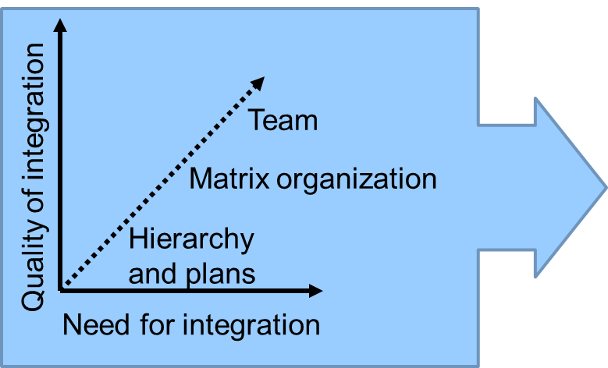
Group work …
… is characterized by a social unit whose members
Number three or more
Are outwardly recognizable as such and regard themselves as such (identity)
Are integrated into an organization (context)
Complete tasks jointly by cooperation
Rather than coordination taking place through hierarchy and plans, teams permit direct and continuous cooperation between the employees and organizational units required for completion of the tasks.

Slide 26
Objectives of group work
Economic objectives | Social objectives
Work process Improvement of work preparation Optimization of the organization of materials and personnel (planning) Improvement of quality assurance and feedback (monitoring) Knowledge of the situation on the ground Complex analysis Delivery of goods and services Improving the quality and quantity of the products Personnel structure Exploitation of employee potential | Working conditions Extension of the scope for action Avoidance of monotony and mental saturation Social relationships Improvement of communication and cooperation, and social support by colleagues Qualification Promotion of the development of professional and social competencies Impacts of work Enhancement of motivation to work and satisfaction with work Reduction of undesired consequences of strain

Slide 27
Strategies for the improvement of company processes
Clear responsibilities
Management personnel on the shop floor
Involvement of employees
Process of continual improvement
Total quality management
Business process reengineering
Lean management
Process-oriented quality management systems
Six Sigma
…

Slide 28
Group work satisfies the job characteristics model
Core characteristics of the work
Characteristics of tasks
Critical psychological experiences
Consequences and effects of the work
Diversity of requirements
Sensed relevance of one's own work activity
High intrinsic motivation
Holism of the task
Importance of the task
High quality of work performance
Sensed responsibility for the results of one's own work activity
Autonomy
High job satisfaction
Knowledge of the latest results, particularly concerning the quality of one's own work
Feedback from completion of the task
Low absence rate and staff turnover
Need for personal development
See.: Hackman, J. Richard; Oldham, Greg R.: Work Redesign (Organization Development). Upper Saddle River (New Jersey): Prentice Hall, 1980. - ISBN 978-0-201-02779-2.
Notes:
The job characteristics model once again summarizes the elements for promoting motivation in the context of a task. Group work in particular enables targets in process ergonomics to be attained.

Slide 29
Causes of waste
Problem Time is frequently regarded as something that contributes to the adding of value. This is incorrect: too much time is more likely to decrease value.
Examples Short-term storage, carrying of heavy workpieces, counting of parts, monitoring of the machine process, transport over long distances, overproduction, multiple handling, waiting for material, locating tools, machine stoppages, faults, shortage of parts, reworking
Question How many tasks are absolutely essential to the completion of production? How many of these tasks add value and do not increase costs? How much is relevant to what the customer sees and what is important for him?
"Waste is anything that does not add value" (FORD 1920)
Approximately 95% of working time expended does not increase value, but only increases cost; approximately 95% of the time, parts are in storage or in transit.
Notes:
Optimum processes are also characterized by the avoidance of waste and the associated use of resources without a tangible result.

Slide 30
Waste: overproduction
Overproduction
Additional stocks Additional need for space
Additional handling Additional conflicts of interest
Additional machines (What is to be manufactured first?)
Additional defects Additional costs
Additional paperwork Additional personnel
→ Difficult to observe, since everyone is busy
Waiting time is better than overproduction, since the latter destroys further resources → discarding of old material, avoidance of purchases of large quantities
Notes:
Clarification: what is waste in the production process?

Slide 31
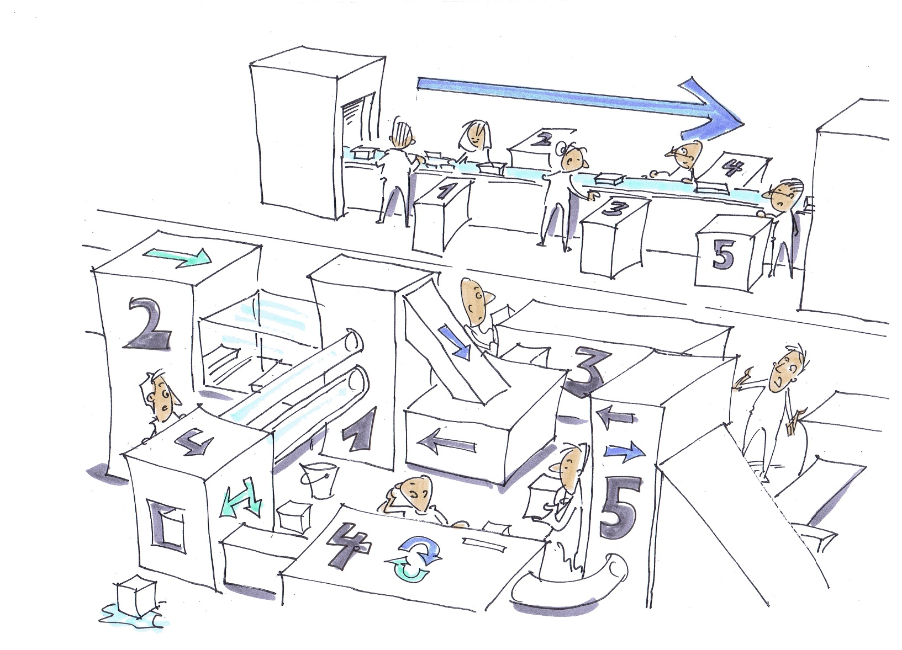
Movement is not necessarily work.
© Michael Hüter

Slide 32
5 S method
Seirien Sort work items in use from those that are not needed. Label them and put them away after a defined time. Elimination of duplicate work items.
Seiton Set items in order: tidy up, restore tidiness in a working area, and define areas for work equipment according to whether it is used frequently or infrequently.
Seisou Sweep: Thoroughly clean at regular intervals.
Seiketsu Standardize: document the results of the 5 S method in photographs, sketches or a standard worksheet.
Shitsuke Sustain: define cycles according to which the method is to be repeated.
Sort
Set in order
Sweep
Standardize
Sustain
Notes:
Widespread method for optimization of a workplace.

Slide 33
7 types of waste
Analysis of the work system according to the 7 types of waste
Overproduction (when and where is what is produced actually needed?)
Stocks (what stocks are built up, and why?)
Transport (how often is carrying, restacking and transport of parts necessary?)
Standby times, wasted time (what is being waited for, and why?)
Waste/rework (what are the causes?)
Movement (resetting movements, handling of parts, adjustments, searching)
Manufacturing process (complex methods, setup, multiple checks, etc.)
Evaluation of the forms of waste
Development of design approaches – measures and methods for avoidance of the forms of waste
Evaluation of the design approaches and specification of the sequence of their implementation (planning of measures, scheduling)

Slide 34
Work instructions – 4-step method
Preparation by instructor
Generate the structure for instruction
Prepare equipment and tools
Inform recipients of instruction of its purpose
Position recipients of instruction suitably for demonstration
Demonstration by instructor
Demonstrate in order to provide an overview
Demonstrate the work in detail, with explanations and reasons
Demonstrate quickly and in context
Notes:
Purposeful instruction avoids incorrect work processes being adopted that result in impaired performance.

Slide 35
Work instructions – 4-step method
Performance of the work by the recipients of instruction
Attempt to perform the work
Attempt with detailed examination and reasoning
Attempt to perform work quickly overall
Practice by the recipients of instruction
The instructor has the task of assisting and correcting where necessary
Recognition of progress made through practice; conclusion
Notes:
Purposeful instruction avoids incorrect work processes being adopted that result in impaired performance.

Slide 36
Analysis of the throughput time
Determining of the time structure for the completion of jobs: the dead periods between the productive phases generally account for the greater part. To reduce the dead periods, measures are required for more efficient organization of the processes and of the flow of material and information.
Measures
Elimination of non-productive processes and tasks
Densification of the work task by reduction of the time requirement
Modification of the production sequence
Overlapping, linking or splitting of processes
Product design
Optimizing of the value-adding flow
Introduction of agreed objectives

Slide 37
Holistic production systems
Process and work organization
JIT
Logistics
Robust processes
Process of
continual improvement
Visual
management
Professional work
routines
Notes:
Within the holistic production system, methods for improving work and processes and for motivating employees are combined in a coordinated system in a complementary way.

Slide 38
Summary of process ergonomics
Process ergonomics
numerous underlying conditions
company’s strategy
organization
behaviour of management
…
Important: Motivation through
facility for action regulation
influencing the work
Notes:
Process ergonomics is dependent upon numerous underlying conditions of the co-process ergonomics company's strategy and organization and of the behaviour of management.
This module has addressed only basic elements of organizational development.
Work scheduling, remuneration arrangements, personnel development and many other influencing factors must also be considered. Technical solutions also have an impact upon process ergonomics, for example when they lead to a rigid concatenation of work systems (worker-worker or worker-machine).
As a matter of principle, all measures taken must consider the aspect of motivation through facility for action regulation and the resulting perceived scope for influencing the work.

Slide 39
Impressum
Author: Prof. Dr.-Ing. Torsten Merkel
Westsächsische Hochschule Zwickau
Professur Arbeitswissenschaft
Torsten.Merkel@fh-zwickau.de
Initiated and funded by
Kommission Arbeitsschutz und Normung (KAN) Alte Heerstraße 111 53757 Sankt Augustin www.kan.de/en https://ergonomie.kan-praxis.de/en

