Slide 1
Design of products and workplaces for the needs of specific target groups and operator populations
Module 5 - Learning ergonomics

Slide 2
Contents of the module:
    Ergonomic and design requirements
    Case study
    Concept of the work system as a structuring strategy
    Application of ergonomic knowledge to the design of the case study according to:
      Targets
      Work equipment and workplaces (objects)
    Evaluation and selection of solutions
    Extras:
    Case studies with video clips from the Institute for Occupational Safety and Health (IFA) of the German Social Accident Insurance (DGUV)
Notes:
This slide presents the content of Module 5.
This module can be used independently of Modules 1-4, but builds upon the procedure for ergonomic design in EN 614-1 “Safety of machinery - Ergonomic design principles - Part 1: Terminology and general principles” and the sub-aspects of Modules 2 to 4.

Slide 3
Levels of ergonomic action and design
Level 1 | Safe design of work equipment and workplaces | Safety
Level 2 | Produktspezifische ergonomische Gestaltung von Arbeitsmitteln und Arbeitsbedingungen | Product ergonomics
Level 3 | Application-specific ergonomic analysis and design of work equipment and working conditions | System ergonomics
Level 4 | Process-oriented ergonomic analysis and design of the entire work process | Process ergonomics and productivity
Level 5 | Overall analysis and design of the working task, the target and the work process | Productivity and innovation
Notes:
By way of introduction, the action and design aspects of ergonomics are presented with reference to the specific content of Modules 2 to 4 and serve as the basis for the further examples of application.

Slide 4
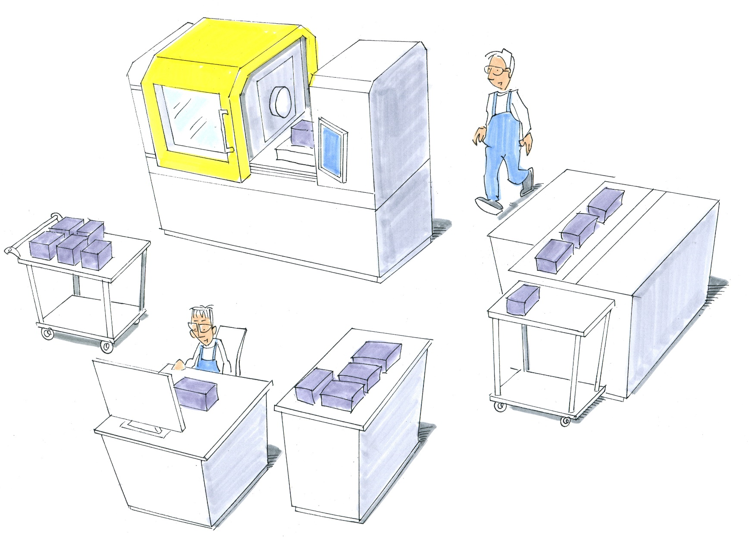
Machining of casing
© Michael Hüter
Notes:
Ergonomic design is based upon study of the underlying conditions in which an activity is to be performed. A manufacturing cell with four workplaces is presented as the starting-point. The workplaces have already been considered in the preceding modules where applicable for the discussion of discrete problems. The explanatory text is displayed or hidden in four steps according to completion of the task. All further content of the module is based upon this manufacturing cell. Further steps are described on the following slides.

Slide 5
Presentation of the case study
❶
© Michael Hüter
❷
Machining of casing
Castings are delivered by fork-lift truck on pallets to the workplace. Remove parts from pallet manually and place on the machine table. Chuck the casing. Close the working area and launch the machining program. Following machining, the casing must be cleaned of the worst of the chips, dechucked and carried to the assembly workplace, where it may have to be placed on the ground on a Europallet.
Enter and teach in the programs using the milling machine's CNC control.
Notes:
Ergonomic design is based upon study of the underlying conditions in which an activity is to be performed. A manufacturing cell with four workplaces is presented as the starting-point. The workplaces have already been considered in the preceding modules where applicable for the discussion of discrete problems. The explanatory text is displayed or hidden in four steps according to completion of the task. All further content of the module is based upon this manufacturing cell. Further steps are described on the following slides.

Slide 6
Presentation of the case study
❶
❷
Cut out the sheet-metal cover
The casing covers are cut to size on a laser cutting machine. The working task is similar to that of operation of the milling machining centre. It differs in that metal sheets must be placed and fixed in position, and following machining the cover and scrap retrieved and consigned to appropriate bins or receiving points. Programs for the laser centre must also be loaded.
© Michael Hüter

Slide 7
Presentation of the case study
❶
❷
❸ Assembly
The motor, transmission, control elements and clamping plate are placed in the casing at the assembly workplace, and mated. In addition, rubber seals must be fitted to all openings.
The wiring loom is then fitted with terminations, inserted though a hole in the side of the casing, and connected to the terminal plate.
❸
© Michael Hüter

Slide 8
Presentation of the case study
❶
❷
❹ Testing
Every 10th drive unit is tested at the adjacent test workplace. In the final step, the cover is fitted and bolted in place, and a label is applied. The complete drive unit is placed on a pallet on the ground.
❸
❹
© Michael Hüter

Slide 9
Work systems: why?
Machines and products and their use in working areas involving different persons present a challenge for analysis and optimum design.
The demarcation of systems enables attention to be focused on essential aspects without sight being lost of the fundamental influencing factors. A complete perspective is obtained on a harmonized level of abstraction/detailing.
System: definition
A system is an entirety of elements subject to mutual interaction and for which a structure, i.e. their relationships to each other, is evident. A system consists of system elements or subsystems. It is constrained by the outer boundaries of the system as a whole. Each of the individual subsystems has a system boundary of its own.
In turn, work systems are open sociotechnical systems consisting of subsystems and elements and interfacing with other systems.
Notes:
The concept of a work system is introduced for the reproducible and structured description of the work. This system enables the scope of analysis to be constrained and broken down into individual elements. This is necessary, since work processes give rise to complex, multidimensional systems which cannot be explained by simple, causal relationships.
Two work system concepts are explained in greater detail on the next slide.

Slide 10
Selection of work system concepts
2. Input
1. Work task
3. Human being
4. Work equipment
5. Work process
Source:
REFA-work system
DIN EN ISO 6385:2004
8. Work place
6. Output
7. Environment
Sociotechnical system, based upon Ulich
Social subsystem
Technical subsystem
Primary task: completion of the task for which the system was planned
Secondary task: sustaining of the system (maintenance, updating,
training, etc.)
Notes:
The structure of the REFA work system has become established in industry
particularly in the area of work planning and industrial engineering and has also
been specified in EN ISO 6385 “Ergonomic principles in the design of work
systems”. This system is intended in particular to ensure that a working
environment is described precisely, thereby permitting validated performance
criteria, for example. The system consists of 7 elements.
Work task – describes the tasks to be completed within the work system. Where applicable, distinction is drawn between primary and secondary tasks, in order to derive a ranking of primary design criteria.
Input – contains all information, materials, energy, etc. introduced into the system which are required for performance of the work task(s).
Human being – describes the persons assigned to the system and their specific performance criteria, such as percentile, sex, training, etc.
Work equipment – encompasses all technical elements of the system, such as tools, machinery and apparatus, but also extends to chairs, workbench and lighting.
Work process – describes the interaction between human being and work equipment during processing of the input for completion of the work task. The work process is characterized by methods, technology, resource requirements, etc.
Output – summarizes the results of the work process and contains the results of its performance in the form of products, processed parts, information and service processes, and also waste and the return of elements no longer required, such as tools used, drawings and other data media
Environment – describes the environmental influences upon the work system. This contains the elements of occupational hygiene, such as climate at the workplace, and also social elements, such as the dependency of work upon others (as is the case on an assembly line), co-operation with superiors, the remuneration structure, etc.
The second "sociotechnical" system is divided into the technical and social
subsystems, each with its own specific requirements and characteristics. Both
subsystems are assessed with regard to their efficiency in completing the
"primary" task for which the system was designed. The secondary aspect, that of
system retention, in relation both to technology and human beings, is however
frequently underestimated. With regard to human beings, for example, planning
must consider the necessary processes for recuperation, further training and
communication.

Slide 11

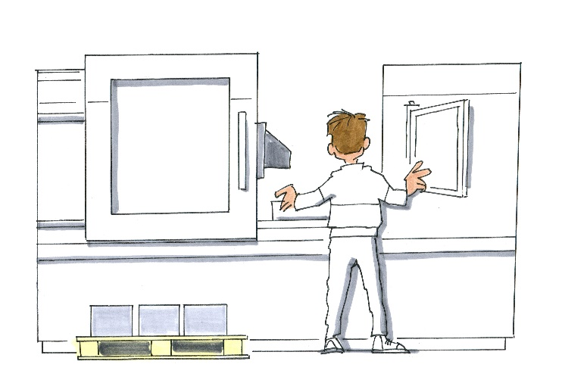
Scope for analysis of work systems
Manufacturing cell (macrosystem)
Door and handle design
(microsystem)
© Michael Hüter
Notes:
The structuring of the work system is applied both to complex work environments involving several persons, and to the structures of individual products and subassemblies. This permits a systematic procedure and results that are reproducible.
The upper part of the slide shows the entire work system comprising all four workplaces (macrosystem). When the focus is shifted to a particular element, such as the design of the sliding door on the machining centre, concentration on a single design detail is possible (microsystem). Both system types can be structured in accordance with the concept of the work system. See next slide.

Slide 12
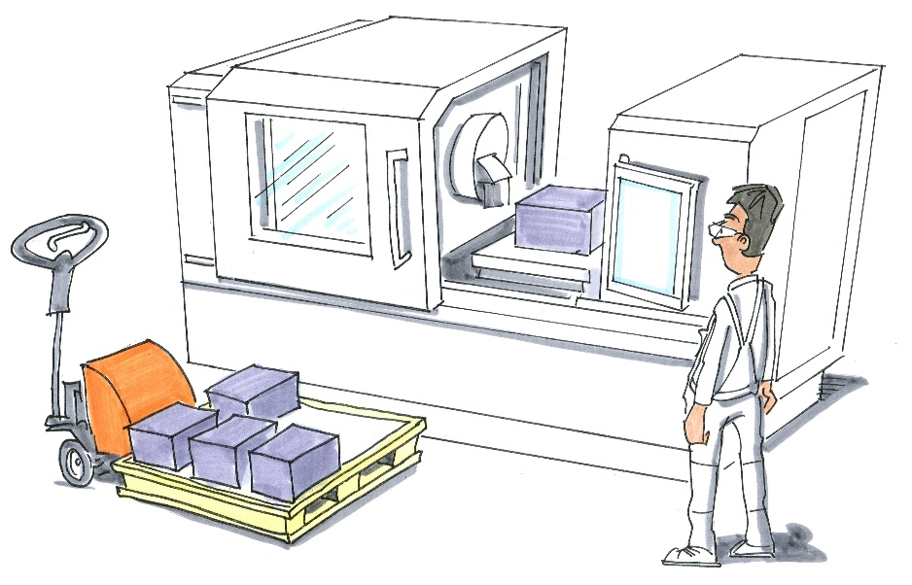
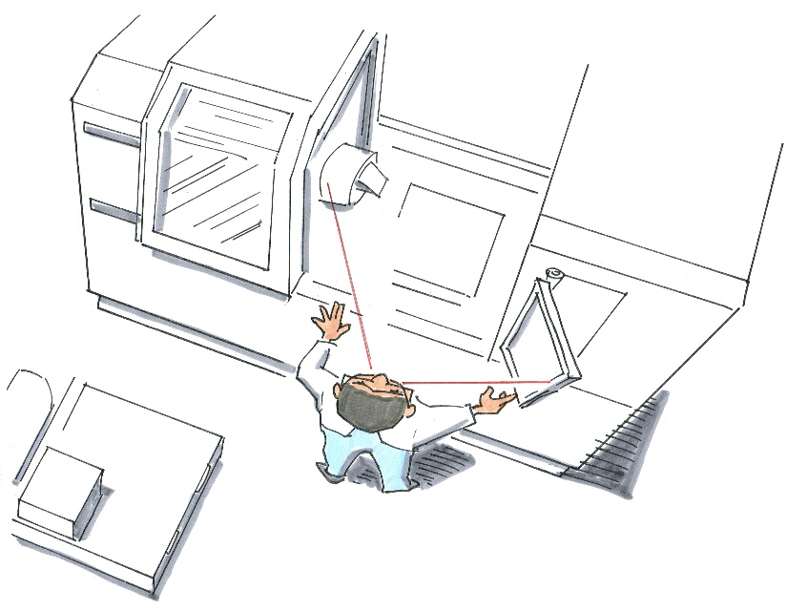
Work system: machining centre
Work task: machining of the casing (milling and drilling)
Input: castings (4 kg) on a pallet, drawing, CNC program, energy
Human being: Skilled worker, male, age: 52
Work equipment: CW 400 machining centre, chip hooks, CNC control
Work process: Read work documentation, load CNC program and start, retrieve casing from pallet, chuck casing on machine table, close door and start machining process, monitor machining process, open door, clean casing and chamber, spot check, unchuck part and transfer to assembly workplace
Output: Machined casing for drive unit, chips, lubricant and coolant
Work environment: machine noise, atomization and vaporization of lubricant and coolant, electromagnetic radiation
Work task:
Input:
Human being:
Work equipment:
Work process:
Output:
Work environment:
© Michael Hüter
Notes:
The students have the task of identifying the elements of the work system when prompted and of entering them on a worksheet.
Allow around 2 to 5 minutes. If possible, use a worksheet or gather suggestions on the board. If this is not possible owing to the circumstances (a large lecture), the lecturer should present the solutions.
The empty table is completed at the touch of a key.

Slide 13
Where do possible ergonomic issues arise?
Opening/closing the door
Hazardous substances (mist, vapours) during the machining process
Noise
Illumination of the work area
Lifting and carrying the casing
Visual geometry
Alternation of view between machining area and controls
Obstruction of view
Areas of reach
Obstruction of access
Body heights
© Michael Hüter
Notes:
In a further step, potential ergonomic problems are to be discussed with reference to the results.

Slide 14
Target-based design
The focus of the design strategy lies upon selected ergonomic aspects, such as:
Safety
Optimization of the working posture for the purpose of avoiding unfavourable postures
Adaptation of the area of reach and motional range for the operator population
Reduction of stress caused by work environment factors, such as pollutants, noise, unfavourable climate, lighting, etc.
Reduction of physical stresses caused by heavy lifting and carrying
Optimization of force exertion for the worker
Efficiency in execution of the work
Notes:
Fundamental objectives of the design process in the example – revision prior to study of the individual examples

Slide 15
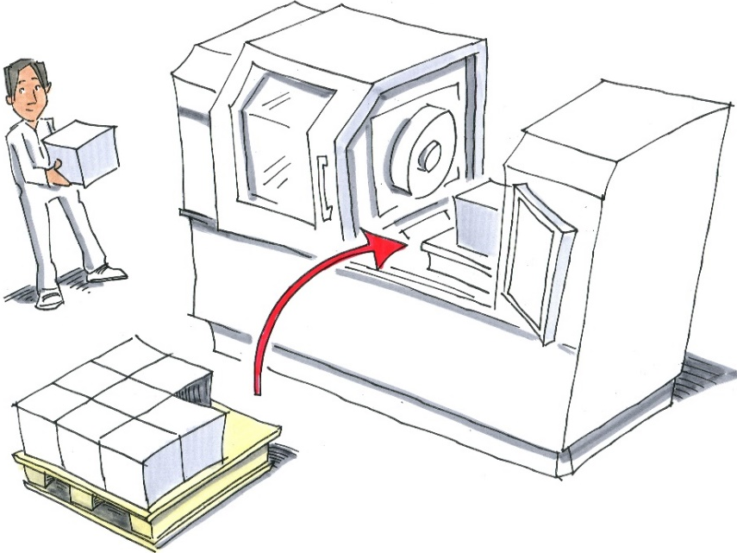
Example: inbound supply of parts
Work task:
Metal casings (350 mm × 200 mm × 200 mm, 4 kg) are supplied on pallets for further processing. In the course of each shift, 80 of these casings must be lifted onto the machine table, and transferred to the assembly workplace (a distance of 3 m) following machining. The centre of gravity of the casing must be lifted into the machine to a depth of 60 cm. The positions on the pallet vary. The maximum reach is also 60 cm.
© Michael Hüter
Notes:
The issues of Module 2 are taken up

Slide 16
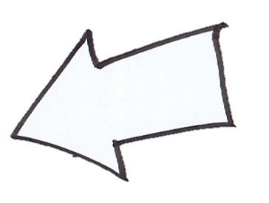
Definition of ergonomic criteria
Target criteria:
      Reducing of the physical severity of the work
      Avoidance of the lifting and carrying of loads
      Reduction of stress upon the spine
      Efficiency in execution of the work
  Gathering of experience with existing machinery
      Use of trucks
      Study of the use of trolleys on airliners
  Description of the characteristics of the expected operator population
      Males and females, 5th-95th percentile
  Risk assessment
      Sustained performance of the work may cause damage to the musculoskeletal system and rapid fatigue owing to the stress upon the cardiovascular system
Design process
to EN 614-1
Notes:
Refer to the slide for the target criteria. Gathering of experience on existing machines with reference to two examples (truck; milling centre) and IFA trolley study on separate slides.

Slide 17

Assessment of the situation at the outset
❶
Weight: 4 kg
Dimensions: 350mm × 200mm × 200 mm
Handle distance: 60 cm + 10 cm casing depth
Duration of lifting: 3 seconds per lift
Number of lifts: 80 per shift
Initial height: 15 cm
Final height: 110 cm
© Michael Hüter
Selection of the procedure:
Assessment to EN 1005-2 Safety of machinery - Human physical performance - Part 2: Manual handling of machinery and component parts of machinery
Result: the task is not permissible
Conclusion of the evaluation process:
The retrieval and insertion depths must be reduced (max. 60 cm) and
the height interval to be overcome must be reduced
Notes:
For the situation at the outset, the stress situation caused by lifting of the casings into the machining chamber is evaluated in accordance with EN 1005-2. The maximum reception/insertion depth is dictated by the method, since reach distances exceeding 60 cm are by definition not permissible. In addition, inbound supply of the casings on pallets forces the workers to bend. The logical conclusion is that consideration should be given to reducing the requirements arising from the lifting process.

Slide 18
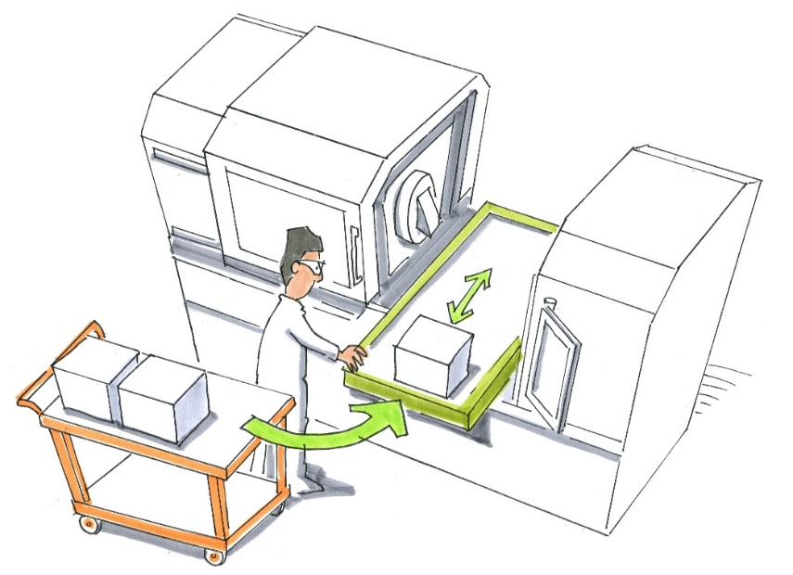
Generation of a preliminary draft design - 1
❶
Tool chucking on a sliding table
Advantages:
Shorter distance between retrieval and deposition points
No need for bending into the machining chamber
More suitable dimensional adjustment for all percentiles, owing to the option of walking round the table
© Michael Hüter
Disadvantages:
Greater technical complexity and correspondingly
high costs
Larger machine footprint
Possible obstruction in the motional range owing to projection of the table
Design process to
DIN EN 614-1:2006+A1:2009
Notes:
Alternative solutions with explanations on the slide

Slide 19
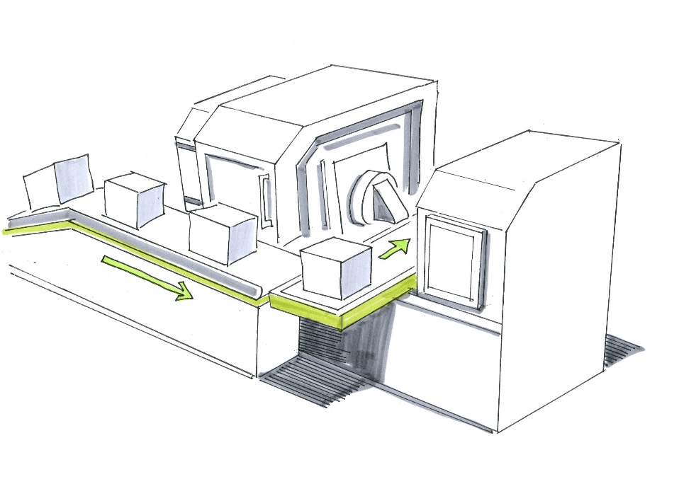
Generation of a preliminary draft design - 2
❶
Tool chucking on a sliding table with
automatic inbound supply of the parts
Advantages:
No lifting and carrying of parts
Work is focused upon setting up and monitoring
Capacity is freed for other tasks/savings in personnel
© Michael Hüter
Disadvantages:
Further increase in technical complexity and correspondingly high costs
Possibly forfeit of flexibility of the system (e.g. complex changeover of chucks etc.)
Larger machine footprint
Possible obstruction in the motional range owing to projection of the table
Notes:
Alternative solutions with explanations on the slide

Slide 20
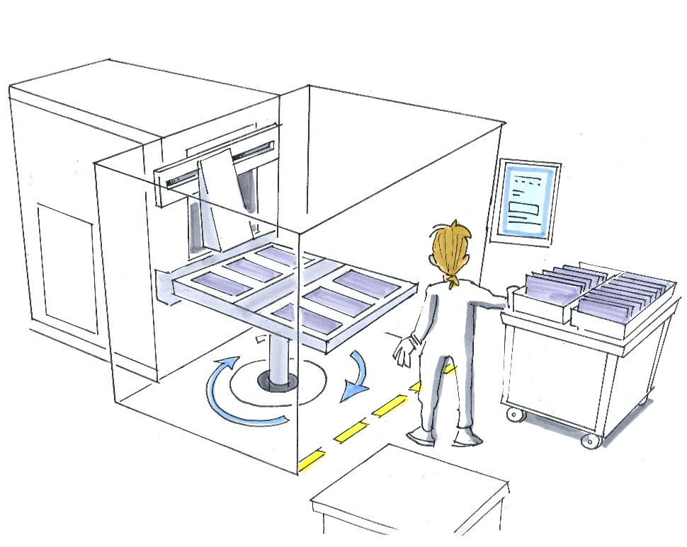
Generation of a preliminary draft design - 3
❶
Tool chucking on a rotary table
Advantages:
Shorter distance between retrieval and deposition points
Somewhat more suitable dimensional adjustment for all percentiles, owing to the possible closer approach to the table
Simultaneous chucking and machining
Lower time pressure upon the employee
© Michael Hüter
Disadvantages:
Greater technical complexity and correspondingly high costs
Larger machine footprint
Design process
to EN 614-1
Notes:
Alternative solutions with explanations on the slide

Slide 21
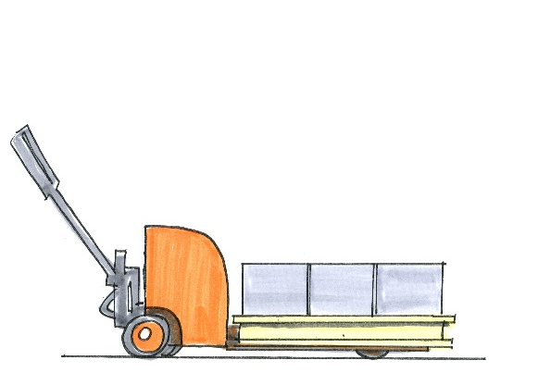
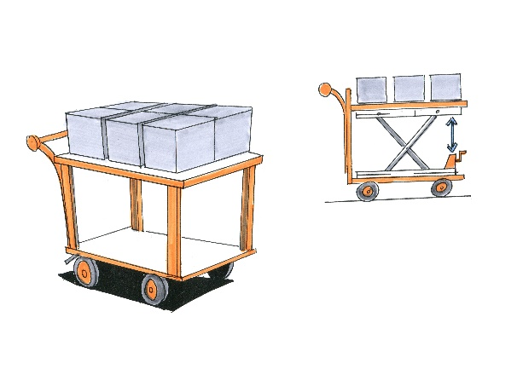
Supplement to preliminary planning- 4
❶
Alternative arrangements for inbound supply Planning of relevant equipment
Design process
to EN 614-1:2006+A1:2009
Einsatz von Transportwagen
Advantage: pushing parts rather than carrying is associated with lower stress; reduction in frequency of stress, since the truck serves as a buffer.
Disadvantage: additional space may be needed to accommodate the truck.
Variant A has a lower centre of gravity, which is advantageous for transport; in Variant B, the height interval to be overcome is lower.
© Michael Hüter
Notes:
In addition to the modifications to the machine, consideration should also be given to inbound supply of the parts themselves. A number of design solutions for trucks are presented, based upon evaluation of the lifting processes and the trolley study.

Slide 22

❶
Specification of the working task and interfaces
Design process to
DIN EN 614-1:2006+A1:2009
Details of supplementary equipment:
Locking of the wheels during lifting and carrying activity
Adjustment of the truck width such that only two rows of casings can be placed on it
If appropriate, height adjustment
Size of the wheels
Handle design
Specification of the maximum number of
casings per truck
Provision of instruction to the users of
the truck
© Michael Hüter
Notes:
The scissor-lift truck is based upon the results of the trolley study (low centre of gravity) and the evaluation of lifting processes (EN 1005-2). Concrete procedures must be defined in relation to the problem. The relevant basic knowledge is taught in Modules 2 to 4.

Slide 23


Evaluation of the usage of the machinery
❶
Selection of the installation with workpiece chucking on rotary table
Reason: this system permits the highest possible productivity, owing to simultaneous chucking and machining, coupled with flexibility. The scissor-lift truck also enables the stress upon workers to be reduced.
© Michael Hüter
Notes:
The result of the revision process is presented. The best option in terms of ergonomics and cost is the rotary table with the facility for simultaneous chucking and dechucking of the casings. The casings are supplied on a scissor-lift truck. The result combines the lowest possible down time and the lowest possible physical strain.

Slide 24
Evaluation of the usage of the machinery
Interview guide for a representative operator population, e.g.:
  „Do complaints arise during the chucking process?
  What is particularly difficult?
  Is use made of adjustment facilities? If not, why not?
  Does callosity occur on the hands?
  Is the truck stable when moving?
  Does the movement of the clamping table obstruct or endanger the workers?
  Has a cost-benefit or cost-utility analysis of the alternatives been produced?
  etc.
Design process to
DIN EN 614-1:2006+A1:2009
Notes:
Further foci of analysis can be sought together with the students if appropriate. Possible approaches would be: assessment by different operator populations; the effect of encapsulation upon the noise exposure; or details such as the implementation of the chucking of the casing. The point can be used for elaboration of the foci in Modules 2 to 4.

Slide 25
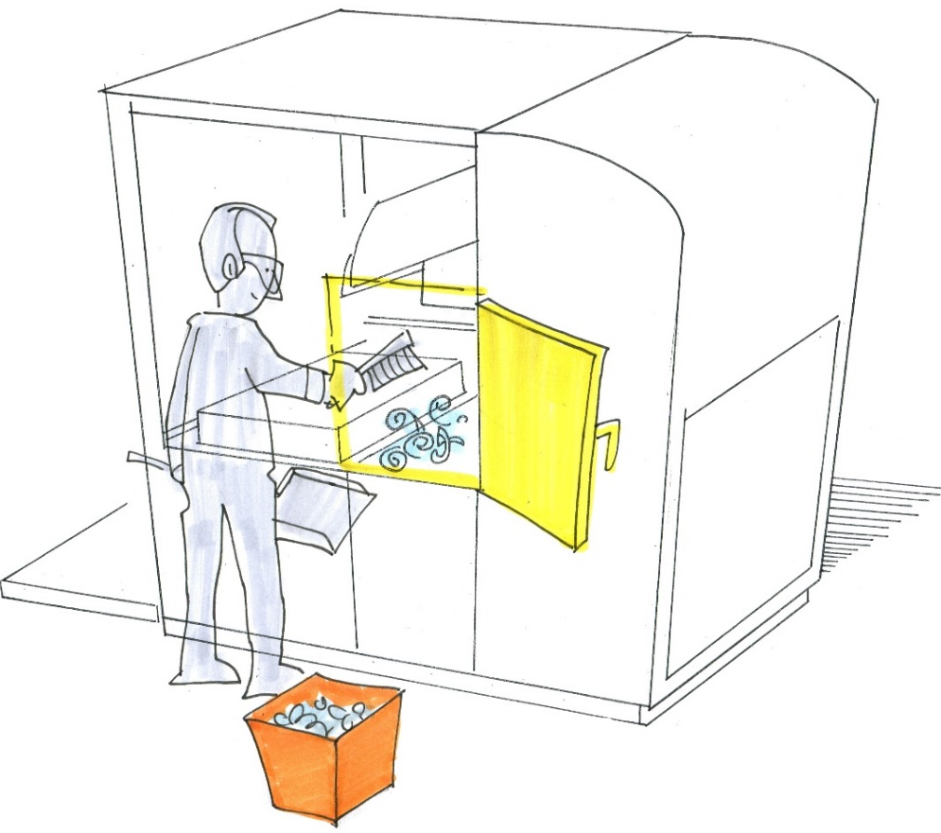
Example: cleaning of the machining chamber
❶
Work task:
The machining process produces long metal chips which must be removed when the parts are changed over. Changing over of the parts occurs approximately 80 times per shift.
Conditions:
The machining chamber has a depth of up to 1.80 m.
The workbench is at a height of 1.10 m.
The trough of the machining chamber is 70 cm above the shop floor.
© Michael Hüter
Notes:
Presentation of the situation at the outset for Example 1. The subsequent procedure is based upon the procedures to EN 614-1 presented in Module 1

Slide 26
Definition of ergonomic criteria
❶
Definition of relevant ergonomic evaluation criteria
  Ease of reach
  Posture
  Avoidance of risk of injury
Gathering of experience with existing machinery
  Gradients for discharge of the chips, hooks for their removal, access to the machining chamber from several sides
Description of the characteristics of the expected operator population
  Skilled worker with appropriate awareness of the problem
Risk assessment
  Low: risk of cutting injuries; stress upon the back and arm muscles caused by static holding tasks
Design process to
DIN EN 614-1:2006+A1:2009
Notes:
Specific procedures must be defined with reference to the issues. The relevant basic knowledge is taught in Modules 2 to 4.

Slide 27
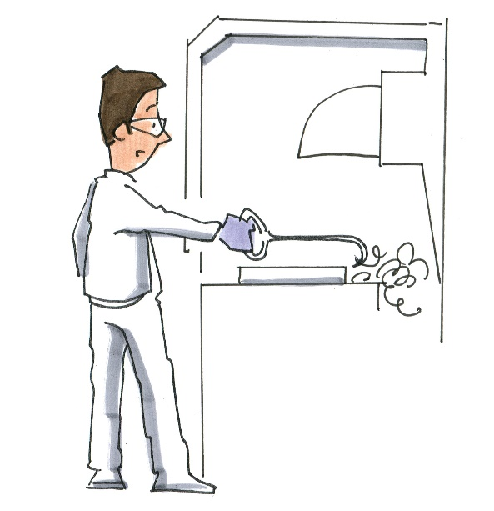
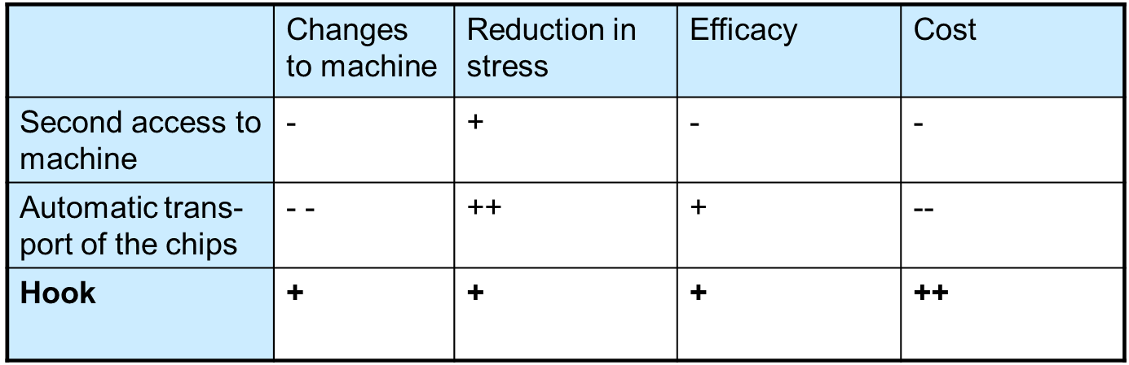
Generation of a preliminary draft design
❶
LPossible solutions:
Access to the machine from the rear
Automatic transport of the chips
Use of a chip hook
Evaluation + selection:
© Michael Hüter
Notes:
Explanation of the evaluation table:
Second means of access: the machine must be fitted with a second door; this increases the costs. In order for the chips to be removed on this side, the worker must walk around the machine, which in the long term he will probably not do.
Automatic chip transport adds considerable cost to the machine, since additional equipment must be selected, developed and adapted. Since long chips frequently become caught, they are only partly recovered by an automatic transport system, thereby necessitating additional manual cleaning tasks.
The chip hook is easy to use and cheap to manufacture. Observation of the work area may present problems; the visual geometry in the machine may therefore have to be checked.

Slide 28
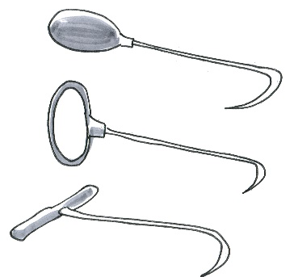
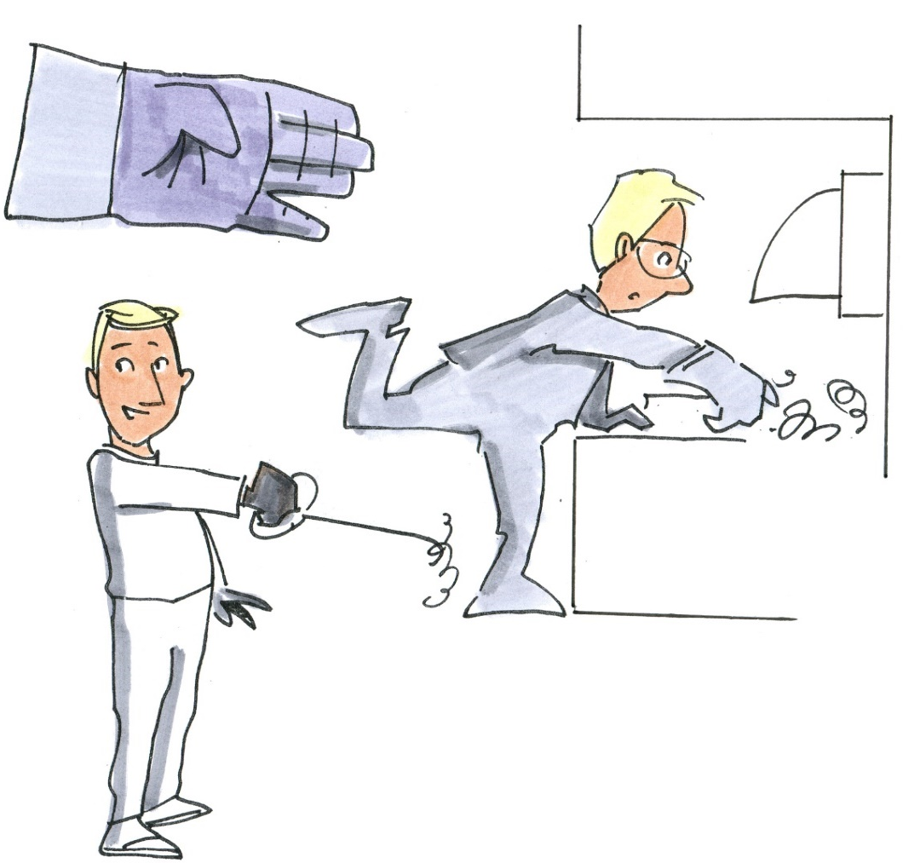
Specification of the working task and interfaces
❶
Specification of chip hook
Handle variants
a)
b)
c)
Selection of handle (b)
Protection for the hands
Variable gripping facility
Holding with positive coupling
Scope for optimization by better
handle geometries, for example by an increase in the handle cross-section
Work with glove
Prevention of risk of injury
© Michael Hüter
Notes:
Specific procedures must be defined with reference to issues. The relevant basic knowledge is taught in Modules 2 to 4.

Slide 29
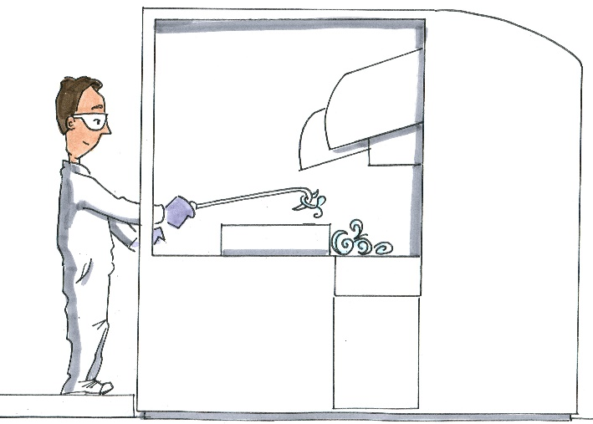
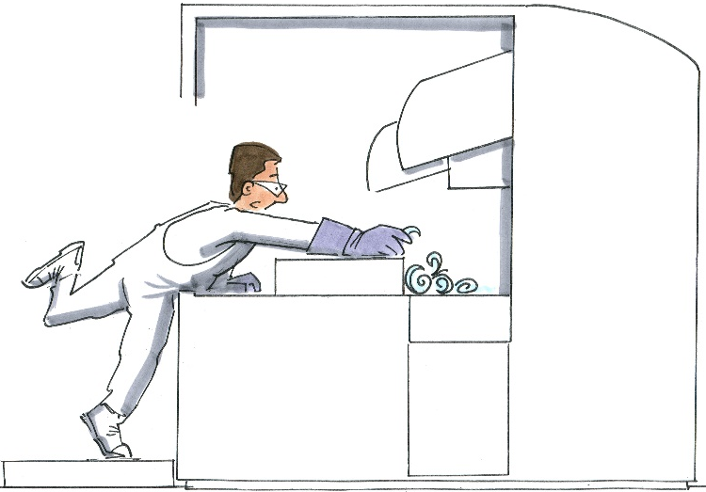
Use in the work system
❶
Visible and accessible without the need to adopt an unfavourable body posture? Access not possible without additional equipment?
Is a platform advantageous?
Does the location of the chip pan give rise to additional stresses and/or hazards?
Is use of the hook (holding task, frequency of use, fatigue, etc.) a source of stress?
Is use of the hook a possible cause of further damage (e.g. catching in the chuck)?
© Michael Hüter
Notes:
Specific procedures must be defined with reference to issues. The relevant basic knowledge is taught in Modules 2 to 4.

Slide 30
IFA – case studies
❶
Case study 1: fettler
Case study 2: distribution warehouse
Case study 3: sewing workplace
All three case studies were provided by DGUV in the context of KAN Study 40. All rights reserved by DGUV.
Notes:
Example clips showing ergonomic design processes, with validation of the results by the IFA.
Fettler (old) clip: this shows the situation at the outset within companies. The students should identify possible ergonomic issues in the clip, discuss them, and make constructive proposals for improvement.
Fettler (new) clip: this shows the improved solution. The presentation validates the results scientifically.
Two optimized workplaces and their effects are described briefly in the distribution warehouse and sewing workplace case studies.

Slide 31
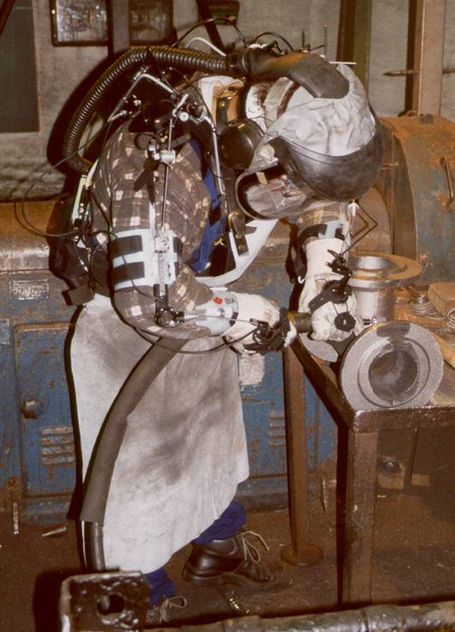
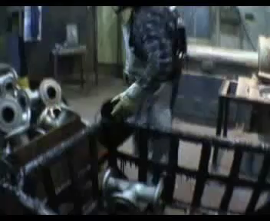
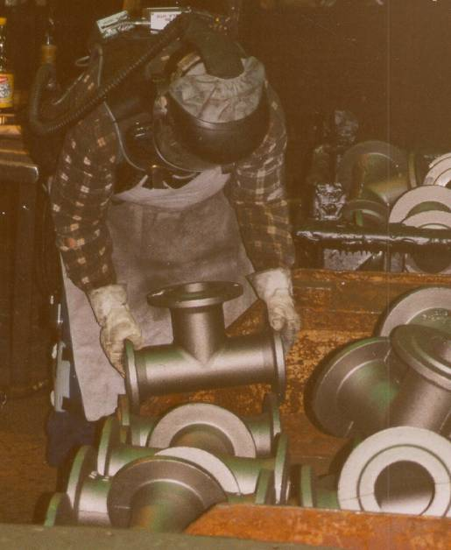
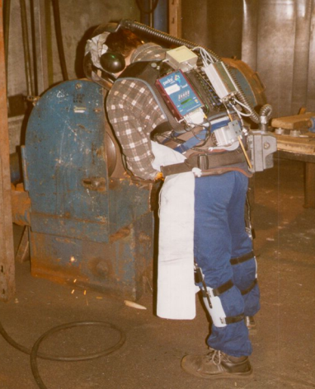
Prevention of musculo-skeletal disorders
Fettler's workplace
Problems:
  Work in a constrained posture
  High component of manual load handling
  Poor lighting at the workplace
To start please click on the video
31
Notes:
To start please click on the video

Slide 32
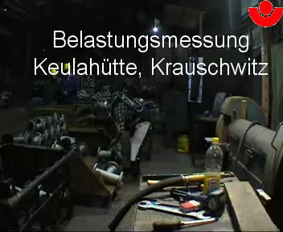
Prevention of musculo-skeletal disorders
Fettler's workplace
Measures:
Reduction of the tasks performed in a constrained posture (for example by adjustment of the height)
Reduction of manual load-handling tasks
Improvement of lighting at the workplace
To start please click on the video
Notes:
To start please click on the video

Slide 33
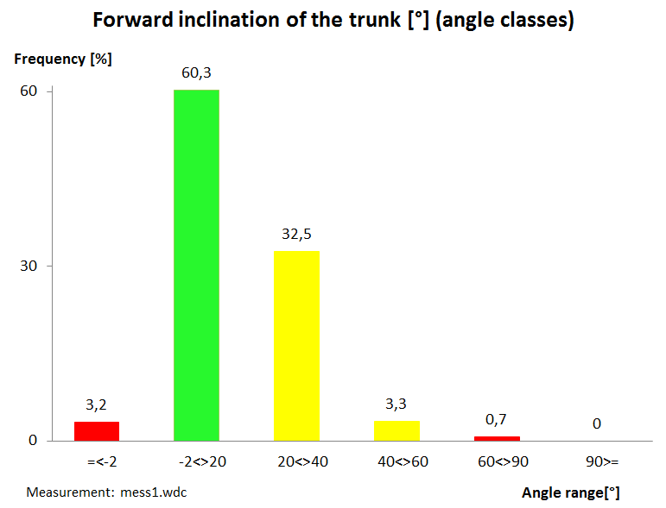
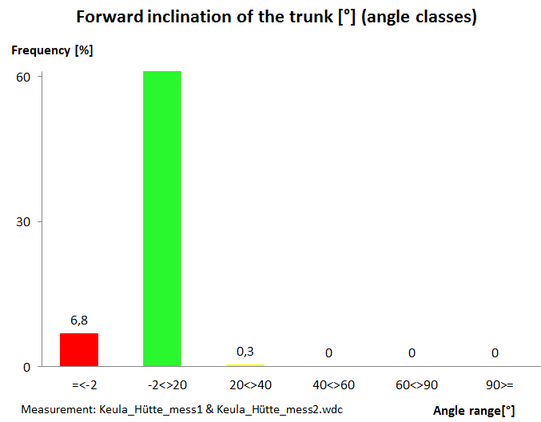



Prevention of musculo-skeletal disorders
Fettler's workplace
Success of the measures:
Before
After
92,2

Slide 34
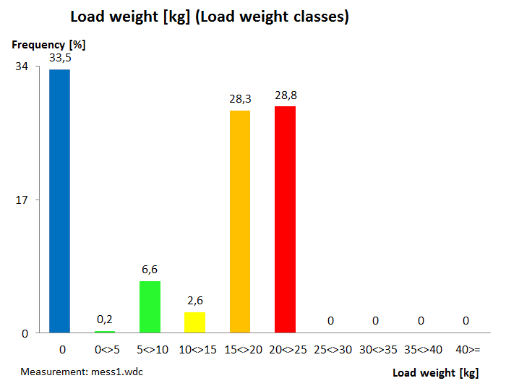
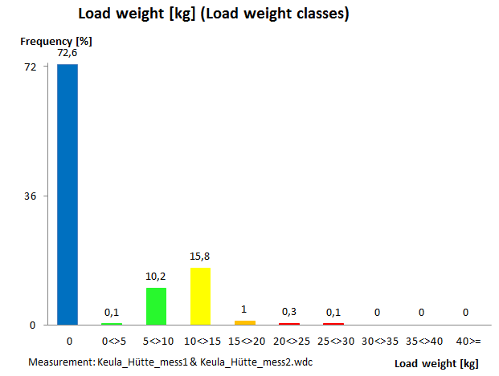

Fettler's workplace
Prevention of musculo-skeletal disorders
Success of the measures:
Before
After
kg
kg

Slide 35
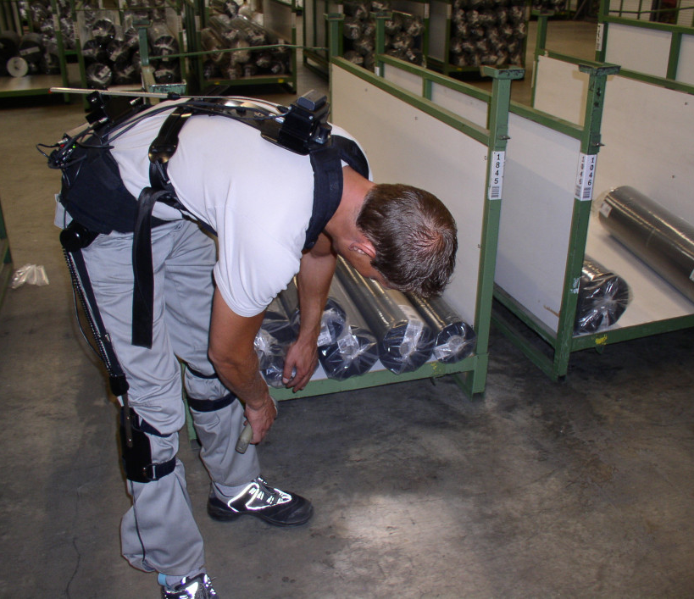
Work in a distribution warehouse
Before:
Unfavourable working heights, resulting in constrained postures during retrieval and scanning of the goods
35

Slide 36
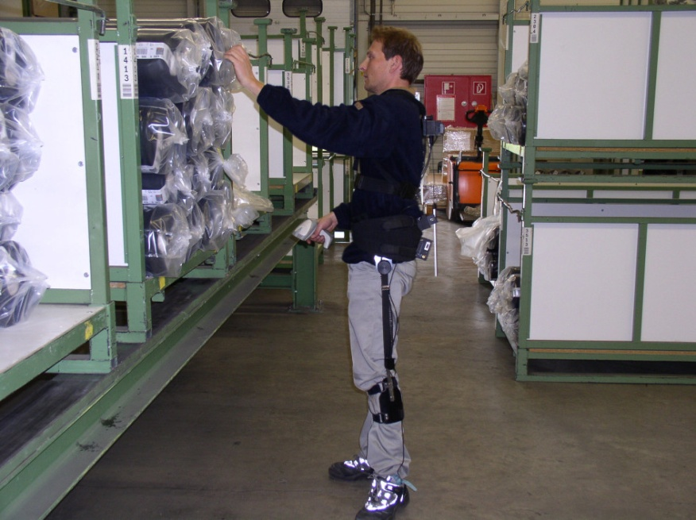
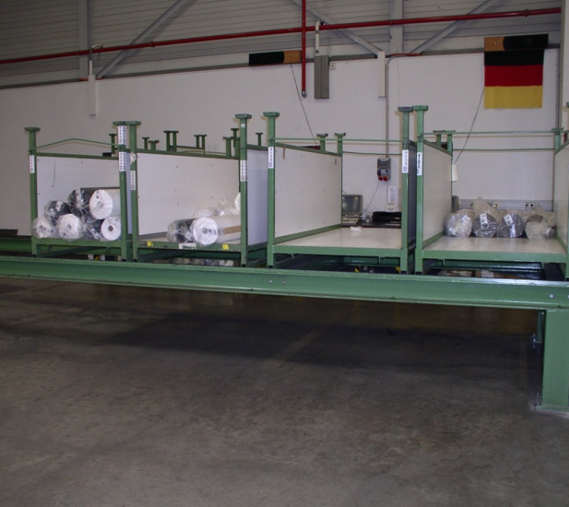
Work in a distribution warehouse
After:
Adjustment of the working heights, resulting in an upright working posture during retrieval and scanning of the goods
36

Slide 37
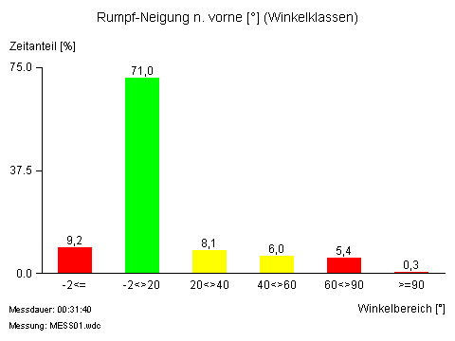
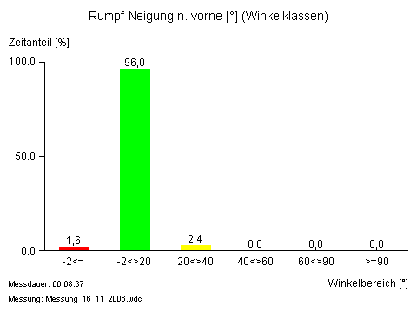
Work in a distribution warehouse: comparison of trunk postures
Postures involving inclination of the trunk
Before installation of the loading stand:
After use of the loading stand:
Forward inclination of the trunk [°] (angle classes)
Forward inclination of the trunk [°] (angle classes)
Time component [%]
Time component [%]
Measurement Duration: 00:31:40
Measurement: MESS01.wdc
Angle range
Measurement Duration: 00:08:37
Measurement: Measurement_16_11_2006.wdc
Angle range
37
Notes:
Reduction of the time spent with a trunk inclination within the range between 20° and 90° from approximately 20% to around 2% of the time.

Slide 38
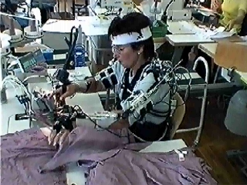
Ergonomic design of sewing workplaces
Problem:
High proportion of musculoskeletal complaints in the sewing industry
Lack of prevention concepts, particularly for ergonomic design
Systematic analysis of stresses at sewing workplaces, and development of ergonomic sewing workplaces
Click on the image to start the clip
38
Notes:
To start please click on the video

Slide 39
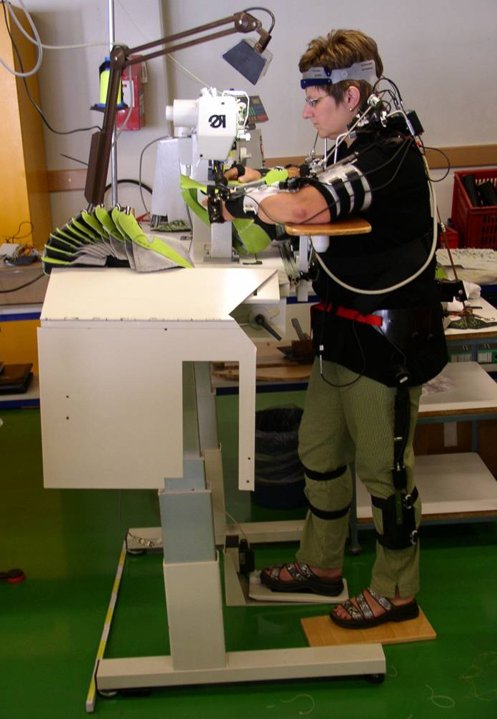
Development of an ergonomic sewing workplace
Properties:
Quick changes possible between seated and standing activity
Wide range of adjustments to the work level
Facilities for individual adjustment of arm rests
Extension of the footroom and legroom
Freely configurable pedal position
39

Slide 40
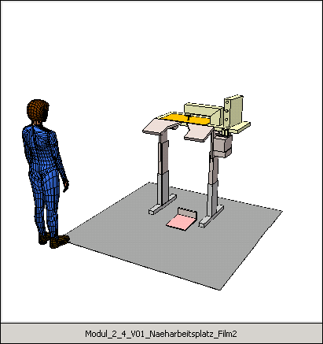
Development of an ergonomic sewing workplace
Consideration for:
Variance in body dimensions within the user population
Ideal field of view and ergonomic areas of reach
Facility for adjustment to different sizes of sewing products and different types of sewing machine

Click on the symbol to start the clip
40
Notes:
Click on the symbol to start the clip.

Slide 41
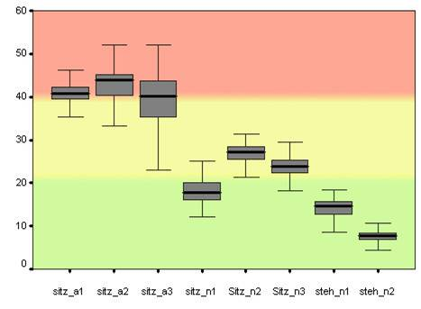
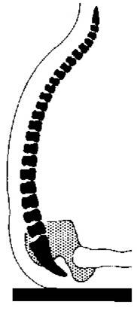
Evaluation of the new workplace in the field
Comparative measurement (old vs. new sewing workplace)
Example: Frequency distributions (box plot over the working shift) of postures with a bent back in the toy industry
Seated
workplaces
(new)
Standing
workplaces
(new)
Back flexion angle [°]
Seated
workplaces (old)
Measurement number
41

Slide 42
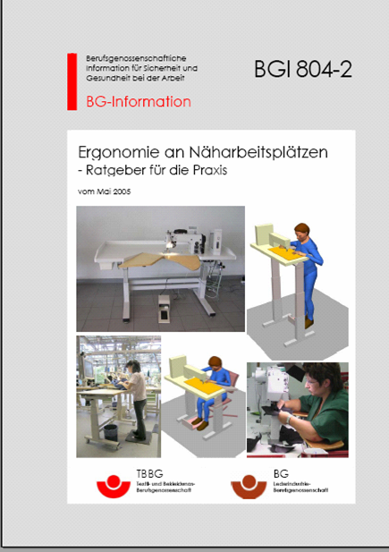
Guidance document for use in the field: BGI 804-2
Explicit information on the design of:
Workplace dimensions
Workplace environmental factors
Aspects of work organization
Also: illustrative approved examples of ergonomic work design
https://www.arbeitssicherheit.de/schriften/dokument/0%3A5004982%2C1/?query=DGUV-Information%20203-023 (in German)
42

Slide 43
❶
Design of work equipment and workplaces
Ergonomic optimization of complete machines, workplaces,
devices, control actuators, displays
  In contrast to target-based optimization, the focus of design lies upon the object as a whole.
  On the one hand, contradictory and mutually interacting targets must be considered.
  On the other hand, these design targets must be ranked.

Slide 44
Work equipment as the focus of the work system
Workpiece
Process interface
Process area
(work side)
Work equipment
Information output and area of activity
(hand side)
Input
Output
Interface between
human being and
work equipment
Natural, technical and social environment
Mensch
Work system
Notes:
The image shows the work system (see beginning of the section). The focus in this case however lies upon the design of the work equipment and its two interfaces, to the human being and to the process.
It must be decided what proportions of the work task are to be assumed by the human being and by the work equipment, and how the interface is to be designed.

Slide 45
Extended product requirements on the part of the end user
❶
Product requirements on the part of the end user
Object-related requirements
Effect-related requirements
Requirements concerning items
Perception requirements
Functional requirements
Aesthetic requirements
Form
Dimension
Surface
Marks
Material
Function principle
Visual
Audio
Haptic
Tactile
Olfactory
Kinaesthetic
Product function
Robustness
Fit
Connections
Storage
Mounting
Safety
Design
Aesthetics
Health
Focus of ergonomics
Notes:
The image shows an overall view of the requirements to be considered in the design process.
In the requirements concerning the effect, the effect is indirect. A machine is for example considered to be particularly safe owing to its visual appearance, although this is not in fact the case. Equally, numerous colour displays may give the impression of a particularly high-quality solution, even though the underlying technology is conventional.

Slide 46
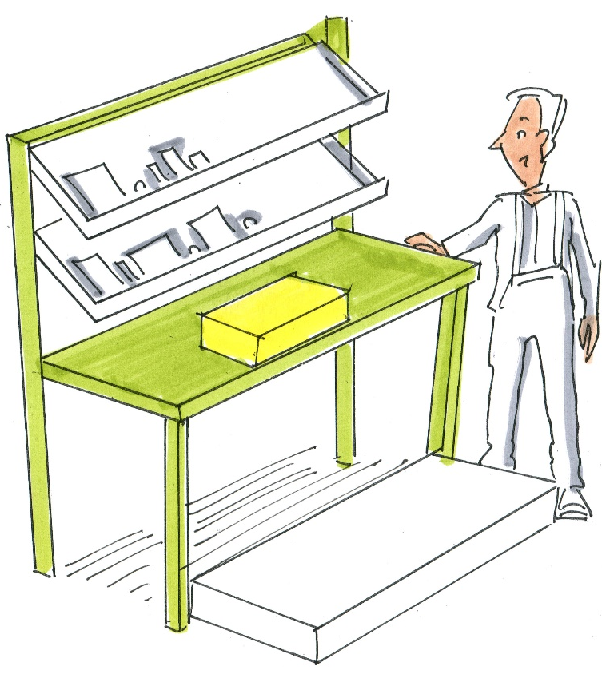


❶
Design task
Selection/design of the tool for bolting the assemblies and the casing cover together. Capacity = 80 casings per day Magnitude:
4 screws per motor
6 screws per cover
© Michael Hüter
Notes:
Presentation of the specific situation

Slide 47
Definition of ergonomic criteria
❶
Selection of framework conditions influencing ergonomic design
Design process to
DIN EN 614-1:2006+A1:2009
Safety
Feedback of result
Feeling, seeing, hearing
Work resistance
Force, torque
Analysis
Frequency
Quantity of movement
Distance, angle
Pace
Form of movement
Static, dynamic
Accuracy
Direction of movement
Linear, rotational
Environmental conditions
Notes:
Possible requirements and the targets derived from them for the design of the screwdriver tool are presented here.

Slide 48
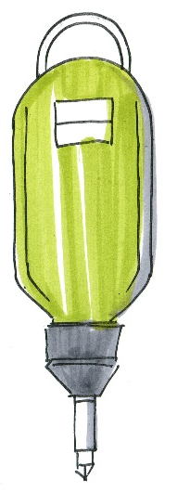
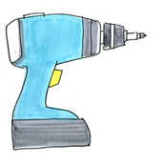
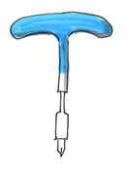
Generation of a preliminary draft design
❶
Design process to
DIN EN 614-1:2006+A1:2009
A
B
C
© Michael Hüter
 | Application of force | Stress upon the hand | Speed | Cost
Pneumatic screwdriver A | + | + | ++ | -
Battery-powered screwdriver B | - | - - | ++ | o
Manual screwdriver C | o | o | - - | ++
Notes:
Explanation of the evaluation table:
Pneumatic screwdriver
With vertical driving, the application of force corresponds to that in the conventional procedure, but does not enable the body weight to be brought to bear; the hand posture is favourable, since the hand and forearm are aligned. The speed is high. So are the investment costs.
Rechargeable battery-powered screwdriver
Owing to the need for the hand to be rotated in order for force to be applied vertically, and the offset of the handle with respect to the direction of work, the application of force is not favourable, and slipping and loss of force are therefore possible. The position of the hand is unfavourable when the tool is applied from above. During driving from the side, the cover/motor must be held in position with the other hand or by means of a jig. The speed is high. The investment costs are lower than for the pneumatic solution.
Manual screwdriver
The manual screwdriver requires constant re-gripping; coupling on the handle is positive, but the axis of force is not optimal. In addition, the hand-arm region is subject to strain owing to the rotational and tightening forces to be applied. The speed is low, particularly owing to the need for re-gripping.
Alternative drive concepts for the most highly rated driver are possible.

Slide 49
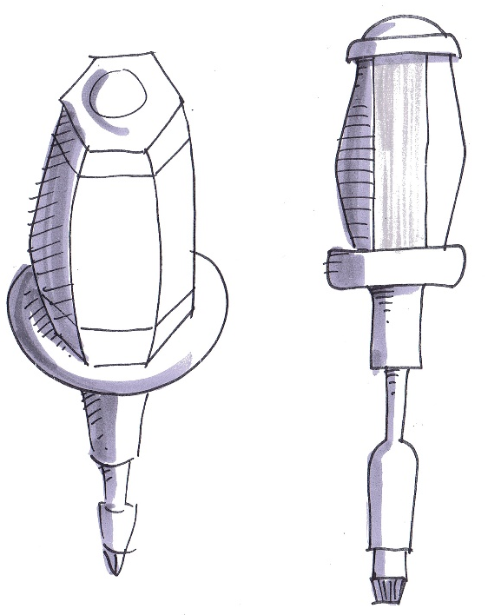


Specification of the working task and interfaces
❶
Diameter of the handle
Convex handle
Design of the surface
Use of non-slip material
Precise adjustment of the balancer
Cable routing
Force limitation
Suitability of the screw head for automated driving
© Michael Hüter
Notes:
For the selected screwdriver tool, design requirements are defined for the hand side (see listing). Of equal importance is the design/selection of the interface as a function of the process. Different coupling variants permit differentiated force transmission (cross-head poor), different mating speeds, etc.
Specific procedures must be defined with reference to issues. The relevant basic knowledge is taught in Modules 2 to 4.

Slide 50
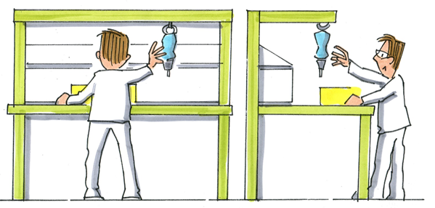
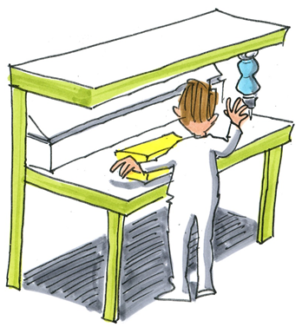
Use
❶
Testing of the design solution
Design process to
DIN EN 614-1:2006+A1:2009
© Michael Hüter
Notes:
Specific procedures must be defined with reference to issues. Key points are design of the area of reach, workplace dimensions and forces.
The relevant basic knowledge is taught in Modules 2 to 4.

Slide 51
Examples
❶
Examples from the Institute for Occupational Safety and Health of the DGUV
The material was provided by DGUV in the context of KAN Study 40. All rights reserved by DGUV.
Case study 4 Structural steelwork/shipbuilding
Case study 5 Ergonomic machine design
Case study 6 Manipulation on machinery
Case study 7 Human-machine interface
Selection of examples from the field for discussion during study
Ergonomics examples
Notes:
A series of further case studies are offered here.
The structural steelwork case study shows very clearly how simple measures can be used for optimization. Reduction of stress by sparks and appropriate body posture.
The second case study shows examples of an ergonomic machine design.
The manipulation of machines is not directly related to the topic. Manipulation particularly occurs when the operating solutions that have been developed are impractical for the user.
Revision – design of the human-machine interface (if required)

Slide 52
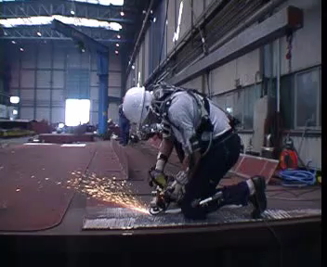
Grinding task in structural steel engineering (shipbuilding)
Before:
Work in constrained postures
Hand-arm vibration
Dust exposure
Uneconomic working
52
Notes:
Manual grinding work on horizontal sheet-steel panels in preparation for welding work has traditionally been an important work process in shipbuilding. Rustproofing of sheet-steel panels prior to welding has considerably increased the proportion of manual grinding work, since the paint coating must be removed again before the welding process. Before now, the worker performed this work in a squatting posture, using an angle grinder (see clip, Slide 1). In order to relieve the spine, he knelt on the cold steel sheet. The grinder was located at arm's length below his face; consequently, he breathed in dust and vapours, besides being exposed to vibration and noise. The aim of improving this working procedure, which was hazardous to health in a number of ways, was to enable an upright posture to be assumed during the grinding work.

Slide 53
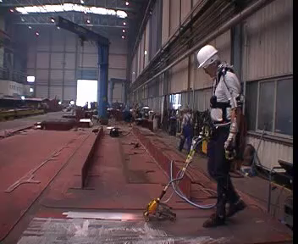
Grinding task in structural steel engineering (shipbuilding)
After: ergonomic redesign of the grinding equipment
Result:
Considerable reduction in the component involving constrained postures
Strong reduction of exposure to hand-arm vibration
Reduction of dust exposure
Doubling of the work efficiency
53
Notes:
For this purpose, the company developed a "turbo belt grinder" based upon a conventional angle grinder (see clip, Slide 2). This enables grinding work to be performed walking in an upright posture, similar to the use of a lawnmower. The guide rod enables the worker to keep precisely to the marked grinding path. The increased distance between the face and the grinding process reduces the inhalation of dust and vapours. The vibration typically caused by the eccentric rotating grinding disk of an angle grinder does not occur with the belt grinder.
The improvement achieved by the use of the ergonomically redesigned "turbo belt grinder" is clear. The company was nevertheless interested in quantifying the reduction in exposure actually attained. For this purpose, measurements were performed by means of the IFA's CUELA measurement system: during performance of the grinding work using the conventional angle grinder, and with the ergonomic "turbo belt grinder". The results of the measurements were evaluated with reference to the Finnish OWAS method.
The results of the posture analysis comparing the two work processes confirmed the elimination of the high time component involving unfavourable body postures in a kneeling position and with inclined trunk. During grinding with the turbo belt grinder, the upright posture without twisting of the trunk predominates.
The OWAS analysis revealed that during work performed with the angle grinder, no need for improvement to the work posture existed for only 9.1% of the working time (OWAS action category 1), whereas the postures assumed for 90.9% of the working time were classified as stressful, harmful or very harmful to the musculoskeletal system (OWAS action categories 2, 3 and 4). For the new grinding method involving the "turbo belt grinder", 93.8 % of the working time was classified as not harmful (OWAS action category 1); only 6.2% of the working time in this case was assigned to OWAS action category 2.

Slide 54
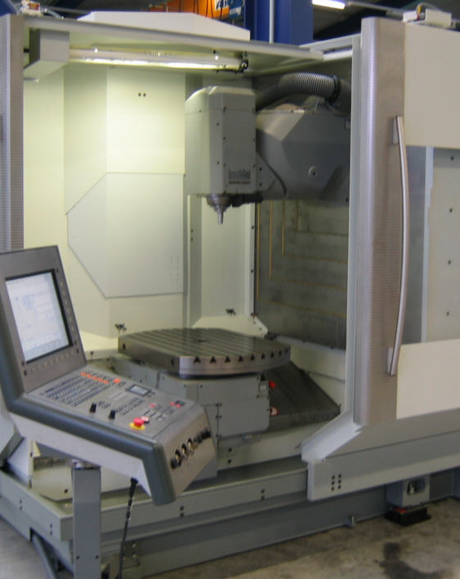
Ergonomic design of machinery
Problem:
60% of occupational accidents on stationary machinery occur during the operation of machines which appear to be serviceable.
One of the reasons for this is poor ergonomic design, leading to:
  More frequent maloperation
  Manipulation of protective devices
Summary of the HVBG-Report (2006):
Report on the manipulation of protective devices on machinery
54

Slide 55
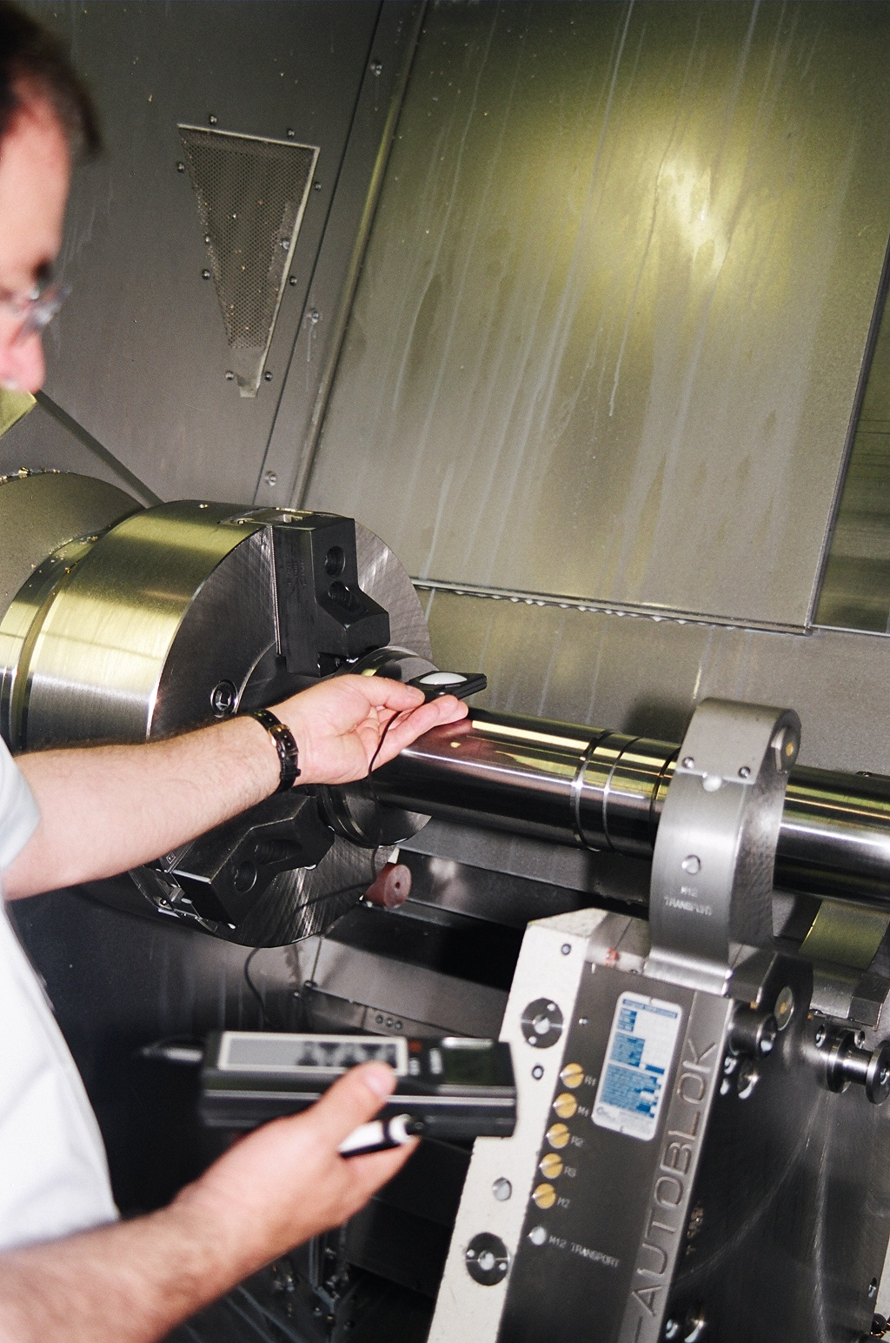

Ergonomic design of machinery
The legal situation:
The 2006/42/EC Machinery Directive requires that attention be paid to
ergonomic aspects:
  "...discomfort, fatigue and physical and psychological stress (...) must be reduced to the minimum possible, taking into account ergonomic principles (...)"
Manufacturers using the CE mark declare, amongst other things, that the ergonomic requirements of the Machinery Directive are satisfied
Hazards presented by the neglecting of ergonomic criteria
(EN ISO 12100 Safety of machinery - General principles for design - Risk assessment and risk reduction)
55

Slide 56
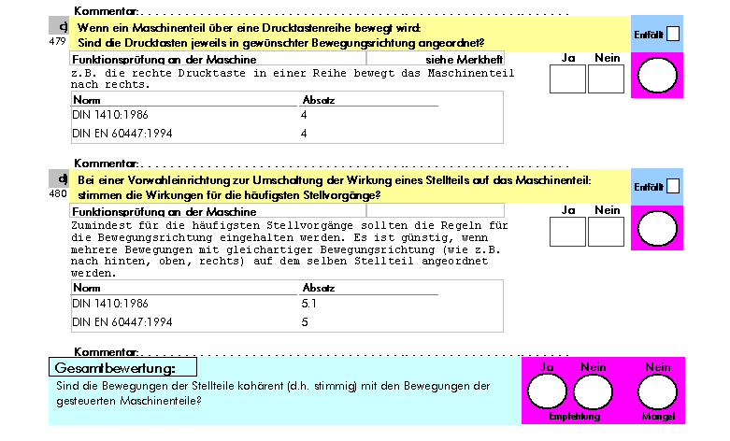

Ergonomic design of machinery
Practical support in the form of the "Ergonomic machine design"
checklist:
Human-machine interface
  Design of control actuators/displays
  Machine visualization
Observance of the manufacturing process
  View of the machining chamber
  Integral lighting on machines
Posture and severity of the work
  Dimensional design of the machine
  Muscular effort during operation
Source: www.dguv.de/ifa:
Ergonomische Maschinengestaltung
DGUV Informationen 209-068/069
56

Slide 57
Ergonomic design of machinery
The more attention is paid to ergonomics during design, the smaller is its proportion in the overall costs.
Consideration from
(stage)
Proportion of design costs
Specification
1–2.5%
Design
1–3%
Manufacture
2–6.5%
Commissioning
4–10.5%
Operation
5–12% and over
Based upon D. Alexander, Auburn Engineers, USA, 1999
57

Slide 58

Ergonomic design of machinery
Conclusion:
Deficits in the design of work equipment lead to costly work-related diseases and occupational accidents.
If timely consideration is given to ergonomic requirements, the associated design costs remain low.
Designers should be familiar with the typical tasks and operating positions on the machine, and also with the work system as a whole.
58

Slide 59

Manipulation of protective devices
Problem:
Manipulation of protective devices, rendering them inoperative, has the result that a machine is used in a manner not intended by its designer, or without the necessary protective measures.
Experts estimate that a quarter of all occupational accidents on stationary machinery are caused by the manipulation of protective devices.
Example of manipulation: actuator of a position switch removed
Module 5 Example: Human-machine interface
59

Slide 60
Manipulation of protective devices
Methodology of the study*
Results of the study*
Empirical analysis of the frequency of manipulation
Empirical analysis of the reasons for documented manipulation
Manipulated
Danger
Tolerated
Number of
protective devices
1/3
1/6
1/9
Summary of the HVBG-Report (2006):
Report on the manipulation of protective devices on machinery
Module 5 Example: Human-machine interface
60

Slide 61
Manipulation of protective devices
Reasons attributable to the design:
60% of the machines studied could not even be operated in all operating modes without manipulation
In 43% of cases, machinery was manipulated in order to speed up the work process
In 30% of cases, protective devices constrained visibility and caused obstruction
5
minutes
60% of manipulations were possible within a maximum of 5 minutes
Module 5 Example: Human-machine interface
61

Slide 62

Manipulation of protective devices
Guidance for designers:
Consultation at an early stage between mechanical and electrical design engineers and suppliers of protective devices
Consideration for all life and operating phases of the machine
Implementation of usability engineering
Use of existing safety solutions
Use of the "Ergonomic machine design"* checklist and the assessment system on incentives to manipulate protective devices**
Sources: *www.dguv.de/ifa: Ergonomische Maschinengestaltung DGUV Informationen 209-068/069
** www.dguv.de/ifa: Incentive to bypass protective devices
Module 5 Example: Human-machine interface
62

Slide 63
"Cognitive ergonomics" on machines
Problem:
Maloperation
Manipulation of the protective devices on machinery
  To speed up the process and facilitate work
  To facilitate observation of the process
  For the performance of certain operating modes
  For the rectification of faults
➔ The occurrence of hazard situations in the work context
Module 5 Example: Human-machine interface
63

Slide 64


Project: manipulation of protective devices on machinery
Manipulated machines:
  Machining centres
  CNC lathes and milling machines
  Presses etc.
Result:
Approximately 33% of protective devices are manipulated some or all of the time
In the opinion of experts, approximately 25% of all occupational accidents can be attributed to the manipulation of protective devices
(HVBG-Report (2006):Summary of the Report on the manipulation of protective devices on machinery)
Module 5 Example: Human-machine interface
64

Slide 65
Solution by:
Observance of cognitive principles
  Suitability for the task
  Self-descriptiveness
  Conformity with user expectations, etc.
Consideration for the context of use
(Source: VDI/VDE 3850 Blatt 1, EN ISO 9241-11
Module 5 Example: Human-machine interface
65

Slide 66
Recommendations
  Development of safety concepts which are "not obstructive" (either ergonomically or economically), such as "intelligent" camera systems
  Consultation at an early stage between machine designers and the suppliers of protective devices
  Reference to the checklist “Ergonomic machine design” (DGUV information 209-068/069) and involvement of end users/machine operators when machinery is purchased
(Source: www.dguv.de/ifa; Checkliste Ergonomische Maschinengestaltung)
Module 5 Example: Human-machine interface
66

Slide 67
Usability
❶
Usability :
"Usability: the extent to which a product can be used by specified users to achieve specified targets with effectiveness, efficiency and satisfaction in a specified context of use"
Based upon EN ISO 9241-11 “Ergonomic requirements for office work with visual display terminals (VDTs) – Part 11: Guidance on usability”
Notes:
A product's usability describes the extent to which it is adapted to the task, the application, the user's expectations and abilities, and the process and the environmental conditions (see www.use-lab.com for definition). This is also referred to as microergonomics; conversely, the scientific study of processes is termed macroergonomics.

Slide 68
Objectives of usability tests
❶
Evaluation of the facility for operation
Identification of weak points/system errors
Comparison of prototypes
Comparison with other systems
Collection of proposals for improvements
Measurement of acceptance
Principles for design style guides

Slide 69

Example problem: usability
❶
Control of a machining centre:
How can the possible movements of the milling head be presented in the control interface in accordance with the requirements for usability?
© Michael Hüter
Notes:
Possible problem: how should the control of a multi-axis milling head in the milling centre example be designed?

Slide 70

Analysis of existing controls: examples
❶
© Michael Hüter

Slide 71


Analysis of existing controls: examples
❶
Selection of typical controls on
milling machines
© Michael Hüter
Notes:
Selected controls typically found in use:
Figure 1 shows a control arrangement with buttons and rotary switches. The geometric data are displayed in numerical form at the bottom of the image.
Figure 2 shows a control system with full keyboard, function keys with variable assignment (content shown on the screen) and the display of geometric data on the display marked xyz.
Figure 3 shows a control arrangement similar to that in Figure 2. in this case however, the screen fitted displays images from the machining process, since a direct view of the machining chamber is not possible.

Slide 72

Analysis of existing controls: examples
❶
© Michael Hüter

Slide 73
Formation of operator populations
❶
Evaluation of the usability is heavily dependent upon the operator population concerned, since operator populations place different requirements upon a user interface.
Examples:
Age: different life experiences with operating concepts
Socialization: differences in modes of thought and action
Nationality: different interpretations of the logic of operation and of colour and symbols
Training: differences in usage and in expectations of performance for tasks of differing scale
Notes:
In addition to the context of use, definition of the target group is also important for the usability design concept.

Slide 74
Usability of control concepts
❶
Selection of measures:
  Analysis of work tasks and specific requirements concerning the control system
  Are complete programs developed on the control system?
  How high is the effort required for teaching-in? Does a complete optimization exist?
  Are only minor corrections made to cutting values?
  Is the task reduced to changing of the tools and launching of the program routine?
  Survey of workers (machine operation)
  Evaluation of the work results (quantity, time, quality, error rate)
  Observation
  Market survey and product catalogues
Notes:
Possibilities are stated for the analysis of different control concepts.

Slide 75


Design
❶
© Michael Hüter
Development of a concept with the involvement of future users
Notes:
In the example, the representation of the complicated milling arm is imported in image form into the control system, and the respective axes are stated. The operating console features suitable rotary switches and joysticks by means of which multidimensional adjustment is possible.

Slide 76



Test of the control system
❶
Analysis concept:
Age: different life experiences with operating concepts
Socialization: differences in modes of thought and action
Nationality: different interpretations of the logic of operation and of colour and symbols
Training: differences in usage and in
expectations of performance for tasks
of differing scale
© Michael Hüter
Notes:
In addition to the context of use, definition of the target group is also important for the usability design concept.

Slide 77
Summary
❶
Ergonomics entails the design of:
  Products and product details
  Workplaces and complex work systems
  on the basis of criteria which are determined by human performance criteria.
No ideal design exists which caters equally well to all potential users and all conceivable uses of a product.
The basis for ergonomic design is always:
  Precise analysis of the work task
  Definition of the operator population with its particular performance criteria
  Definition of the division of labour and the interface between the human being and the machine
In general and depending on the situation, evaluation criteria should be developed, which ensure the ergonomic quality.

Slide 78
Impressum
Autor: Prof. Dr.-Ing. Torsten Merkel
Westsächsische Hochschule Zwickau
Professur Arbeitswissenschaft
Torsten.Merkel@fh-zwickau.de
initiiert und finanziert durch
Kommission Arbeitsschutz und Normung (KAN)
Alte Heerstraße 111
53757 Sankt Augustin
www.kan.de/en
http://ergonomie.kan-praxis.de/en

