Slide 1
Introduction to ergonomics
Module 1 – Learning ergonomics.
Notes:
The tuition modules have been developed independently of each other, and can therefore be used independently.
Module 1 should however be regarded as an essential introduction to ergonomics, whereas Module 5 repeats and applies the content of Modules 2 to 4.

Slide 2
Definition of the term "ergonomics" Ergonomie
Ergonomics is the science of human beings and technology. It encompasses the design of products, product details, workplaces and complex work systems against criteria which are determined by human characteristics and performance conditions.
Ergonomics: "Scientific discipline concerned with the understanding of interactions among human and other elements of a system, and the profession that applies theory, principles, data and methods to design in order to optimize human well-being and overall system performance".
Original definition of "ergonomics" in EN 614-1 (identical to the definition in EN ISO 6385)
Notes:
Simplified definition based upon EN 614-1 “Safety of machinery - Ergonomic design principles - Part 1: Terminology and general principles“ for adaptation of the technology to human performance conditions. Ergonomics must always be viewed as a complex design problem, since improvements at one point may result in drawbacks at another.
Example: in order to reduce the weight and size of a mobile control unit, multiple functions are assigned to buttons, or must be called up through menu structures with the aid of a display. The resulting control unit is smaller and lighter, but the speed and reliability with which it can be operated are reduced.
Animated inserted:
Original definition of "ergonomics" in EN 614-1 (identical to the definition in EN ISO 6385 "Ergonomic principles in the design of work systems"):
Ergonomics: "Scientific discipline concerned with the understanding of interactions among human and other elements of a system, and the profession that applies theory, principles, data and methods to design in order to optimize human well-being and overall system performance".

Slide 3
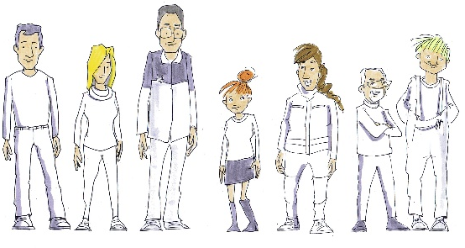
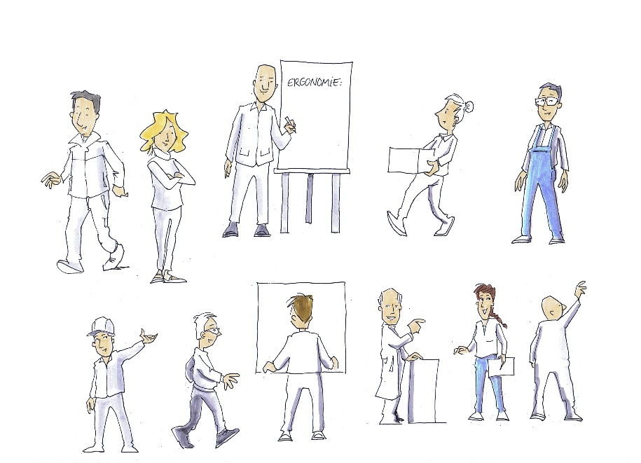


Performance conditions
Performance conditions are determined by the physiological and mental conditions of the person performing a task.
Owing to the breadth of human performance conditions, consideration must be given to the constraints and minimum conditions of the operator population concerned.
© Michael Hüter
Notes:
Everyone is different. Besides age, sex, physical size, etc., training, education and the specific situation, such as the time of the day, personal relationships, etc. also have an impact upon the performance conditions. (More information is provided in the stress/strain model.)

Slide 4
Stress/strain model
Stress
Strain
Effect modifiers
Feedback
Short-term effects
Impairment Improvement
Long-term effects
Impairment Improvement
To the BAuA's advanced model
Individual human being
Based upon Rohmert, 1984 EN ISO 26800
Notes:
The ergonomic stress/strain model is a fundamental concept explaining the effect of work upon the human being.
It begins with the concept of stress.
Stress encompasses the requirements deriving from the work. The work task and the scope of the work, the impacts of the technology, for example as a result of one-sided stress, the working environment, for example owing to noise, and the work organization, with issues concerning the start of work, its duration, etc., have an impact upon the worker. Note: the stress for a given work task is the same for all workers concerned.
The worker counters the stress with his or her personal performance.
The performance is what each worker is able to present to the stress, which may be predominantly physical or mental. This may for example be the maximum force, concentration, or series of motor movements stable over the long term.
The impact of the stress upon the worker differs widely, depending upon their performance. Whereas one person may be completely incapable of performing a certain task or may tire very quickly, another may be able to perform the task for substantially longer, possibly for the full duration of the shift. Different persons may therefore also differ in their suitability for a certain task. This can be influenced by selection of personnel or by training.
Consequences of strain are effects which are triggered by the strain. These consequences may be positive, such as the effects of familiarization and training, leading to increases in performance. Negative consequences are however also possible, such as loss of performance owing to demotivation, health disorders, or permanent injury as a result of excessive work stress.

Slide 5
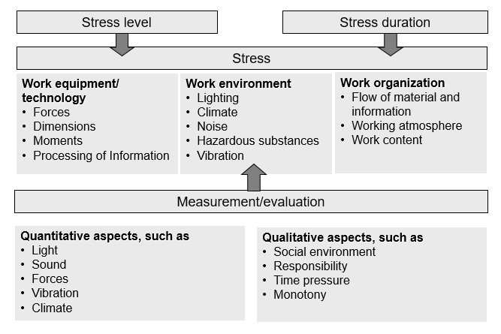
Stress types and analysis
Notes:
The stress is characterized essentially by its intensity (level) and duration. For a task to be assessed, suitable measurement systems must therefore be defined which assure the most objective assessment possible of the stress.
For this reason, indirect indicators are frequently used for forms of stress that can be measured qualitatively. Such indicators are for example the number of units attained within a specific period; the nature of performance of the work (intensity and efficacy); or the electrical conductivity of the skin, weight loss, heart rate (these are indicators of the strain rather than of the stress), etc.

Slide 6
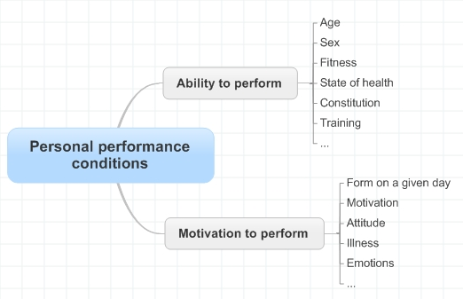
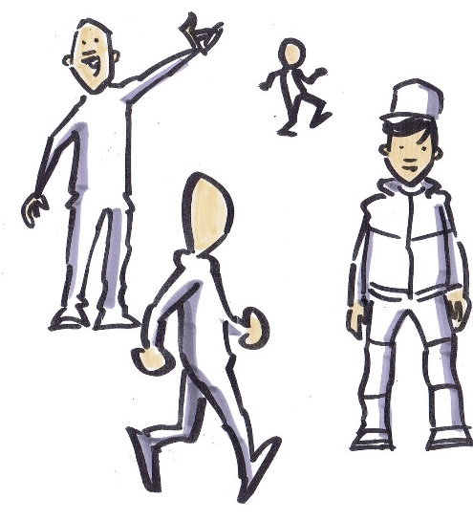
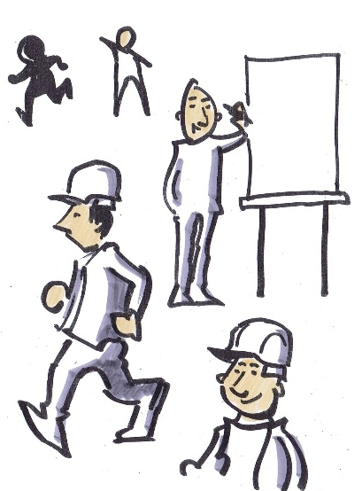
Personal performance conditions
Body dimensions
Posture
Body movement
Physical strength
Mental abilities
© Michael Hüter
Notes:
Overview of a selection of individual performance conditions. The division can be continued in seminars if the content is to be addressed in greater depth.
On the right-hand side, the factors are listed to which the designer can refer specifically for his task.

Slide 7
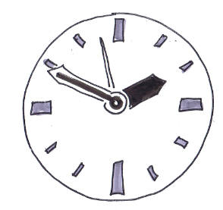
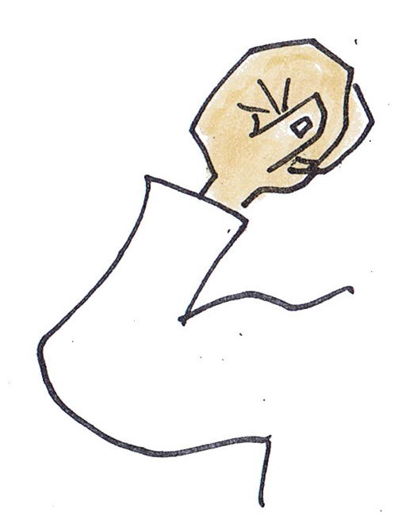
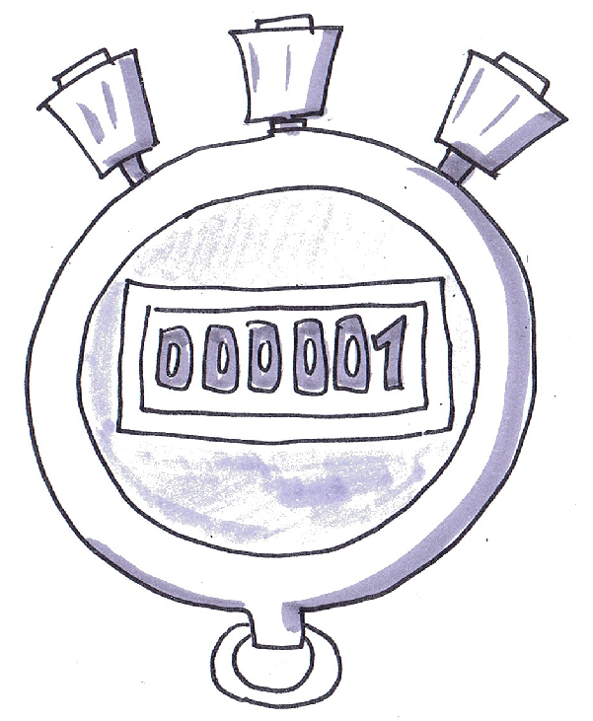

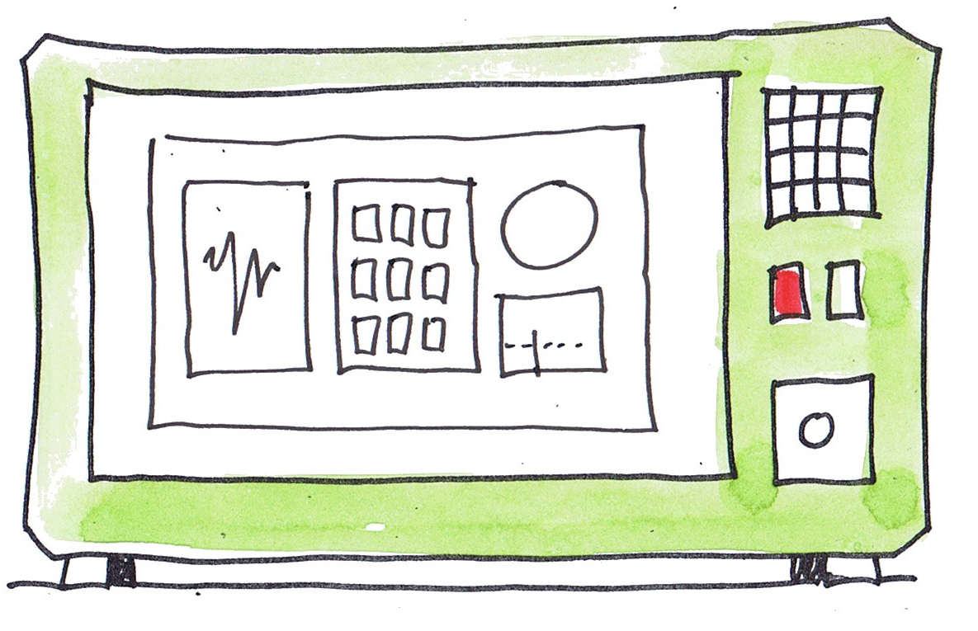
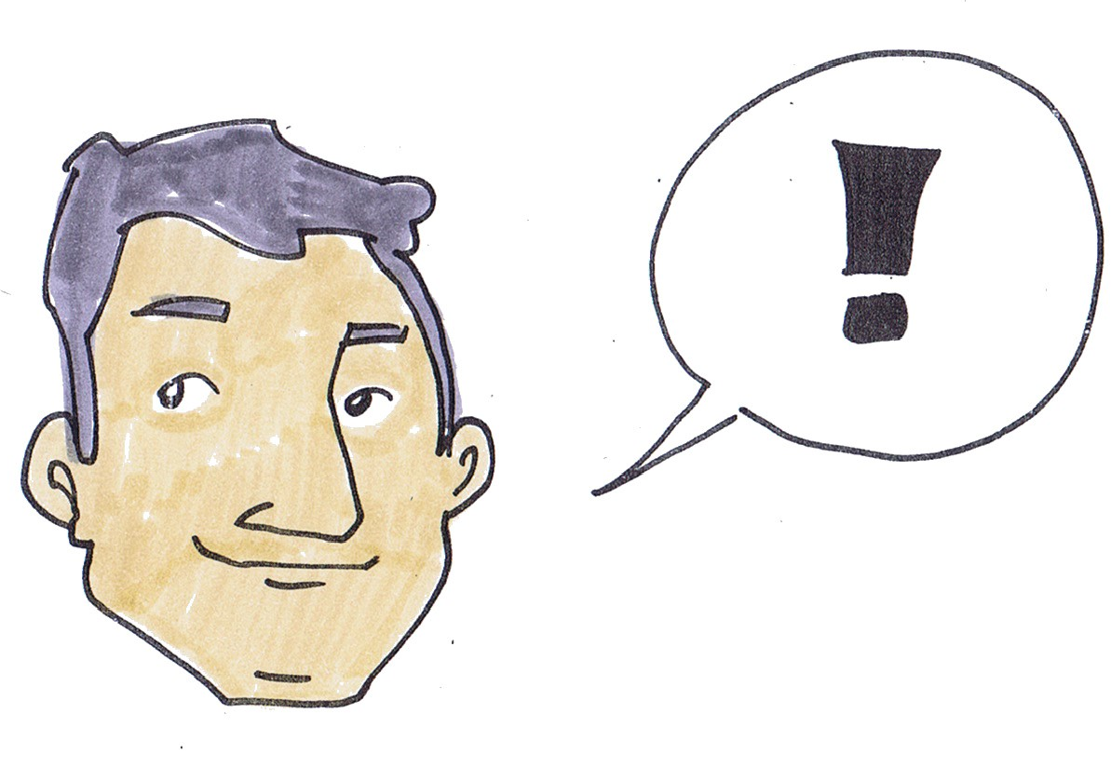


Strain
Pace of work
Fluid loss
Cardiovascular system
Muscular strain
As a function of the performance conditions, the stress leads to a person-specific strain
Fatigue
Power of concentration
Reaction speed
Attention
© Michael Hüter
Notes:
The images symbolize the heart-rate characteristics, muscles and concentration
As a function of the performance conditions, the stress leads to a person-specific strain
(The issue here is not the performance conditions as such, but the influence – i.e. the stress – upon these conditions, which gives rise to a positive or negative strain).

Slide 8
Long-term consequences of strain
State of training
Increase in performance
Increase in knowledge
Development of abilities and skills
Loss of performance
Illness
Incapacity for work
Demotivation
Fatigue
+
-

Slide 9
Ergonomics as a design function
Manufacturer
Employer
Product
Ergonomics
Work process
Manufacturers of products have an obligation to take ergonomic findings into account.
For the use of products, employers are obliged to assure appropriate ergonomic conditions of use.
Beyond the statutory mandate, however, ergonomic working conditions also promote the enhancement and retention of performance in the work process.
Notes:
Standards are regarded as validated ergonomic findings and should therefore be given appropriate attention, or have an indirect binding effect.
This includes aspects of the avoidance of harm to health and the improving of efficiency.
Complete Titles:
DIN EN 614-1 Safety of machinery - Ergonomic design principles - Part 1: Terminology and general principles
DIN EN 614-2 Safety of machinery - Ergonomic design principles - Part 2: Interactions between the design of machinery and work tasks
DIN EN 894-3 Safety of machinery - Ergonomics requirements for the design of displays and control actuators - Part 3: Control actuators
DIN EN 1005-1 Safety of machinery - Human physical performance - Part 1: Terms and definitions
DIN EN 1005-2 Safety of machinery - Human physical performance - Part 2: Manual handling of machinery and component parts of machinery
Reference to standards animated

Slide 10
Standards assist in the fulfilment of these requirements, for example:
EN 614-1: Safety of machinery - Ergonomic design principles
EN 894-3: Safety of machinery - Ergonomics requirements for the design of displays and control actuators
EN ISO 6385: Ergonomic principles in the design of work systems
EN 1005-1: Safety of machinery - Human physical performance
Facilities for searching for ergonomics standards at KAN-Praxis – NoRA: Searching for standards (Ergo Nora).
Notes:
Standards are regarded as validated ergonomic findings and should therefore be given appropriate attention, or have an indirect binding effect.
This includes aspects of the avoidance of harm to health and the improving of efficiency.
Complete Titles:
DIN EN 614-1 Safety of machinery - Ergonomic design principles - Part 1: Terminology and general principles
DIN EN 614-2 Safety of machinery - Ergonomic design principles - Part 2: Interactions between the design of machinery and work tasks
DIN EN 894-3 Safety of machinery - Ergonomics requirements for the design of displays and control actuators - Part 3: Control actuators
DIN EN 1005-1 Safety of machinery - Human physical performance - Part 1: Terms and definitions
DIN EN 1005-2 Safety of machinery - Human physical performance - Part 2: Manual handling of machinery and component parts of machinery
Reference to standards animated

Slide 11
Ergonomics as a marketing argument
Ergonomie wird von zahlreichen Unternehmen als Faktor zur Kundenwerbung eingesetzt.
Überzeugen Sie sich selbst durch die Suche im Internet nach:
Ergonomics & products
Notes:
Ergonomics is most effective as a marketing argument when the purchasers and end users are one and the same

Slide 12
Prospective and corrective design
Ergonomic design requirements and customers' wishes are taken into account at the beginning of a development process.
Should attention not be paid to ergonomic findings and customer requirements, problems may arise during the utilization process.
Prospective and customer-oriented ergonomics
Corrective ergonomics
The realization of ergonomic and customer requirements during the design process
Retrospective correction of ergonomic problems; resource-intensive and frequently of limited efficacy
Notes:
If ergonomics is considered from the outset of planning of a new development, potential errors in development can be avoided which would lead to either incalculable secondary costs or above-average stresses upon the workers. This is one reason for the development of these tuition materials. Respecting of the ergonomic benchmarks set out in the standards avoids such negative consequences for companies and users.
Standards are part of prospective ergonomics.

Slide 13
Ergonomic design of machinery
Consideration for ergonomic aspects at different stages during design has an influence upon the costs:
Consideration from (stage)
Proportion of design costs
Specification
1– 2.5 %
Design
1 – 3 %
Manufacture
2 – 6.5 %
Commissioning
4 – 10.5 %
Operation
5 – 12 and over %
Based upon D. Alexander, Auburn Engineers, USA, 1999

Slide 14
Design process
Planning and clarification of the task
Development of design requirements
Ergonomic criteria
❶
Conceptual design
Preparation of design outlines
Outlines of work tasks and interfaces
❷
Outline design
Preparation of detailed design
Specification of work tasks and interfaces
❸
Detaileddesign
Implementation of the design
Evaluation of the usage of the machinery
Solution
❹
Design methodology to
VDI 2222 Blatt 1 „Methodisches Entwickeln von Lösungsprinzipien“ (simplified)
Design process in accordance with EN 614-1
In consideration of ergonomic principles
Notes:
On the left-hand side, the methodology to VDI 2222 Blatt 1 „ Konstruktionsmethodik - Methodisches Entwickeln von Lösungsprinzipien“, employed in many cases for development processes, is shown.
The elements on the right with blue background show the procedure for ergonomic design to EN 614 -1 Safety of machinery - Ergonomic design principles - Part 1: Terminology and general principles .
This shows that integration of ergonomic design requirements into the development process is possible and does not present difficulties.
Note: the issue of ergonomics must be considered over the entire product life-cycle. This also includes maintenance, repair and recycling/disposal. See also EN 60300-1 Dependability management - Part 1: Dependability management systems (IEC 60300-1) and EN 60300-2 et seqq.

Slide 15
Definition of ergonomic criteria
Ergonomic criteria
Specification of relevant ergonomic requirement and evaluation criteria based on general ergonomics principles and on prior risk assessment carried out in accordance with EN ISO 12100
Requirements deriving from the work process and task
Gathering of experience with existing machinery
Description of the characteristics of the expected operator population
Risk assessment
❶
Notes:
Specific procedures must be defined with reference to tasks. The relevant basic knowledge is taught in Modules 2 to 4.
Reference to risk assessment:
EN ISO 12100 Safety of machinery - General principles for design - Risk assessment and risk reduction
ISO /TR 14121-2 Safety of machinery - Risk assessment - Part 2: Practical guidance and examples of methods
Points a) to d) include a hazard analysis which must precede the risk assessment.

Slide 16
Generation of a preliminary draft design
Outlines of work tasks and interfaces
Allocation of the functions and tasks to the operators and the machinery
Description of the tasks and activities to be performed by the operators
Proposal of the outline(s) of the interface
Evaluation of operator-machine interface against the established criteria
❷
Notes:
Specific procedures must be defined with reference to tasks. The relevant basic knowledge is taught in Modules 2 to 4.

Slide 17
Specification of the working task and interfaces
Specification of work tasks and interfaces
❸
Evaluation of the operator-machine interface in detail using relevant ergonomics standards and task simulation if needed
Determination and implementation of the necessary corrections to the interface
Production of the design documentation
Notes:
Specific procedures must be defined with reference to tasks. The relevant basic knowledge is taught in Modules 2 to 4.

Slide 18
Evaluation of the usage of the machinery
Evaluation of the usage of the machinery
Performing trials with operators (test personnel)
Determination and implementation of the necessary modifications
Gathering feedback from the actual use of the machinery
Specification of the instructions for use and level of qualification of the operator personnel
❹
Notes:
Specific procedures must be defined with reference to tasks. The relevant basic knowledge is taught in Modules 2 to 4.
The prototype was produced between Steps 3 and 4.

Slide 19
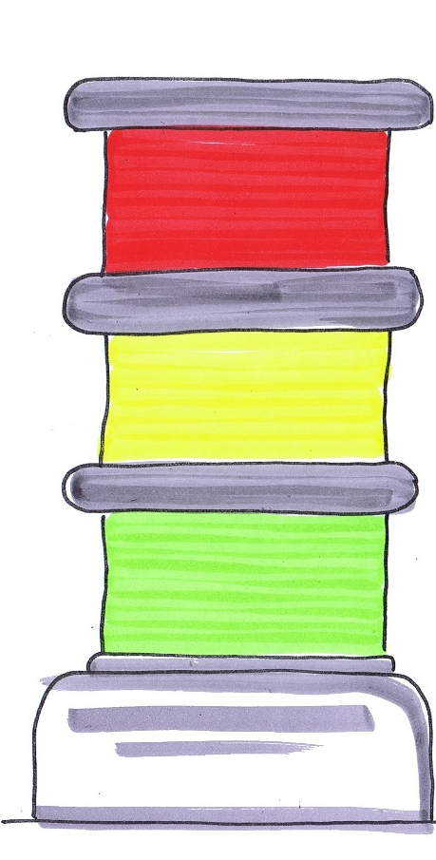
3-zone rating system
The 3-zone model represents a structured procedure for risk minimization in design.
Zone 1 (green zone)
Safe design
Safe operation
Ergonomic principles fulfilled for:
Tasks of frequent use
Tasks of longer duration
Working with comfort (well-being)
Design process to EN 614-1
© Michael Hüter
Notes:
Within an in-house discussion process, the 3-zone model constitutes a simple means of presenting the status of the ergonomic design quality and of identifying the specific need for action.
Note: explain the three-zone "traffic-light" model only in general terms; indicate that separate assessments must be performed for each hazard factor, e.g. physical strengths.

Slide 20


3-zone rating system – (cont.)
Zone 2 (yellow zone)
Ergonomic principles fulfilled for tasks of:
Temporary use
Short duration
Zone 3 (red zone)
Ergonomic principles not fulfilled
Existing Conditions can lead to unsafe operation

Slide 21
Use of ergonomic design
Selection of examples for the use of ergonomic design
Example 1: palletization of containers
Example 2: assembly of emergency lights
Example 3: "iceberg" – the costs of inadequate ergonomics
Example 4: ergonomic workplace design (sewing workplaces)
Example 5: ergonomic machine design – complex example
Notes:
The links show three examples which are intended to illustrate the benefits of ergonomic machine design. The focus lies upon both economic and human factors.
Extend the links with examples of your own in order to address your audience directly: for example, relating to the vehicle for vehicle designers, or to machine tools for machinery manufacturers.
Example 5 represents an alternative for design improvements in the complex example. This forms the basis of Module 5, where it is taken up again. Opportunity for recap between the introduction and application of the taught content.

Slide 22
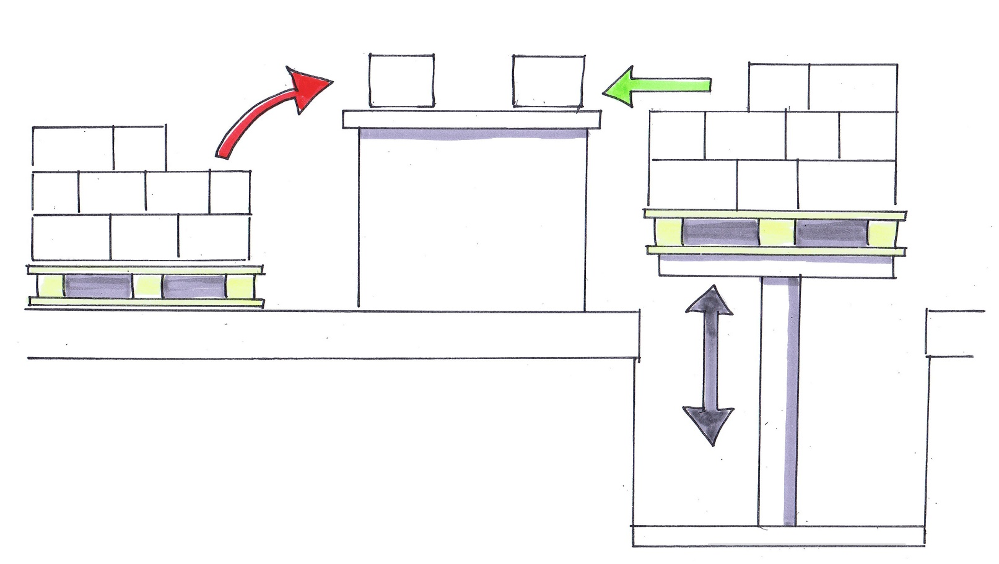
Example 1: palletization of containers
Before
After
© Michael Hüter
Notes:
Creation of a virtually constant stack height for containers by the use of a lowerable lifting platform:
As a result, improved posture and reduction in time requirement from 1.93 to 0.88 hours per 100 containers (since lifting and bending are no longer required), and reduction in force requirement

Slide 23
Example 1: palletization of containers
 | Before | After | Savings
Time required for 100 containers, in hours | 1.93 hours | 0.88 hours | 1.05 hours
Costs for 100 containers, in € | €20 | €9 | €11
Cost of lifting platform: €15,000
Lifting platform has paid for itself after one year
Notes:
If an investment of €15,000 is assumed for the lifting platform, it has paid for itself after approximately one year when in use over the whole day (1,600 hours/year) or after up to three years when used for part of the time.

Slide 24
Example 2: assembly of emergency lights
Before:
The emergency lights are assembled on long benches in batches of 60. On one side of the bench, two persons assemble the lights part by part on the baseplate, which is laid out beforehand.
Problems:
Assembly required too much time
Unfavourable postures during the lifting of parts bins
Twisting of the body during assembly, owing to location of the product on the
bench
Fixed bench height
Inadequate work surface areas
All work performed standing and walking
From: Schultetus, W: Nutzung und Nutzen arbeitswissenschaftlicher Methoden in der Praxis; In: Arbeitswissenschaft – von der Theorie zur Praxis, Wirtschaftsverlag Bachem, Cologne, 2006

Slide 25
Example 2: assembly of emergency lights
Solution:
Assembly line with three workplaces, two of which are parallel to each other
Assembly seated
Third workplace for final assembly and packaging in a standing position
Timing of the work procedures matched for all three workplaces
Employees rotated every two hours
Individual parts and tools are within easy reach
Small, inclined bins
Jig at workplaces enables the product to be rotated/inclined
Modifications to workplace lighting

Slide 26
Example 2: assembly of emergency lights
After:
Reduction of the job throughput time
Savings in floor space
Improvements to posture
Alternate working in standing and seated positions
 | Before | After | Improvement by
Productivity (products per person per day) | 93,3 | 134,7 | +44,0%
Job throughput times (minutes) | 155 | 72 | -53,5%
Value-adding activities as a percentage of the entire working time | 74 | 92 | +24,0%
Working area (m²) | 80,5 | 45 | -44,0%

Slide 27
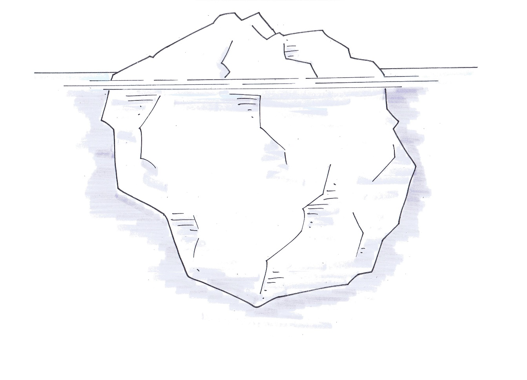
Example 3: "iceberg" – the costs of inadequate ergonomics
Example: dashboard insulation; two assembly lines for two models with approx. 50 employees
Iceberg – visible/invisible costs
Continued wage payments
in the event of illness
Hardship allowance
Convalescence
times
Contribution to sick pay
Costs per vehicle approx. 1 €
=
€ 1.4 million per
modell
Travel and waiting times
Repair costs
Familiarization time
for new employees
Meetings
Accident costs
Level of employer's contribution to the accident insurance premium
Loss of productivity
© Michael Hüter
Notes:
Task: workplace design for "dashboard insulation" (automotive industry)
Trigger for improvements to the work design: considerable time lost owing to disorders affecting the musculoskeletal system and locomotor apparatus (costs of unfitness for work) caused by a very unfavourable posture, high stress upon the back
Costs caused by insufficient attention being paid to ergonomic findings during the design of the product (in this case, a car) and in the design of the workplaces for manufacture of the product, leading to critical stress upon the assembly personnel
"Visible" costs:
Hardship allowance (in this case, owing to the constrained posture) → remuneration
Recuperation times → payment of remuneration without productivity
Continuation of wage payments in the event of sickness (ergonomics-related continued wage payment costs can be identified from a code indicating the diseases)
"Invisible" costs including:
Travel and waiting times for visits to the occupational physician
Loss of productivity owing to dropping out of experienced personnel
Supplement to sick pay
Repair costs
Higher contributions to the statutory accident insurance institution (in the event of an accident)
Meetings of designers, work planners, physicians, etc.
…
Figure 1: Visible and invisible costs ("iceberg")
Note: Costs of the example appear after clicking.

Slide 28
Example 3: "iceberg"
Follow-on costs and investment comparison
Costs per vehicle/model over the model cycle = approx. €1
Production of 240,000 vehicles per year over a model cycle of 6 to 7 years
i.e. 240,000 vehicles × 6 years × €1 = €1,440,000 potential savings per model
Investment for conversion of production: once-off costs of around €160,000 for relocation of the assembly operation to a more favourable location for installation on the assembly line
Notes:
Conversion of production
The dashboard is no longer insulated at the beginning of assembly, where this entails a very unfavourable posture (low position of the workplace); instead, this takes place towards the end of assembly. As a result, the installation height and thus the accessibility have been considerably improved, and the ergonomic deficits largely eliminated.
Investments: The conversion of production entailed a once-off cost of around €160,000.

Slide 29
Example 3: "iceberg"
Improvements to development and design take effect only with a delay for new or revised models, i.e.
→ Get it right the first time → design ergonomic deficits out of the process, and reduce costs as a result
Conclusion: it is worth incorporating ergonomic findings into development and design of the products at an early stage, in order:
To protect employees' health. Objective: OSH and health protection
To keep manufacturing costs (materials and labour) as low as possible. Objective: improvements to competitiveness
To enhance ease of use. Objective: to increase the benefit to customers (not considered in this example)

Slide 30
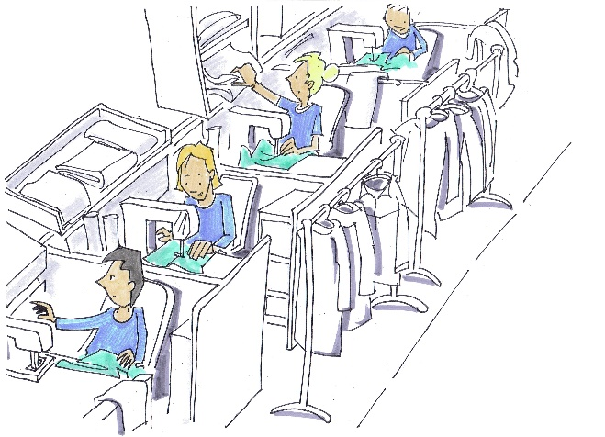
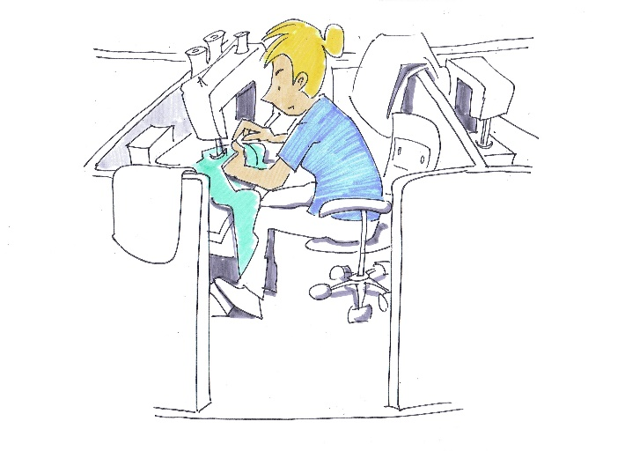
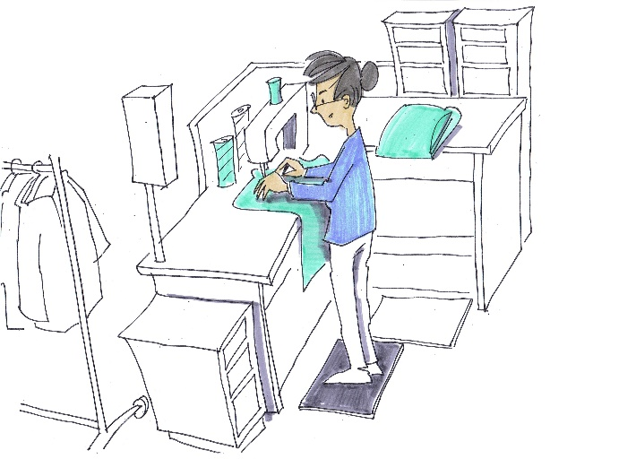
Economic benefits of ergonomic design
Example 4 at MEWA: repair of work clothing
Before
Redesign of the sewing table and the foot-operated controls
Ergonomic design of 40 workplaces
Costs of €1,500 per workplace, approx. €60,000 in total
Following conversion:
16% decrease in unfitness for work (in days)
5% increase in productivity
→ Investment was recouped within a year
After
© Michael Hüter
Notes:
In February 2008, MEWA Textil-Service AG & Co. was awarded first place of the 2007 European Good Practice Award by the European Agency for Safety and Health at Work for its development of ergonomic standing sewing workplaces.
The spine, neck and shoulder, and stomach regions are generally subject to particular stress during sewing work performed seated, owing to the bent posture. The result of the two-year research project is a workplace that has very little in common with conventional sewing tables: instead, the work is performed standing. The sewing operatives are able to move freely, and thus also to work at different special machines. The hand and arm rests can be adjusted individually. This relieves stress upon the shoulders and neck. Foot controls and height-adjustable workbenches prevent a bent posture. The stress upon the spine is relieved. In addition, attention was paid during creation of the new workplaces to an open design and to the greatest possible ingress of natural light. The costs of conversion have long been recouped.

Slide 31
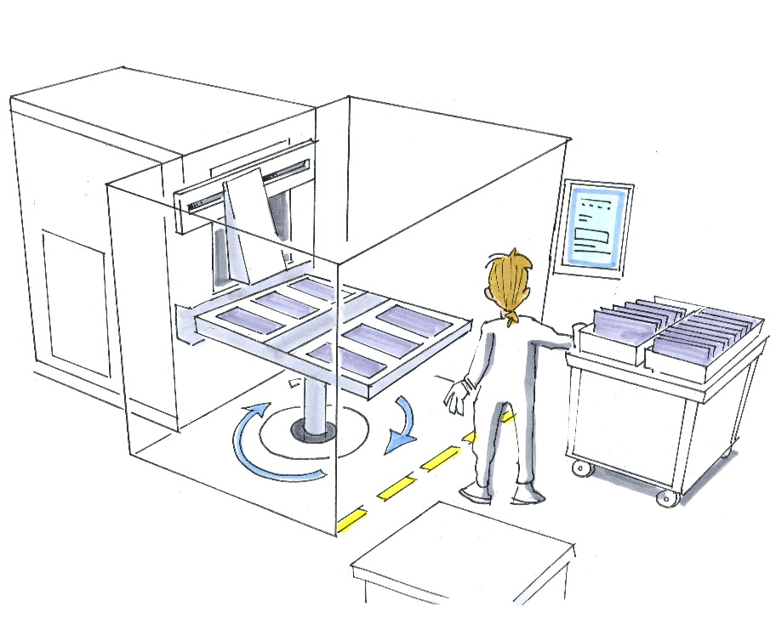
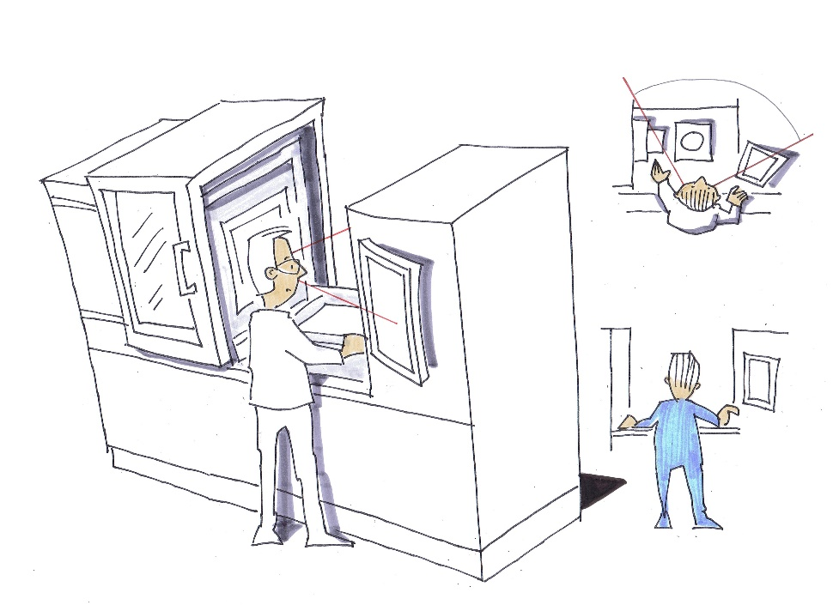
Example 5: ergonomic machine design – complex example
Comparison between milling centres with and without rotary tablerotary table
© Michael Hüter
Notes:
The students have the task of identifying the elements of the work system when prompted and of entering them on a worksheet. Allow around 2 to 5 minutes. (If possible, use a worksheet or gather suggestions on the board.) If this is not possible owing to the circumstances (a large lecture), the lecturer should present the solutions.
The empty table is completed at the touch of a key.

Slide 32
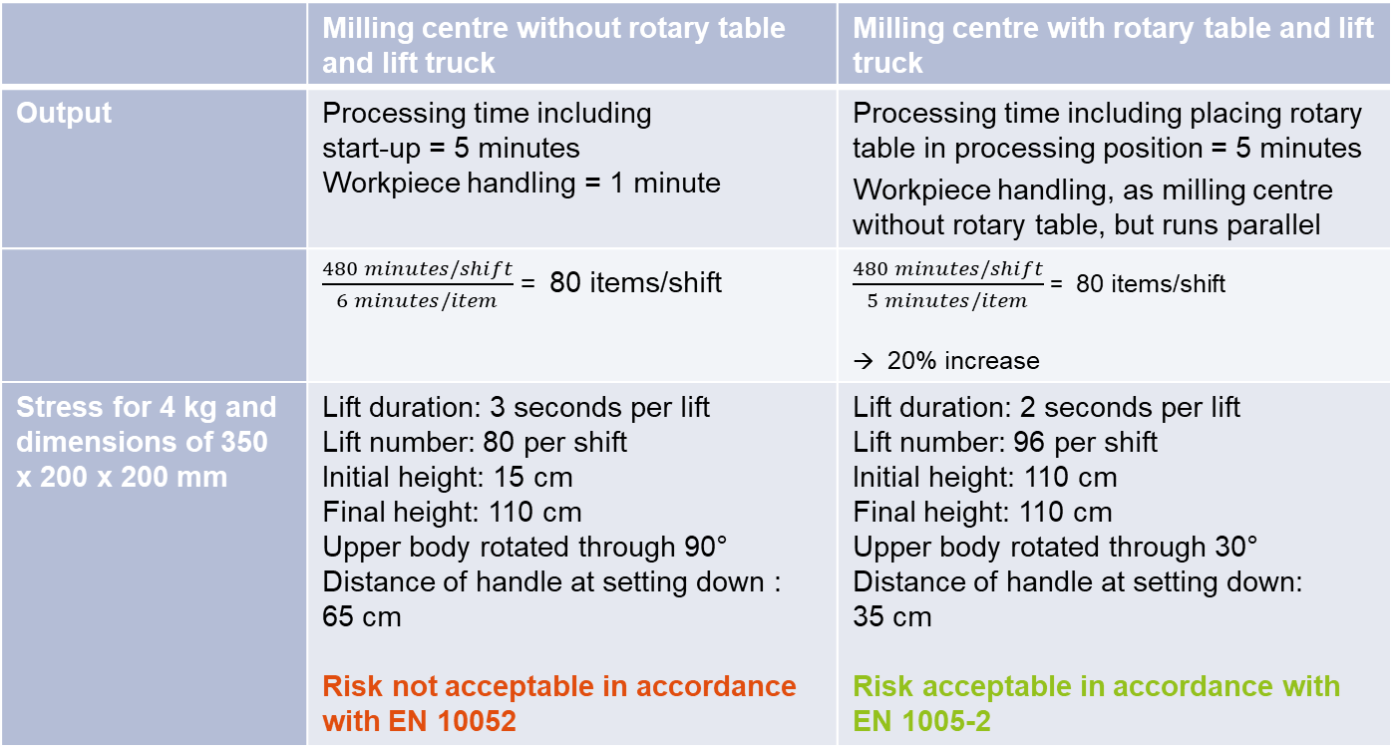
Example 5: milling centres
 | Milling centre without rotary table and lift truck | Milling centre with rotary table and lift truck
Output | Processing time including start-up = 5 minutes Workpiece handling = 1 minute | Processing time including placing rotary table in processing position = 5 minutes Workpiece handling, as milling centre without rotary table, but runs parallel
 | $\frac{480 minutes/shift}{6 minutes/item}$ = 80 items/shift | $\frac{480 minutes/shift}{5 minutes/item}$ = 80 items/shift → 20% increase
Stress for 4 kg and dimensions of 350 x 200 x 200 mm | Lift duration: 3 seconds per lift Lift number: 80 per shift Initial height: 15 cm Final height: 110 cm Upper body rotated through 90° Distance of handle at setting down : 65 cm Risk not acceptable in accordance with EN 10052 | Lift duration: 2 seconds per lift Lift number: 96 per shift Initial height: 110 cm Final height: 110 cm Upper body rotated through 30° Distance of handle at setting down: 35 cm Risk acceptable in accordance with EN 1005-2
Notes:
Alternative solutions
Milling centre with rotary table: one half of the table is loaded whilst the other six workpieces are already being processed

Slide 33
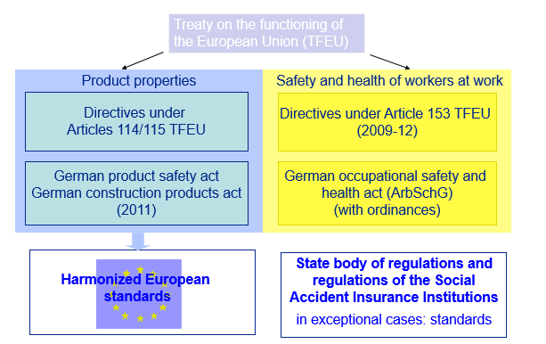
European law and standards
Notes:
Single Market directives under the New Approach make reference to harmonized European standards developed by CEN (the European standards organization). Standards reflect the state of the art and are drawn up by means of a consensus-based process (in which all stakeholders are able to participate).
Standards are harmonized when the European Commission has issued a mandate for the standard, it has been developed in observance of defined mechanisms, and has been ratified. European standards are transposed in Germany by DIN e.V. They are deemed to form a part of the German body of regulations once their references have been published in the Federal Labour Gazette.
Products which comply with harmonized European standards are presumed to meet the requirements of the directives covered by the standards concerned. This "presumption of conformity" absolves parties placing the product on the market from the obligation to demonstrate its conformity.

Slide 34
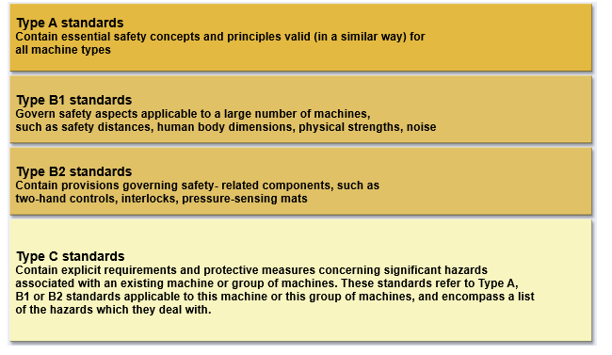
Contents of standards governing product safety
Notes:
The hierarchy of the standards structure in the area of machine safety is set out in EN ISO 12100 Safety of machinery - General principles for design - Risk assessment and risk reduction.
Type A and B standards are generic standards which can be used by Type C standards.

Slide 35
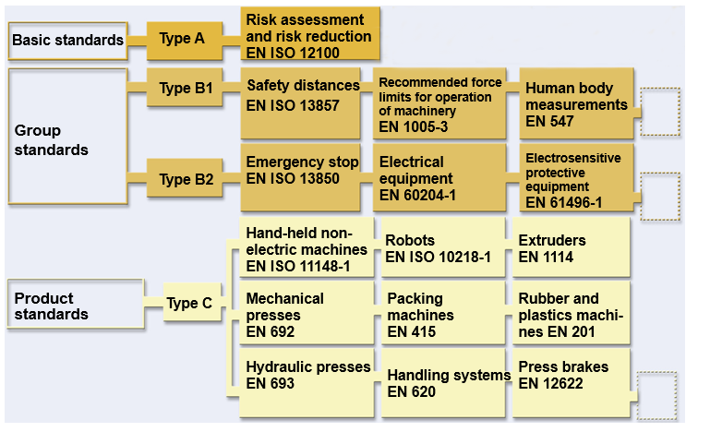
Hierarchical structure of European safety standards
Notes:
In the area of machine safety, ergonomic requirements are set out in Type A, Type B and Type C standards. Besides, further ergonomics standards exist which were not developed under the Machinery Directive.
In Germany, the Ergonomics standards committee at DIN develops standards dealing exclusively with ergonomics.
The types of standard used in the hierarchical standards structure in the field of machinery safety are defined in CEN Guide 414:
type A standard (basic safety standard): standard giving basic concepts, principles for design, and general aspects that can be applied to all machinery
type B standard (generic basic standard): standard dealing with one safety aspect or one type of safeguard that can be used across a wide range of machinery:
 type B1 standard on particular safety aspects (e.g. safety distances, surface temperature, noise);
 type B2 standard on safeguards (e.g. two-hand control devices, interlocking devices, pressure sensitive devices, guards)
type C standard (machinery safety standard): standard dealing with detailed safety requirements for a particular machine or group of machines

Slide 36
Rules for the drafting of safety standards (CEN Guide 414)
Chapter 6: Format of a safety standard (Type C standard) – structure
Section | Foreword
Section 0 | Introduction
Section 1 | Scope
Section 2 | Normative references
Section 3 | Terms and definitions, symbols and abbreviated terms
Section 4 | List of significant hazards" including ergonomics
Section 5 | Safety requirements and/or protective measures" including ergonomics
Section 6 | Verification of compliance with the safety requirements and/or protective measures
Section 7 | Information for use
Annexes | normative and informative annexes
Notes:
The structure of a safety standard is set out in CEN Guide 414 Safety of machinery – Rules for the drafting and presentation of safety standards.
Further specifications can be found in the German standards:
DIN 820-12 governing the presentation of standards concerning safety regulations
(identical with ISO/IEC Guide 51)
Type C standards should follow this structure. Section 4 and 5 of the Type C standard are particularly important for the designer.
Ergonomic aspects must be addressed in the list of significant hazards (Section 4 of the relevant standard).
The safety requirements and protective measures set out in Section 5 of the standard also include ergonomic aspects, and must be implemented.
Where Type C standards are applied, it may be assumed that the requirements of Annex I of the machinery directive are met and that the product thus complies with the directive (presumption of conformity).

Slide 37
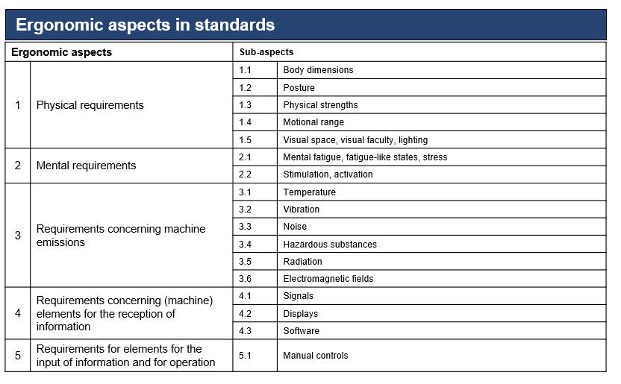
Ergonomic aspects in standards
Based upon Höhn, K. et al: Maschinennormung und Ergonomie. Article 1074, publications of the Bundesanstalt für Arbeitsschutz und Arbeitsmedizin, Dortmund/Berlin/Dresden 2006
Notes:
List of selected ergonomic aspects frequently found in standards (hazardous substances and radiation however form part of ergonomics only in the wider sense, and are therefore dealt with here only peripherally, if at all).

Slide 38
Four forms of incorporation of ergonomic requirements into Type C standards:
Ergonomic requirements are addressed directly in the text of the standard.
Reference is made in the text of the standard to an ergonomics standard.
Normative references to ergonomics standards (e.g. to Type B ergonomics standards) are stated in Chapter 2 of the standard.
Information on ergonomics standards or literature on ergonomics is provided in the form of sources in the bibliography or the informative annexes of the standard.

Slide 39
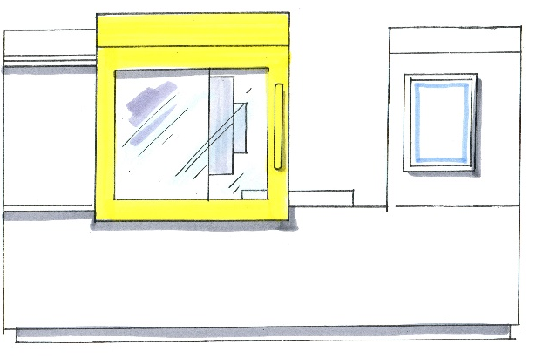
Ergonomics standardization with reference to machining centres
Excerpt from EN 12417:2009 Machine tools – Safety – Machining centres
Example for body dimensions: "Access openings shall be in accordance with EN 547-1, -2, -3."
Example for visual space, visual faculty, lighting: "Observation: Where routine observation of the machine operation is required, means (e.g. windows) shall be provided so that this can be achieved without the need to open, remove or suspend any work zone guard or other protective device(s)."
Example for hazardous substances:
"Operating platforms shall: […] give protection against swarf/chips and metal working fluid."
Example for displays:
"Screen displayed information shall be clear and unambiguous. Reflections and glare shall be minimised (see EN 894-1/-2)."
© Michael Hüter
Notes:
With reference to the example of EN 12417:2009, examples of ergonomics requirements in Type C standards are described relating to the machining centre, and explained in support of the preceding slide.
DIN EN 547-1/-2/3:2009 Safety of machinery - Human body measurements
Part 1: Principles for determining the dimensions required for openings for whole body access into machinery
Part 2: Principles for determining the dimensions required for access openings
Part 3: Anthropometric data
DIN EN 894-1:2009, Safety of machinery - Ergonomics requirements for the design of displays and control actuators - Part 1: General principles for human interactions with displays and control actuators
DIN EN 894-2:2009, Safety of machinery - Ergonomics requirements for the design of displays and control actuators - Part 2: Displays

Slide 40
Important literature for Module 1
DIN-Taschenbuch 352 „Ergonomische Gestaltung von Maschinen“
DIN EN ISO 26800:2009-11 Ergonomie - Genereller Ansatz, Prinzipien und Konzepte
DIN EN 614-1:2006+A1:2009-06 Sicherheit von Maschinen - Ergonomische Gestaltungsgrundsätze - Teil 1: Begriffe und allgemeine Leitsätze;
DIN EN 614-2:2000+A1:2008-12 Sicherheit von Maschinen - Ergonomische Gestaltungsgrundsätze - Teil 2: Wechselwirkungen zwischen der Gestaltung von Maschinen und den Arbeitsaufgaben
DIN EN 13861:2003-04 Sicherheit von Maschinen - Leitfaden für die Anwendung von Ergonomie-Normen bei der Gestaltung von Maschinen
DIN EN ISO 6385:2004-05 Grundsätze der Ergonomie für die Gestaltung von Arbeitssystemen
Rohmert, W.: Das Belastungs-Beanspruchungskonzept, Zeitschrift für Arbeitswissenschaft, 38. Jg. (1984), H.4, S. 193-200
For further standards, see KAN-Paxis NoRA: Searching for standards
!

Slide 41

Impressum
Autor: Prof. Dr.-Ing. Torsten Merkel
University of Applied Sciences Zwickau (WHZ)
Chair of Ergonomics
Torsten.Merkel@fh-zwickau.de
With the collaboration of Dr.-Ing. Katrin Höhn katrin.hoehn@tu-dresden.de
Initiated and funded by:
KAN – Commission for Occupational Health and Safety and Standardization
Alte Heerstr. 111 53757 Sankt Augustin
Germany https://www.kan.de/en/
Download of all modules at:
https://ergonomie.kan-praxis.de/en/tuition-modules/

