Slide 1
Brief presentation "What is ergonomics?"
Module 0 – Learning ergonomics.
Notes:
This presentation provides a brief overview of the subject of ergonomics and its objectives.

Slide 2
Definition of the term "ergonomics"
Ergonomics is the science of human beings and technology. It encompasses the design of products, product details, workplaces and complex work systems against criteria which are determined by human characteristics and abilities.
Ergonomics: "Scientific discipline concerned with the understanding of interactions among human and other elements of a system, and the profession that applies theory, principles, data and methods to design in order to optimize human well-being and overall system performance".
Definition of ergonomics in EN 614-1 (identical to that in EN ISO 6385)
Notes:
Simplified definition based upon EN 614, Safety of machinery – Ergonomic design principles – Part 1: Terminology and general principles, for adaptation of the technology to human abilities. Ergonomics must always be viewed as a complex design problem, since improvements at one point may result in drawbacks at another.
Example: in order to reduce the weight and size of a mobile control unit to a minimum, multiple functions are assigned to buttons, or must be called up through menu structures with the aid of a display. The resulting control unit is smaller and lighter, but the speed and reliability of its operation are reduced.
Inserted with animation:
Original definition of "ergonomics" in EN 614-1 (identical to the definition in EN ISO 6385, Ergonomic principles in the design of work systems):
Ergonomics: "Scientific discipline concerned with the understanding of interactions among human and other elements of a system, and the profession that applies theory, principles, data and methods to design in order to optimize human well-being and overall system performance".

Slide 3
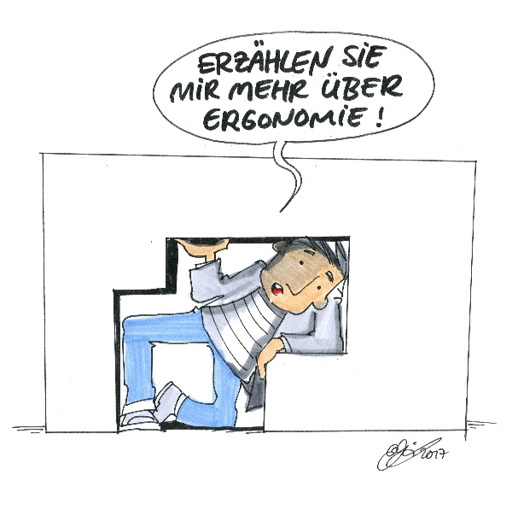
Ergonomics is a holistic design approach
Tell me more about ergonomics!
Objectives: Ease of performance,
harmlessness, acceptability, personality
development, social acceptability
Design issues: Physical stresses, Mental
stresses, Working environment, Interfaces Anthropometrics: Body posture, Range of vision,
Ranges of reach (reach of the arms, legroom)
Work processes, Work content
Levels of design:
Safety, Product ergonomics, System ergonomics, Process ergonomics, Productivity, Innovation
,
© Michael Hüter

Slide 4
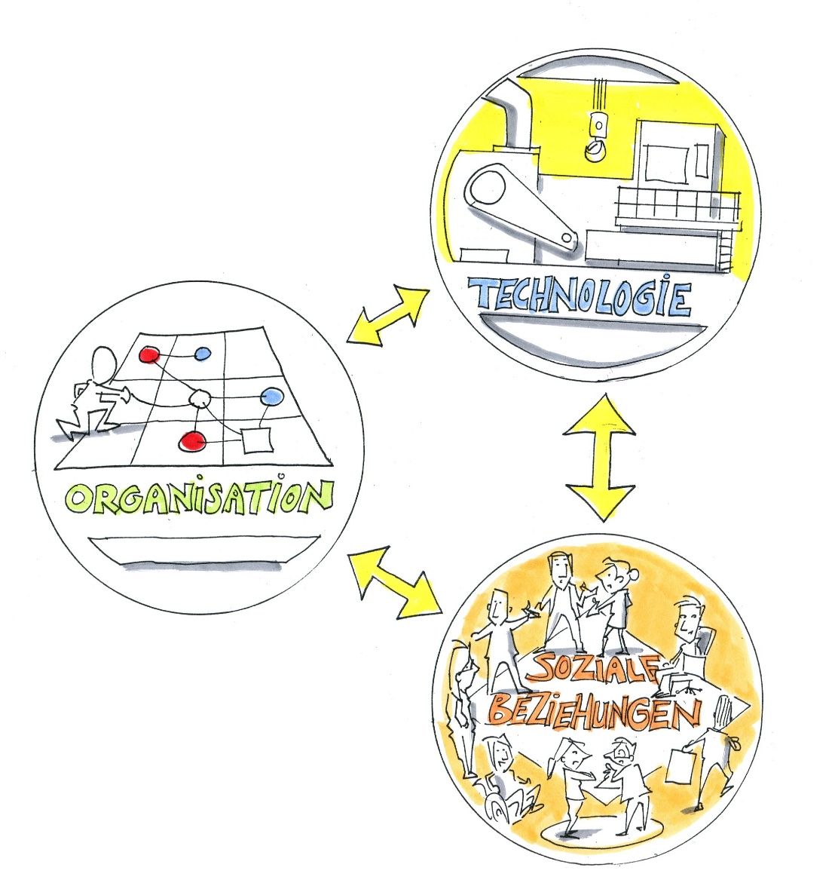
Ergonomic design is dependent upon:
Engineering
Organization
Social
relationships
© Michael Hüter
Notes:
Ergonomics is dependent upon the interrelationship of the three elements stated above.

Slide 5
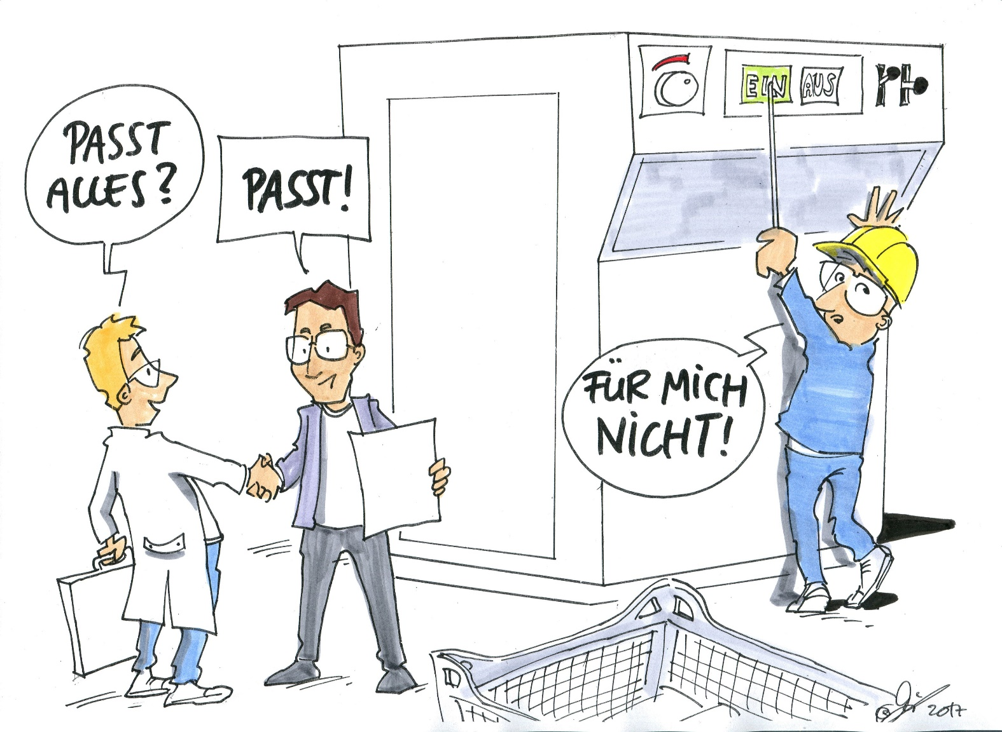
Ease of performance
Everything alright?
Yes it is!
Not for me!
© Michael Hüter

Slide 6
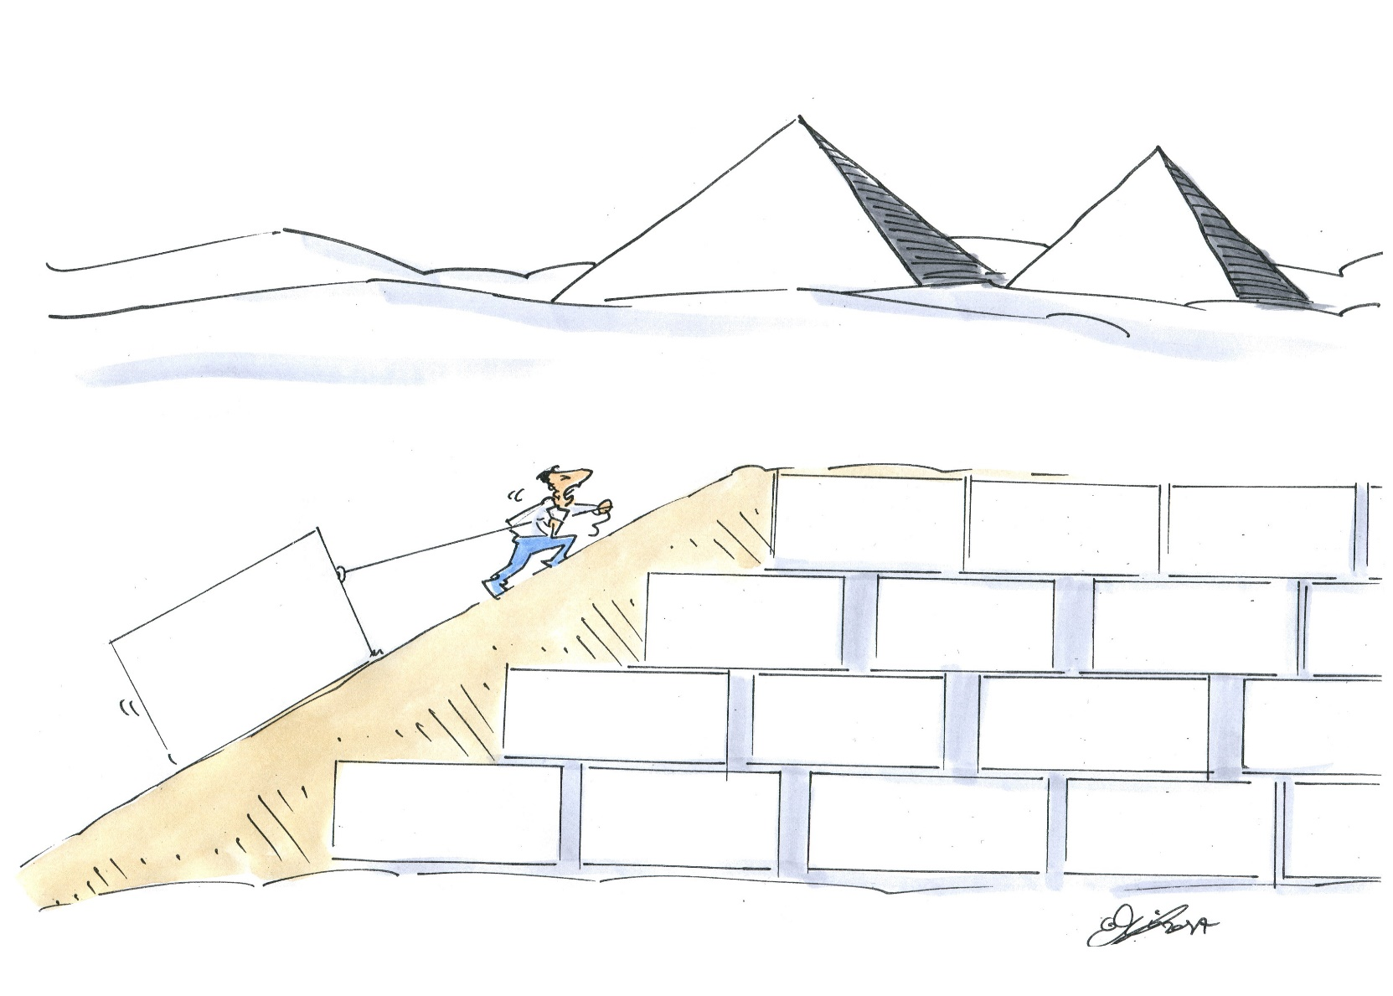
Endurability?
© Michael Hüter

Slide 7
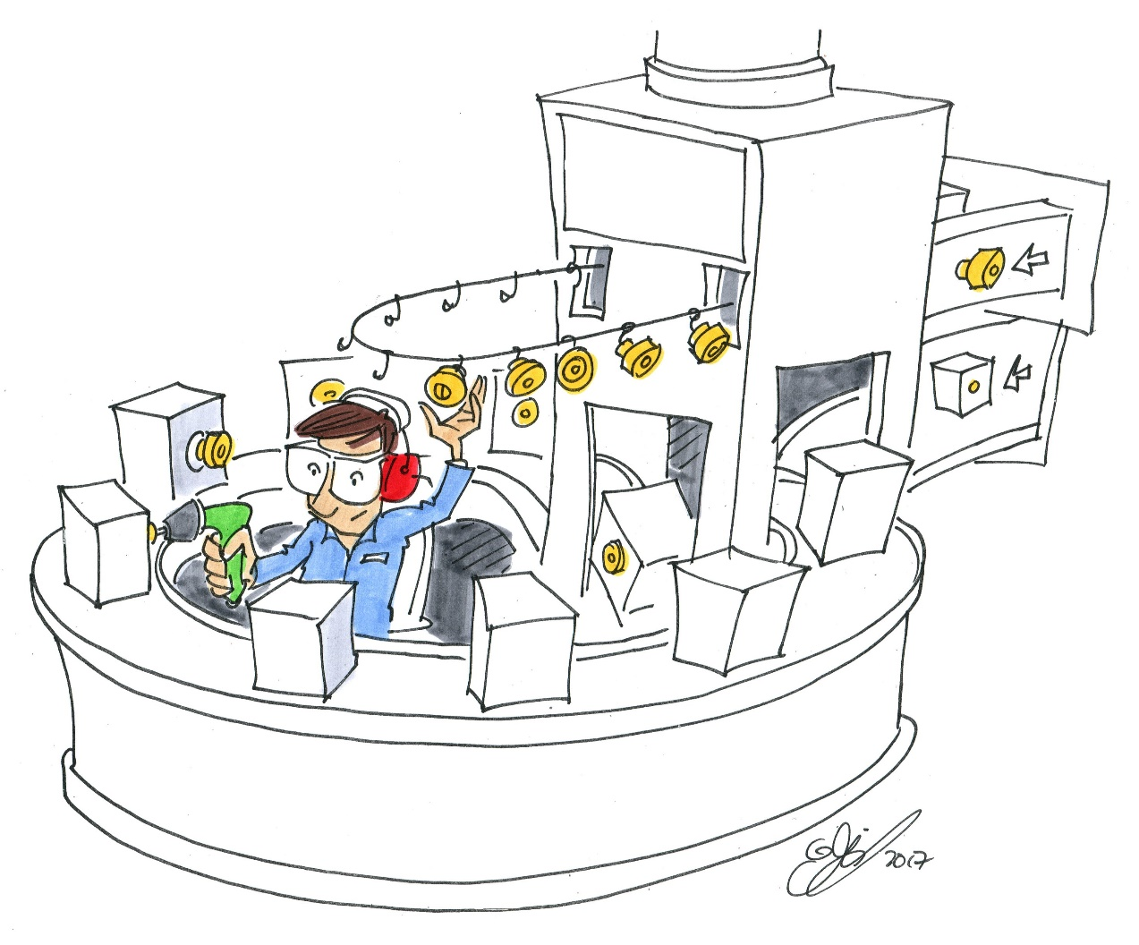
Acceptability?
© Michael Hüter

Slide 8
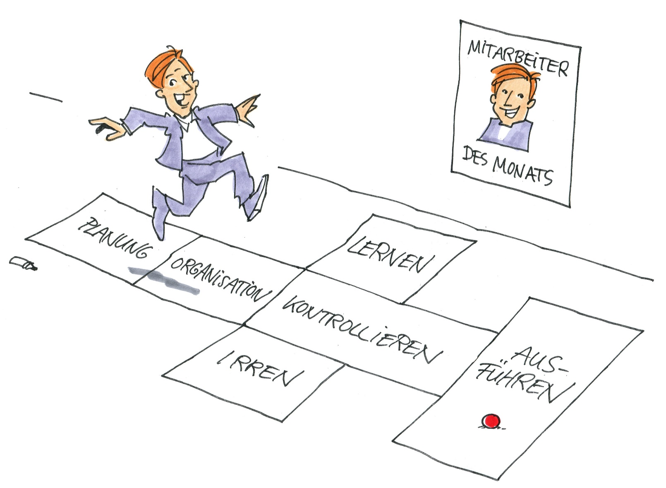
Personality development?
Employee
of the month
planning
learning
organizing
checking
erring
doing
© Michael Hüter

Slide 9
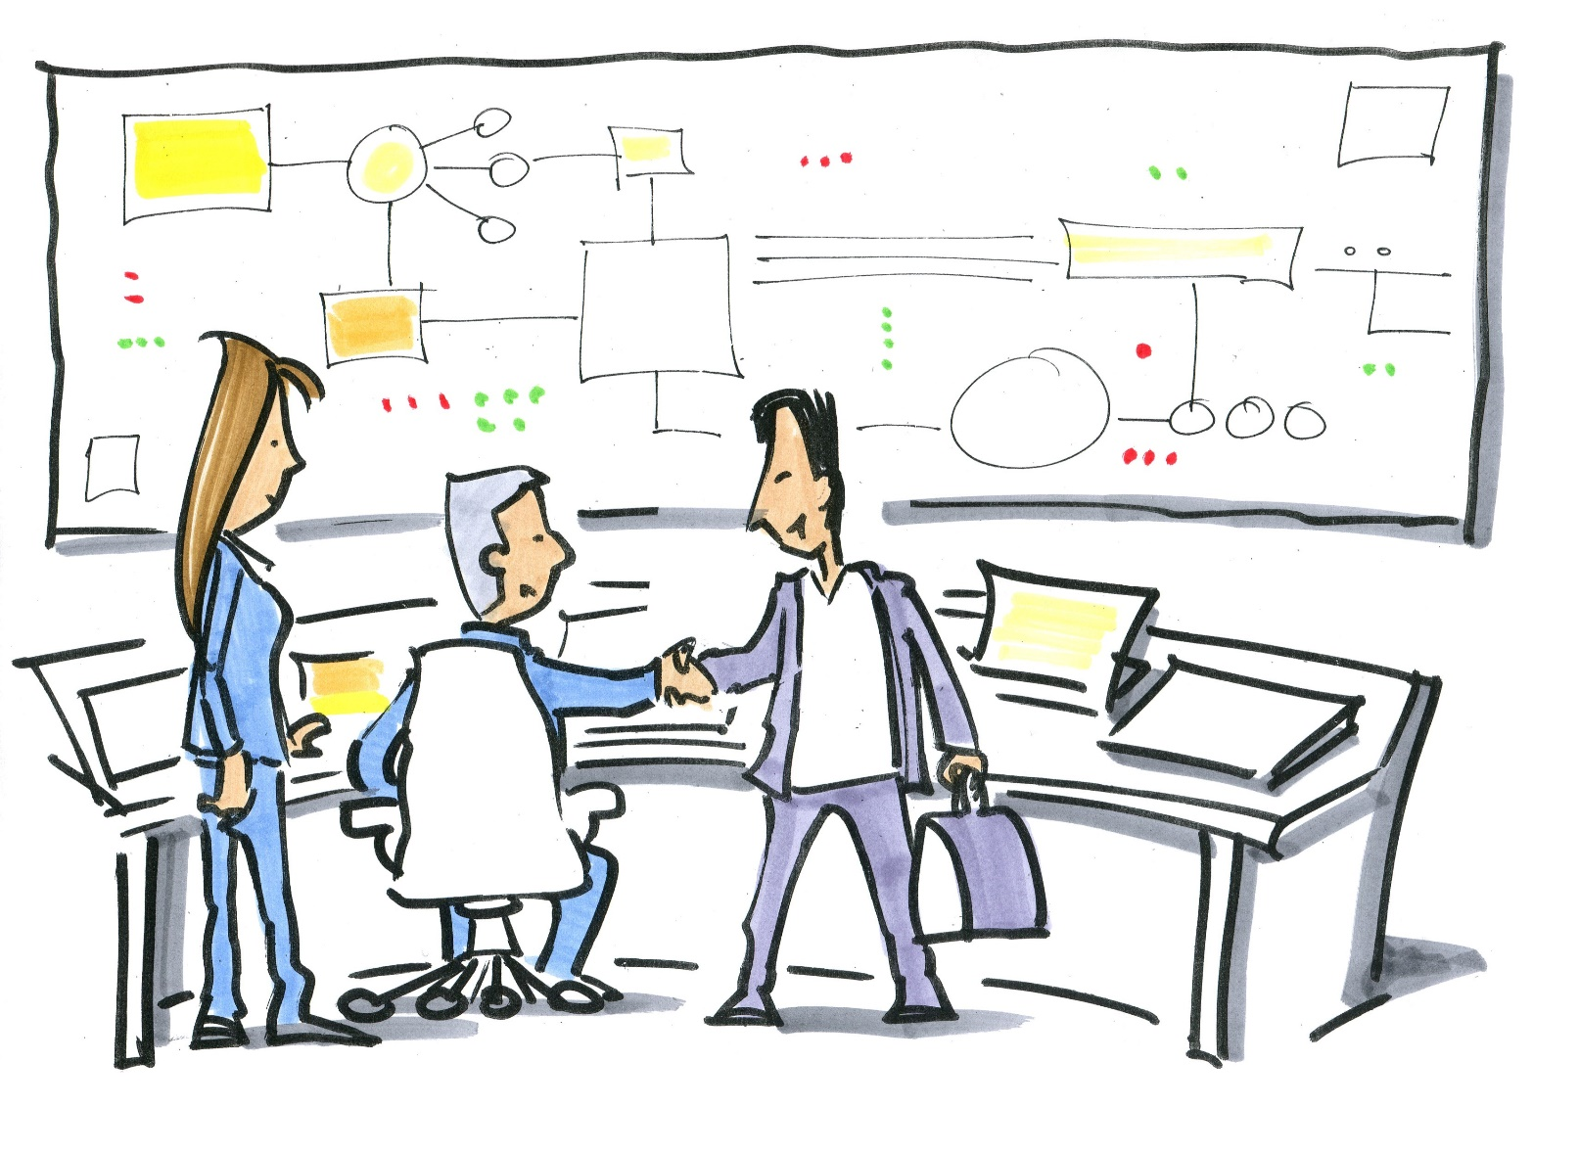
Social acceptability?
© Michael Hüter
Notes:
Social acceptability concerns the level of cooperation between all employees, including between the different hierarchical levels of an organization.

Slide 10
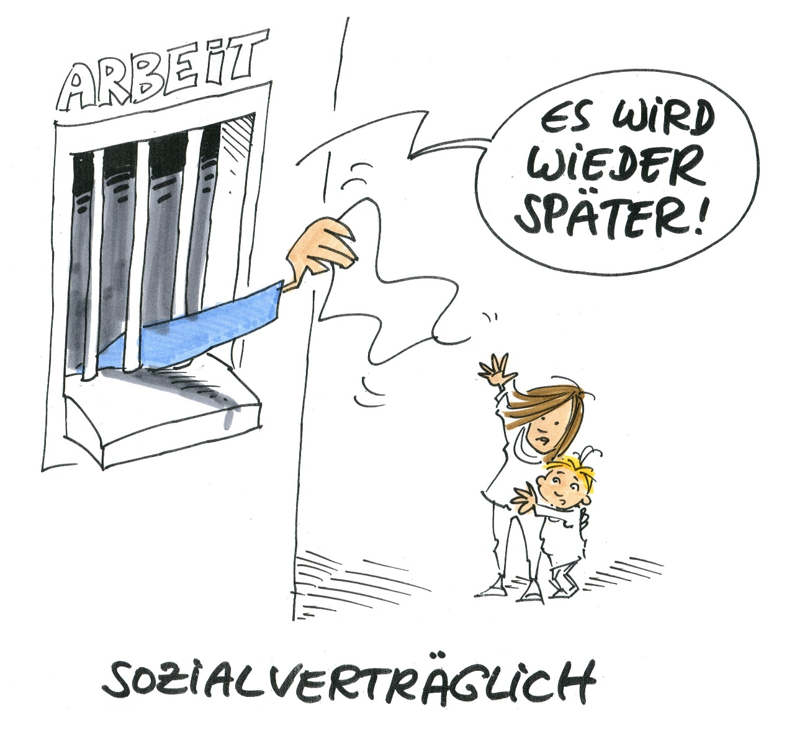
Social acceptability (2)?
WORK
I’ll be late again!
Socially acceptable

Slide 11
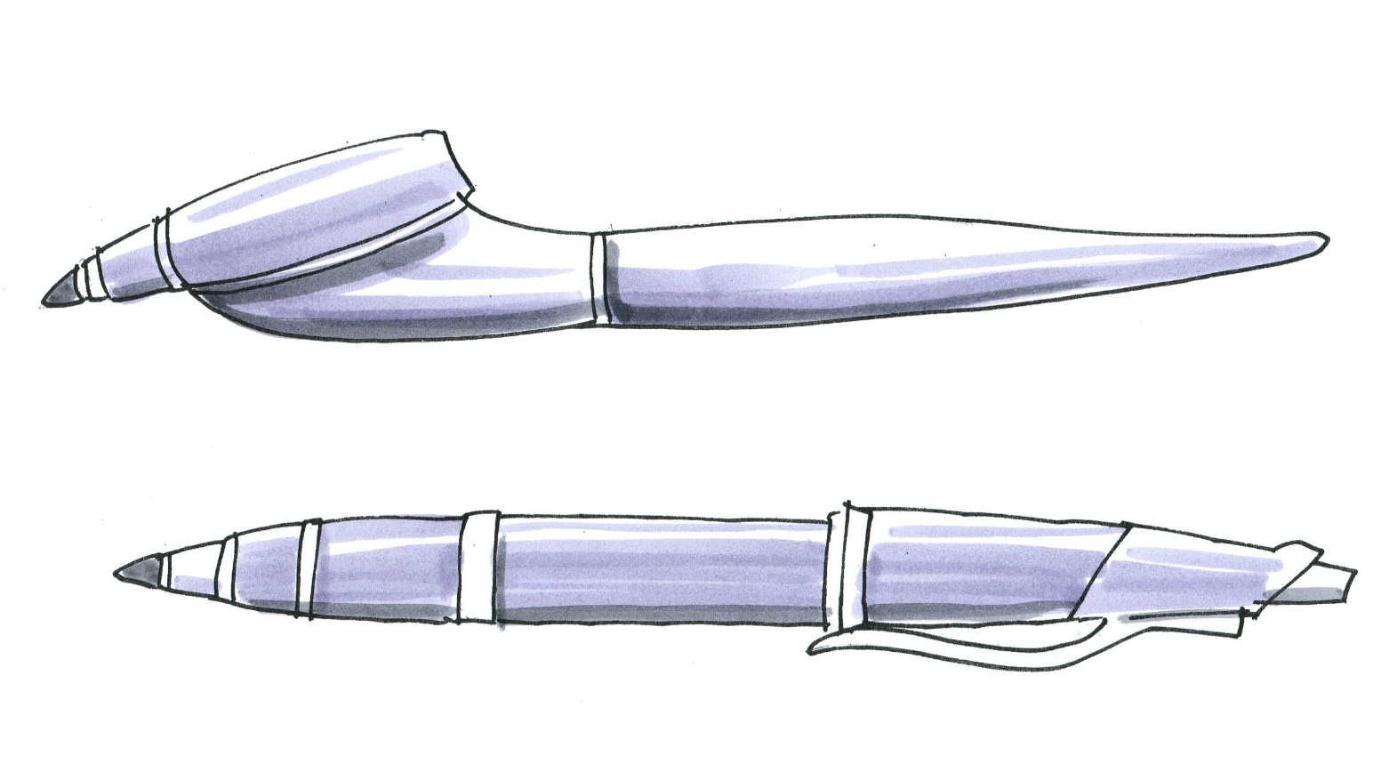
It's ergonomic when it fits!
Two ballpoint pens: which is the more ergonomic?
Offset tip, rubber-faced plastic
© Michael Hüter
Colour anodized, glossy, smooth
Notes:
The five levels of ergonomics should be applied successively.
Level 1, the development of safe products, takes priority.
Level 2 concerns design of the direct interface between the user and the work equipment.
In Level 3, the emphasis lies upon the linking of multiple elements, for example of an item of work equipment. A handle that fits well in the hand for example is of little benefit if its position is not ideal for the application of force (for example on an electric drill). The overall ergonomics of a pushbutton concerns not only how easily it can be reached, but also the reaction of the process triggered by its operation.
Level 4 concerns the linking of multiple workplaces. On a production line, the quality of work is dependent upon the balance of the requirements imposed by the work in the system as a whole.
Level 5 challenges conceptions of existing solutions and seeks innovative and ergonomically superior solutions by way of new approaches.

Slide 12
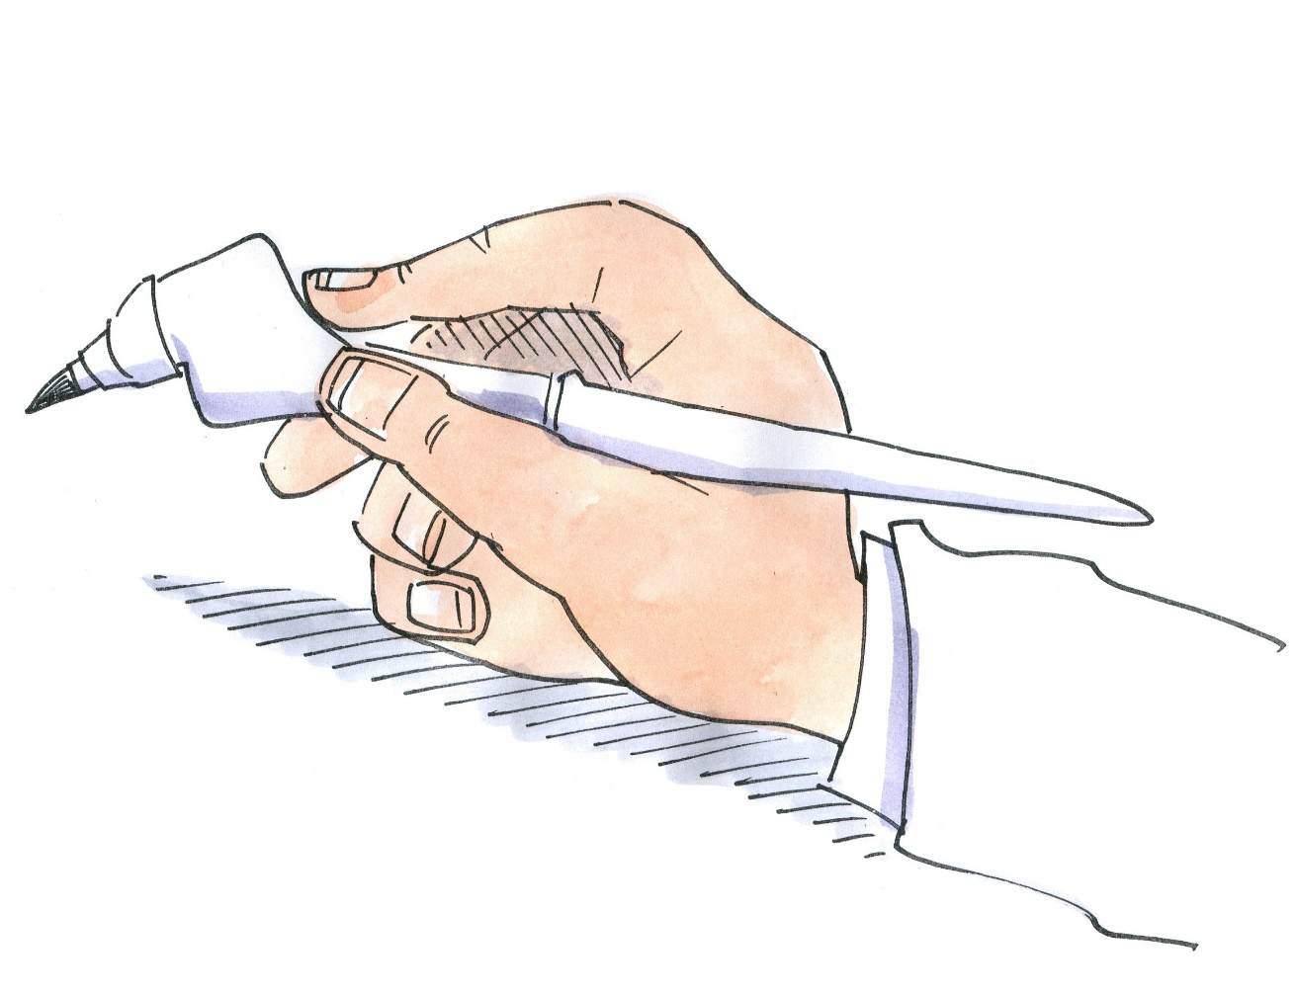
Solution
The finger rests behind the tip with positive coupling
= no slipping = ideal direction of force
The pen permits relaxed work by considering the anatomical and physiological principles with which the hand works
Rubber-facing
= low force required of the thumb for holding = high friction, even with perspiring fingers
© Michael Hüter
Notes:
The five levels of ergonomics should be applied successively.
Level 1, the development of safe products, takes priority.
Level 2 concerns design of the direct interface between the user and the work equipment.
In Level 3, the emphasis lies upon the linking of multiple elements, for example of an item of work equipment. A handle that fits well in the hand for example is of little benefit if its position is not ideal for the application of force (for example on an electric drill). The overall ergonomics of a pushbutton concerns not only how easily it can be reached, but also the reaction of the process triggered by its operation.
Level 4 concerns the linking of multiple workplaces. On a production line, the quality of work is dependent upon the balance of the requirements imposed by the work in the system as a whole.
Level 5 challenges conceptions of existing solutions and seeks innovative and ergonomically superior solutions by way of new approaches.

Slide 13
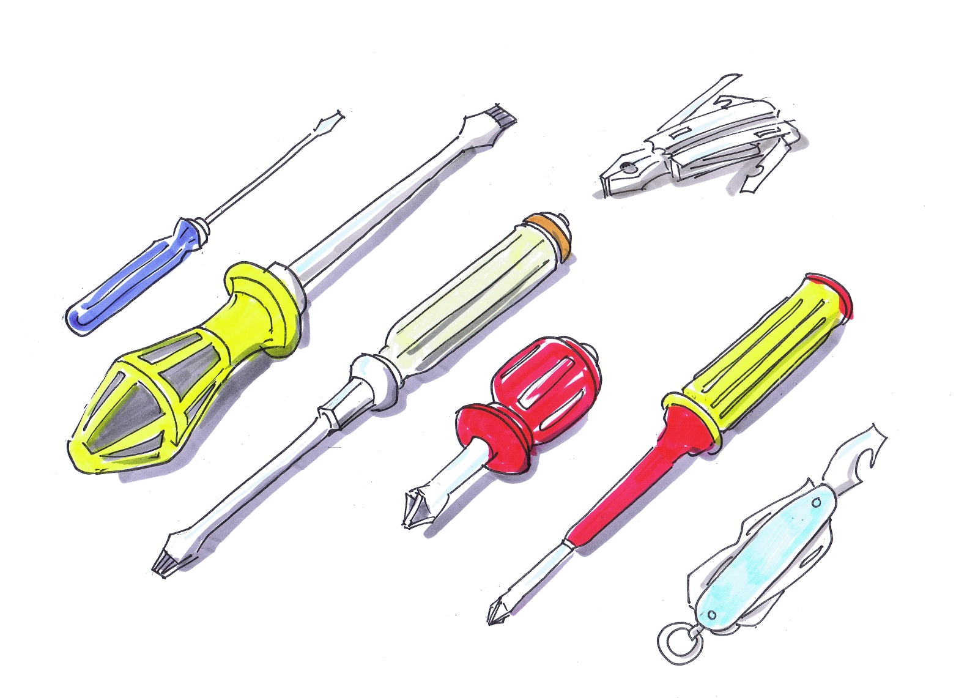
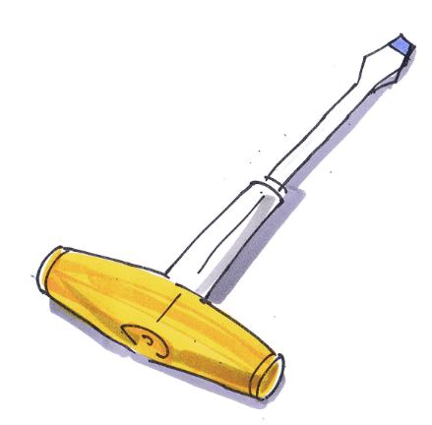

Which screwdriver is the most ergonomic?
Notes:
Discuss with the participants which screwdriver is particularly suitable in their view for which task.
Objective: good handle geometry, rapid movement (no regripping) – problematic with the T handle, which however exhibits good positive coupling and force transmission; the ratchet is fast, but exerts high stresses upon joints; avoidance of edges

Slide 14
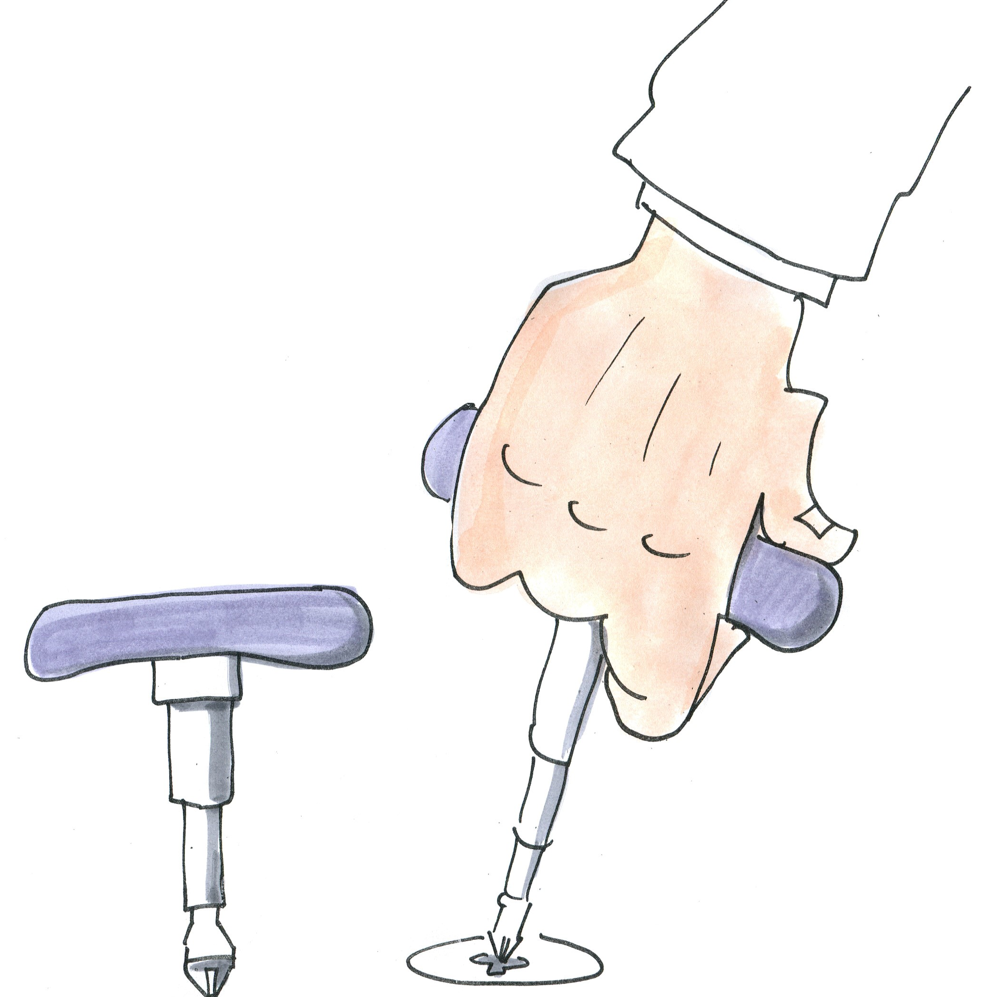
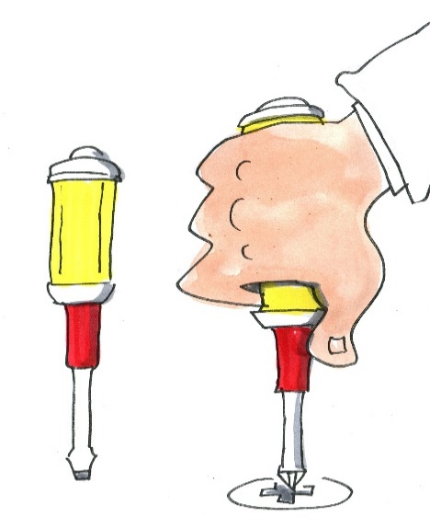
Compare use!
When the screwdriver must be turned several times:
Best compromise, thanks to ratchet, frictional coupling and clench grip
Handle is bulbous and provides good contact; regripping possible if necessary
Good control owing to the short distance between the bit and the grip
Only a few turns, but with high force:
T-handle permits positive coupling and maximum transmission of force without force loss
Interchangeable bits are accommodated in handle
A drawback is the need for regripping for rotations over approximately 160°

Slide 15
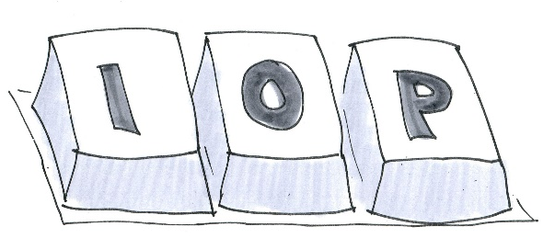

Ergonomics of interfaces
keyboards
Dark letters on light keycaps matches the positive display on the screen. This reduces the strain on the eyes.
The level of soiling is evident more quickly on light keyboards (this can be considered either an advantage or a drawback)
Black keyboards have a tendency to shine, making the characters on them difficult to discern.
Notes:
Discuss the different keyboard concepts.
Deviations from the positive display on the screen, size of keys, poor feedback, an additional input device in the form of the stylus, fingertips substantially larger than the keys, etc.

Slide 16
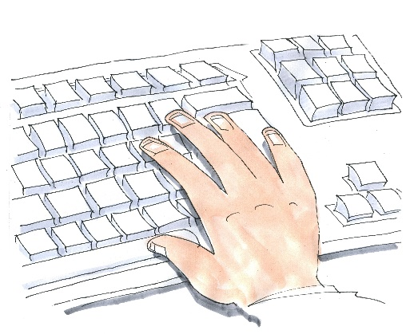
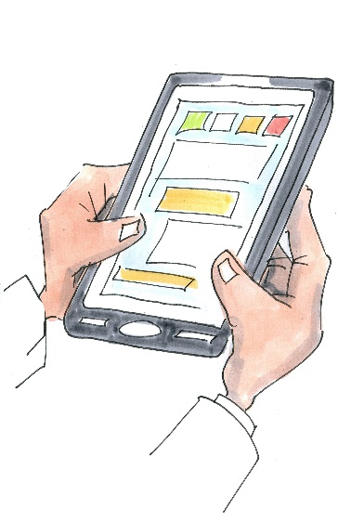

Ergonomics of interfaces
advantages standard keyboard :
Clear pressure point
large keys, geometry matching the fingertips
drawback is its space requirement
Mobile devices → touch screens,
no pressure point (it may be signalled by vibration)
switch → abc → 123 …this leads to input errors
small device (stylus)
Alle Bilder: © Michael Hüter

Slide 17
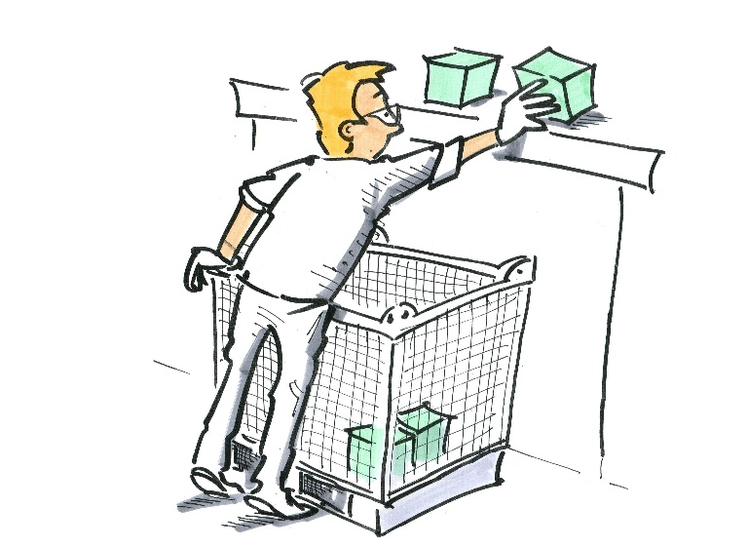
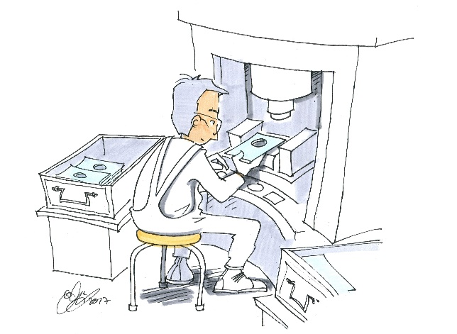
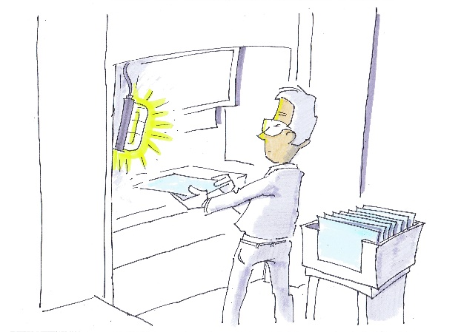
Ergonomics and work equipment/ workplace design
Design solutions give rise to stresses of technical origin which may lead to impairing strain.
© Michael Hüter
Supply of parts during assembly Roller conveyor too high | Press workplace Control panel too low for operation in a standing position. No room for the feet during operation in a seated position. | Press workplace Retrofitted lighting for the working area – ideal illumination not possible (glare)
Notes:
Example 1: containers for small parts must be lifted to a height of approximately 1.70 m in order to buffer the parts requirement of a workplace at a roller conveyor belt. Supply of the parts was resolved in this way so that the logistics did not obstruct the assembly personnel. The worker placed the transport container in a stress-exacerbating position: although he selected a route involving the shortest distance, it gave rise to additional physical stress when the containers were set down.
Example 2: the small press possesses a control panel with two-hand control at a height of approximately 70 cm. The boards must be inserted into the machine at a height of approximately 85 cm. The worker performs the task whilst seated. Owing to the lack of legroom, the worker sits in front of the machine with legs apart.
Example 3: problems occurred on the press both during die changing and during visual inspection of proper insertion of parts, owing to inadequate lighting. Lighting was retrofitted in the remaining available space envelope. An optimum solution was then no longer possible. For example, the open lamp has a high glare effect, owing to the absence of a shade.

Slide 18
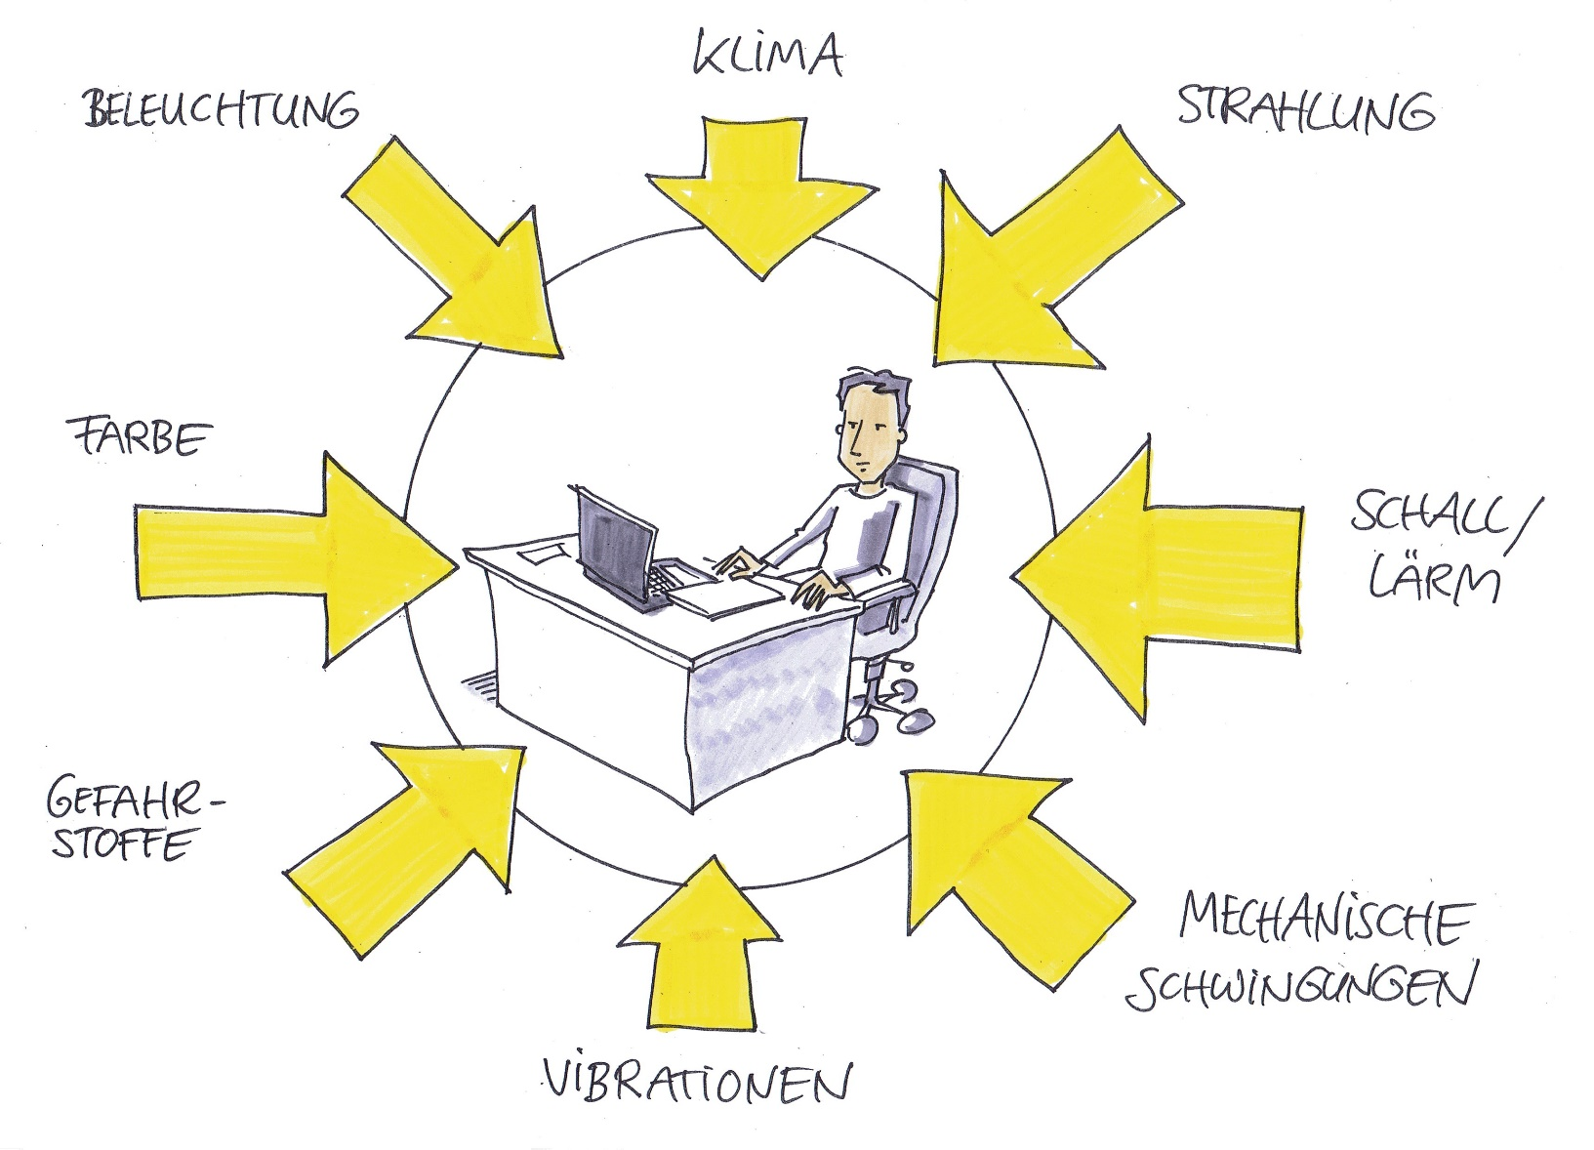
Impact of the work environment
Climate
Radiation
Lighting
Colour
Sound/noise
Hazardous substances
Mechanical
vibration

Slide 19
Legal information
Author of this module: Professor Dr.-Ing. Torsten Merkel University of Applied Sciences Zwickau (WHZ) Chair of labour sciences Torsten.Merkel@fh-zwickau.de
Launched and financed by:
Commission for Occupational Health and Safety and Standardization (KAN)
Alte Heerstrasse 111
53757 Sankt Augustin, Germany
www.kan.de
https://ergonomie.kan-praxis.de/die-module

